Slide 1
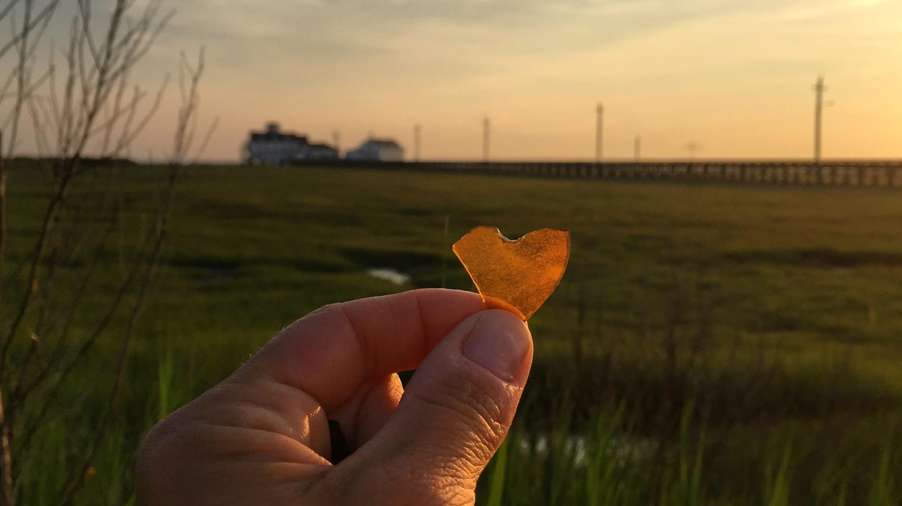

New Brunswick, NJ
NJCRC Coastal Climate & Resilience Conference 3/12/2024
Amanda Archer, Jacques Cousteau National Estuarine Research Reserve – Rutgers University

Slide 2
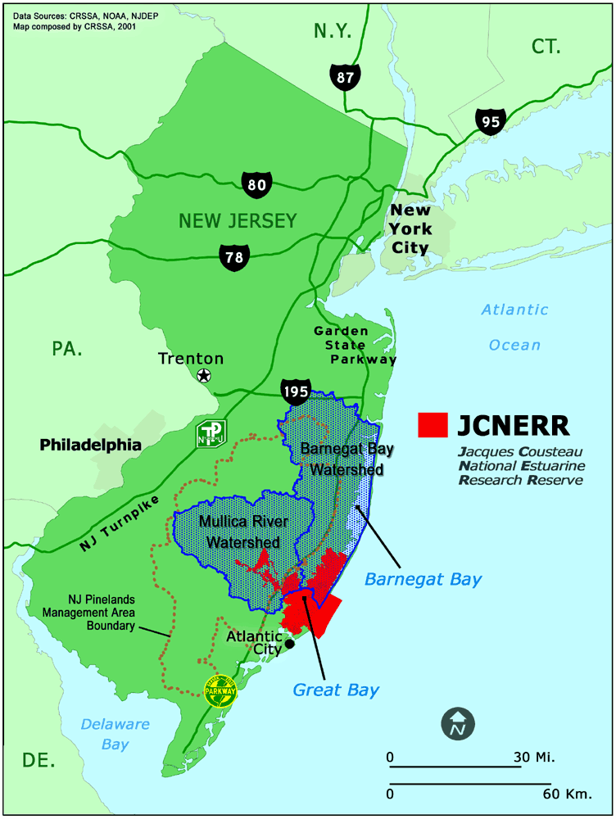
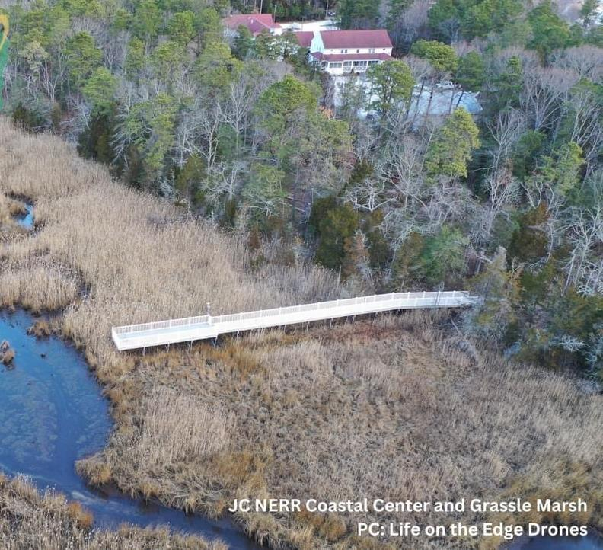


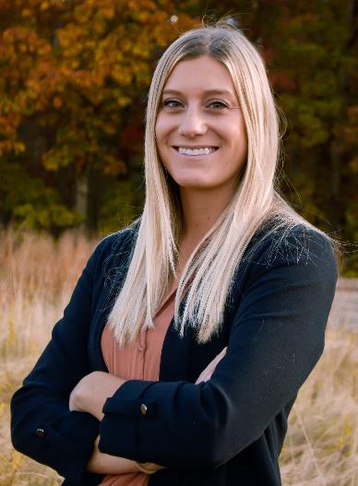


Slide 3
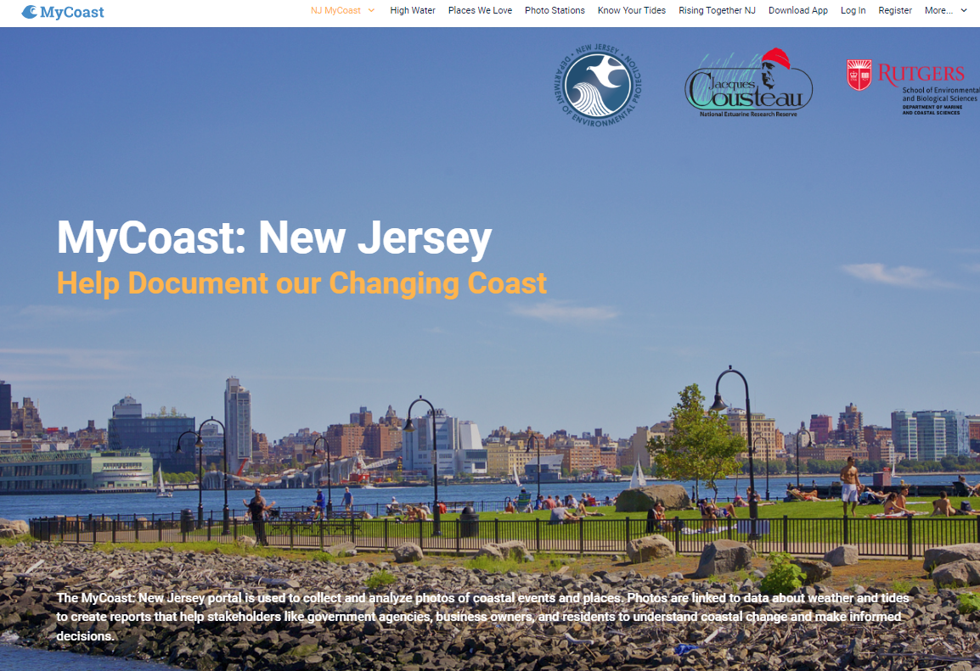
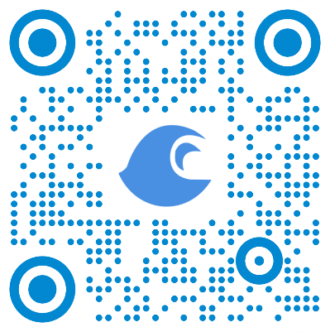
Portal used to collect and analyze photos of coastal events and places.
Photos are linked to data about weather and tides to create reports that help stakeholders like government agencies, business owners, and residents understand coastal change and make informed decisions.
Notes:
Application available online and in app store
Available for all coastal states to create their own page
Allows users to share photos
Uses data from photo to collect

Slide 4
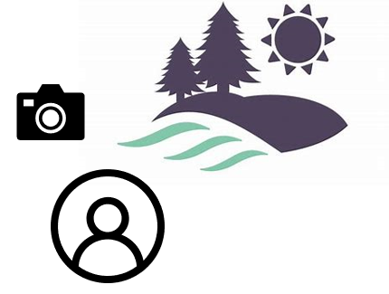
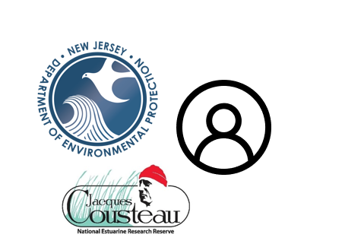



Education & Outreach
Visual Science & Storytelling
Informed Management Decisions
Notes:
Whole community approach using a simple tool

Slide 5
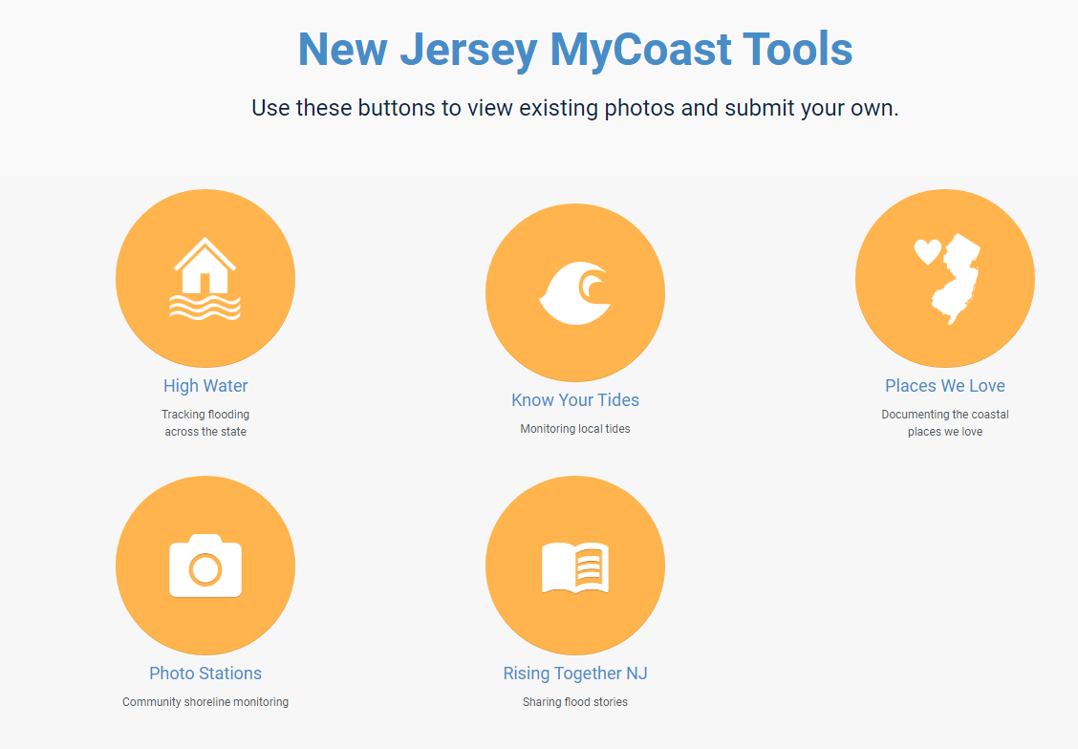

Slide 6
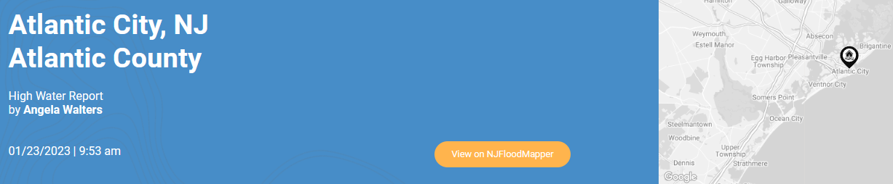

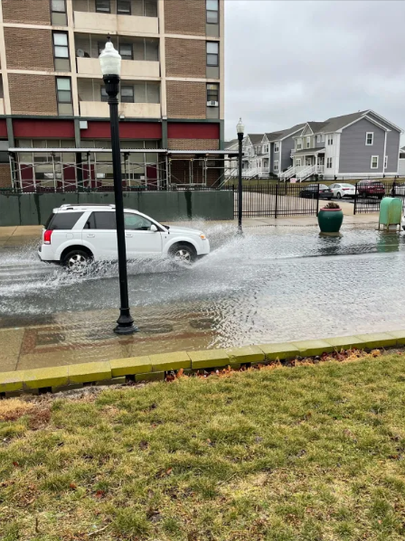
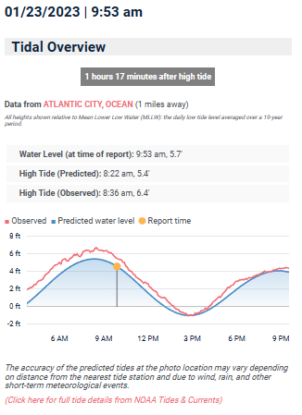
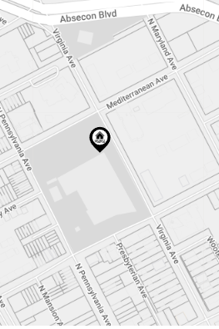
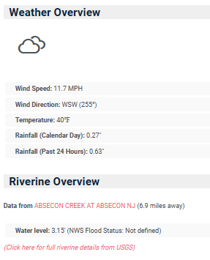
High Water

Slide 7
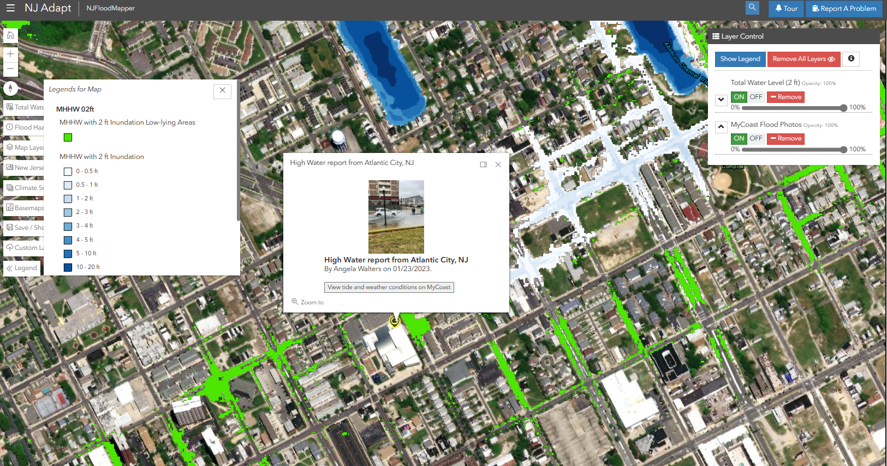

Slide 8
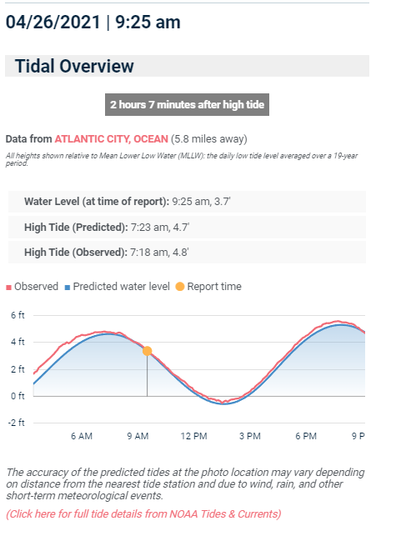
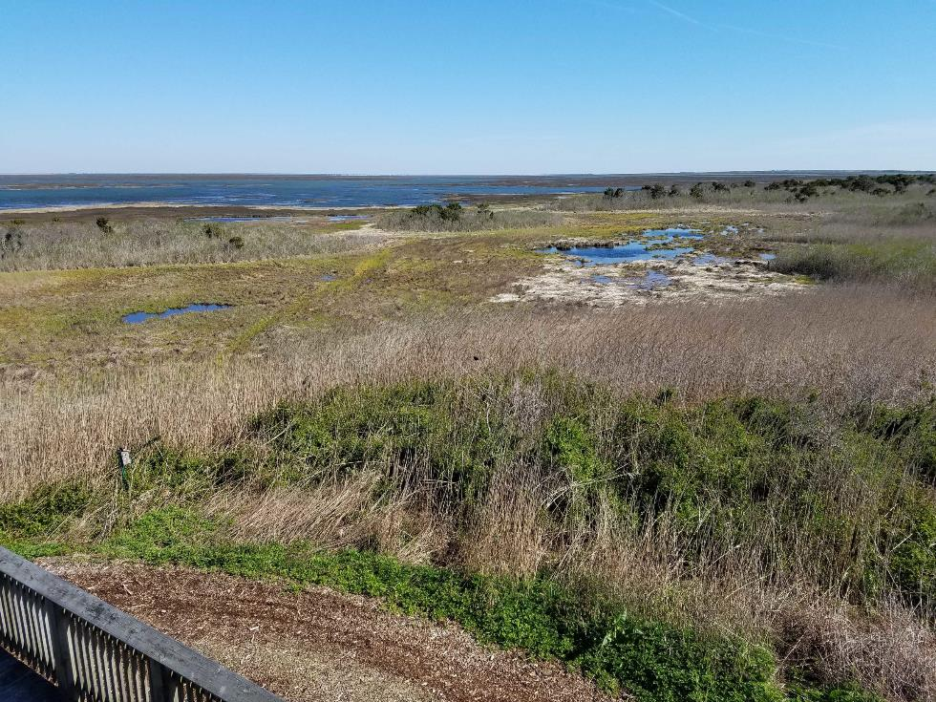
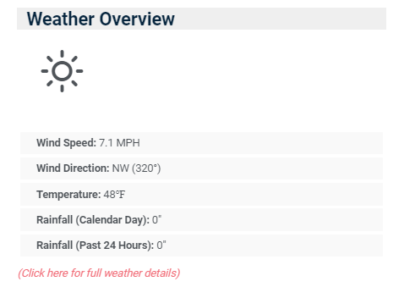
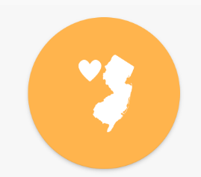
Places We Love
Notes:
Encouraging tool to help share places people love to visit
Shows important areas that was want to protect and help flourish
Tags

Slide 9
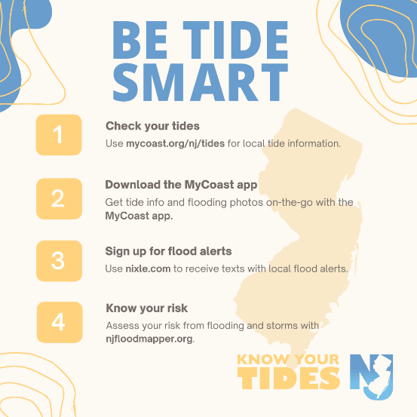
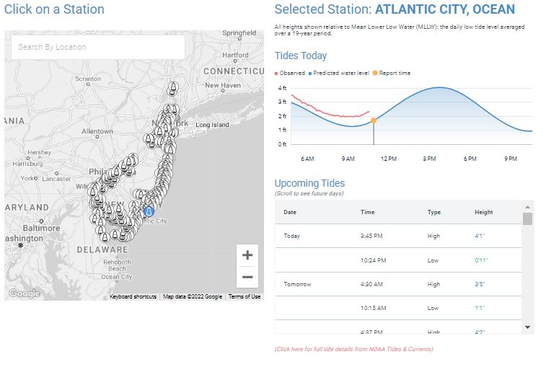
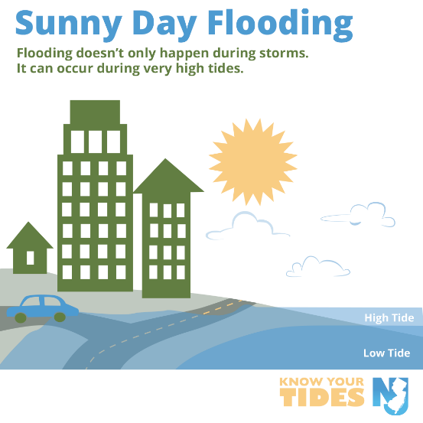

Know Your Tides
Notes:
Social media campaign- KYT wanted people to be aware and involved
Tide smart
Types of flooding
Flood prep tips
Understanding where tide stations are
Tide predictions and actual tides- can see a month out

Slide 10
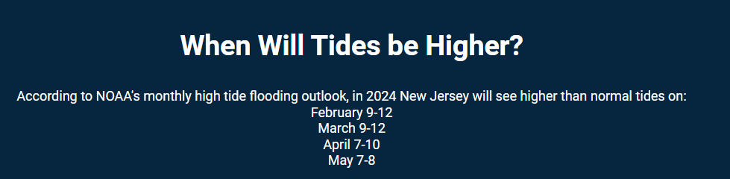
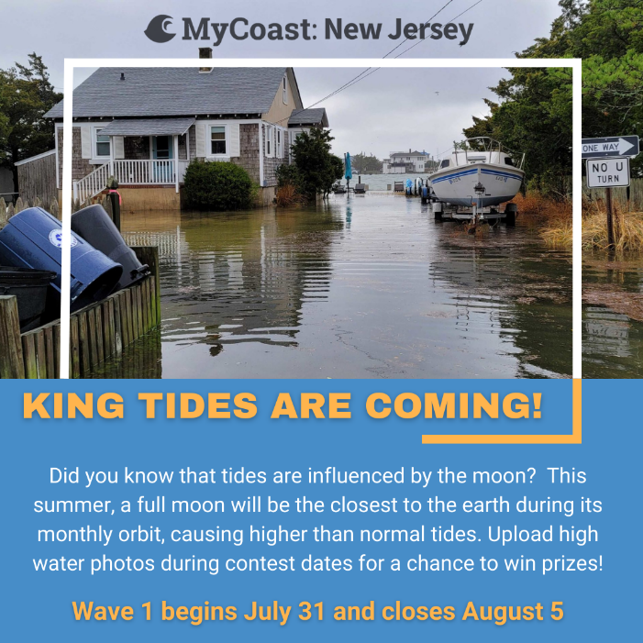
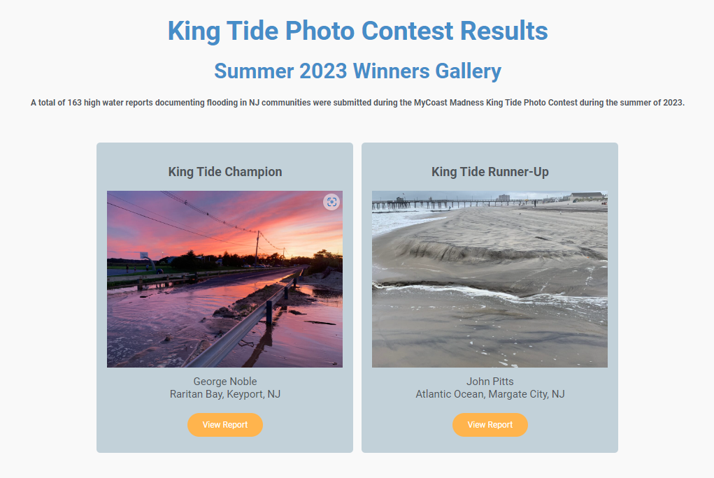

Slide 11
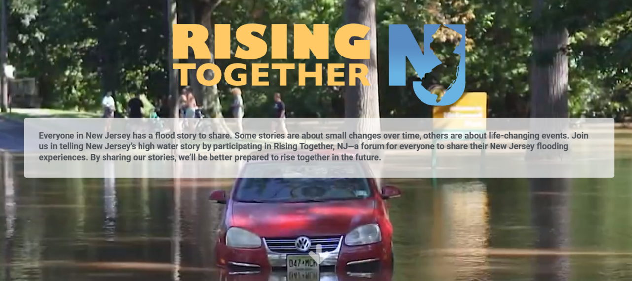
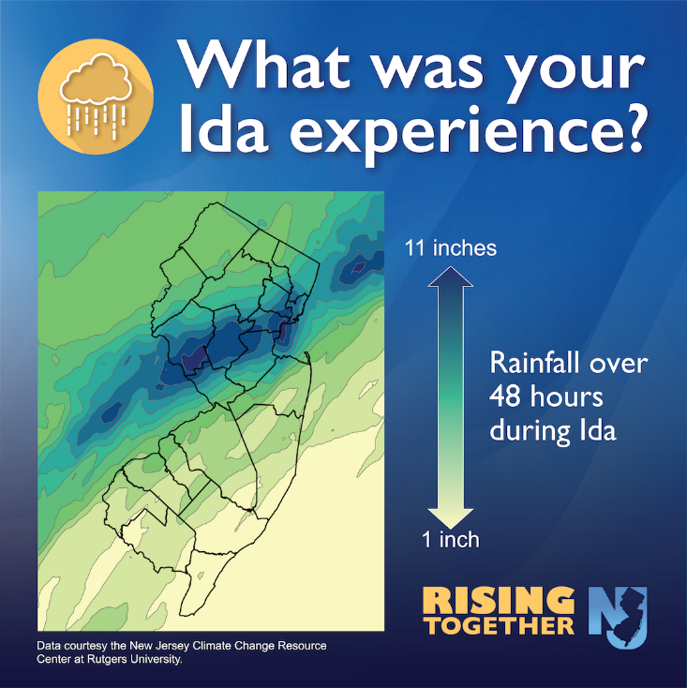

Notes:
All agencies worked together, struggled with outreach but we encourage others to keep
Sandy (10) and Ida (1) anniversary
Wanted everyone to have a place to share stories
Flooding happens everywhere not just coast
Impacted differently everyone has their own stories
Received written stories, photos, videos, even songs
See our compilation video if you scan the QR code

Slide 12
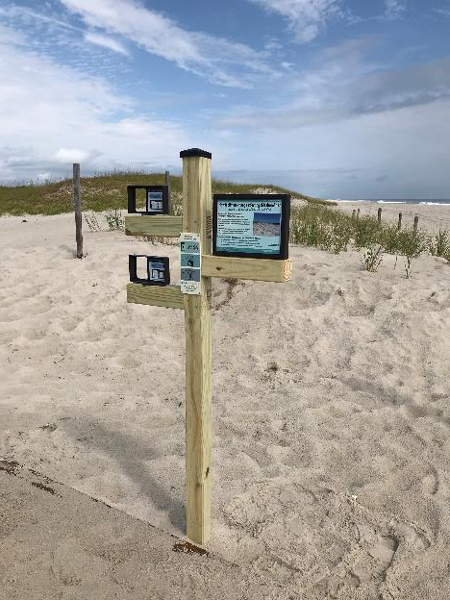

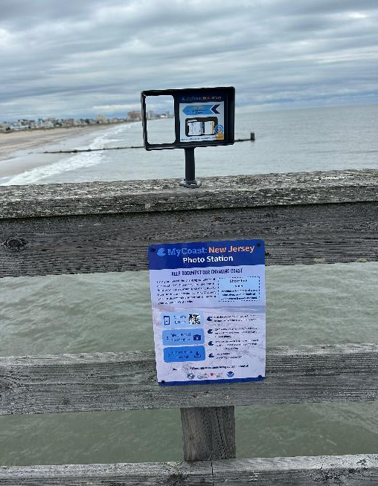
Photo Stations
Five locations
  Various coastal lines
Document climate/coastal changes
Time-lapse of photos collected
Installed for climate week launch September 2023

Slide 13
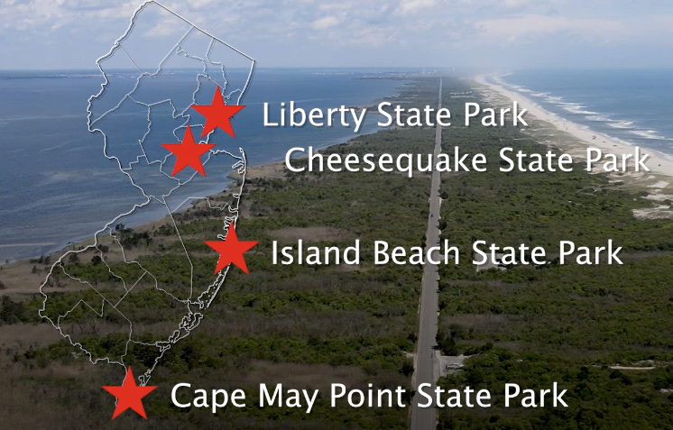
Photo Station locations
5 Locations | 6 Photo Stations
Margate City

Slide 14
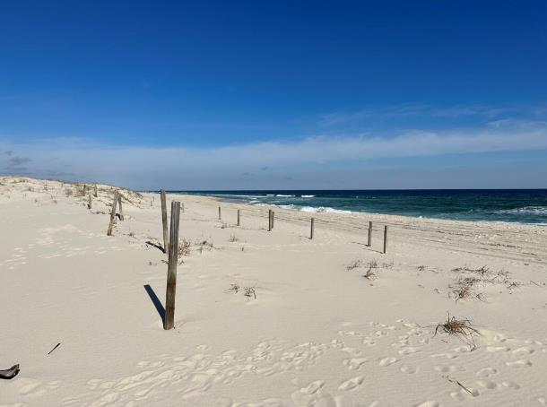
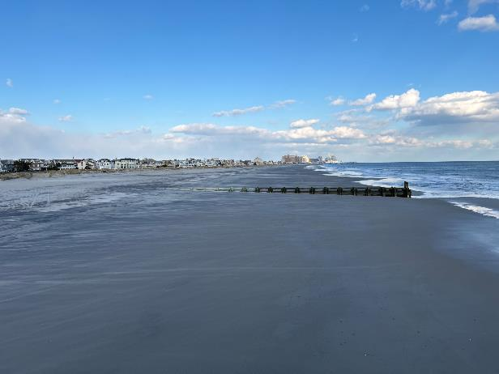
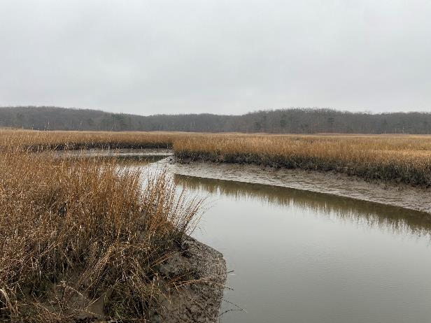
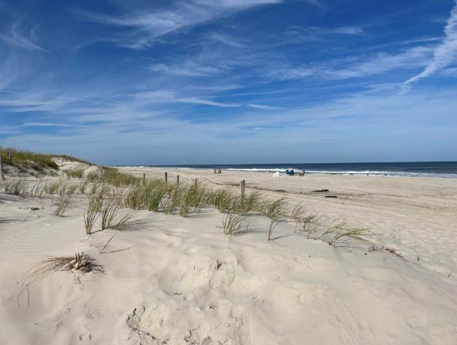
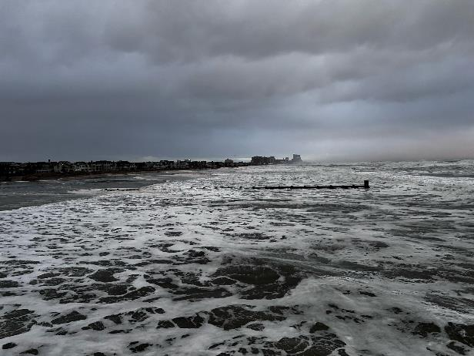
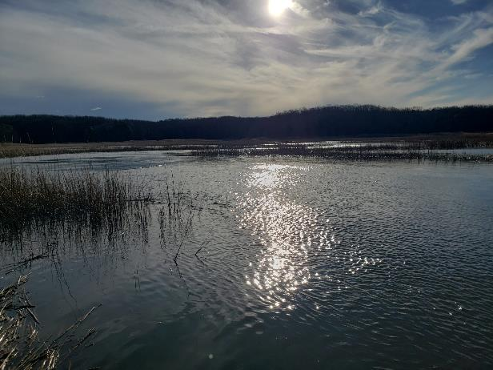
Fisherman's Walkway -
Amanda Archer, 2/27/23
Margate City Pier- NJ Anonymous, 11/28/23 2:44pm
Cheesequake State Park-
NJ Anonymous, 12/27/23 2:15pm
Fisherman's Walkway -
NJ Anonymous, 9/16/23 3:57pm
Margate City Pier- Steven Jasiecki, 1/10/24 7:36pm
Cheesequake State Park-
NJ Anonymous, 1/10/24 9:32am
Notes:
Fisherman's walkway – dune change from project scope to installation
Margate – low tide to rain event and high tide
Cheesequake – low tide to rain event and high tide

Slide 15
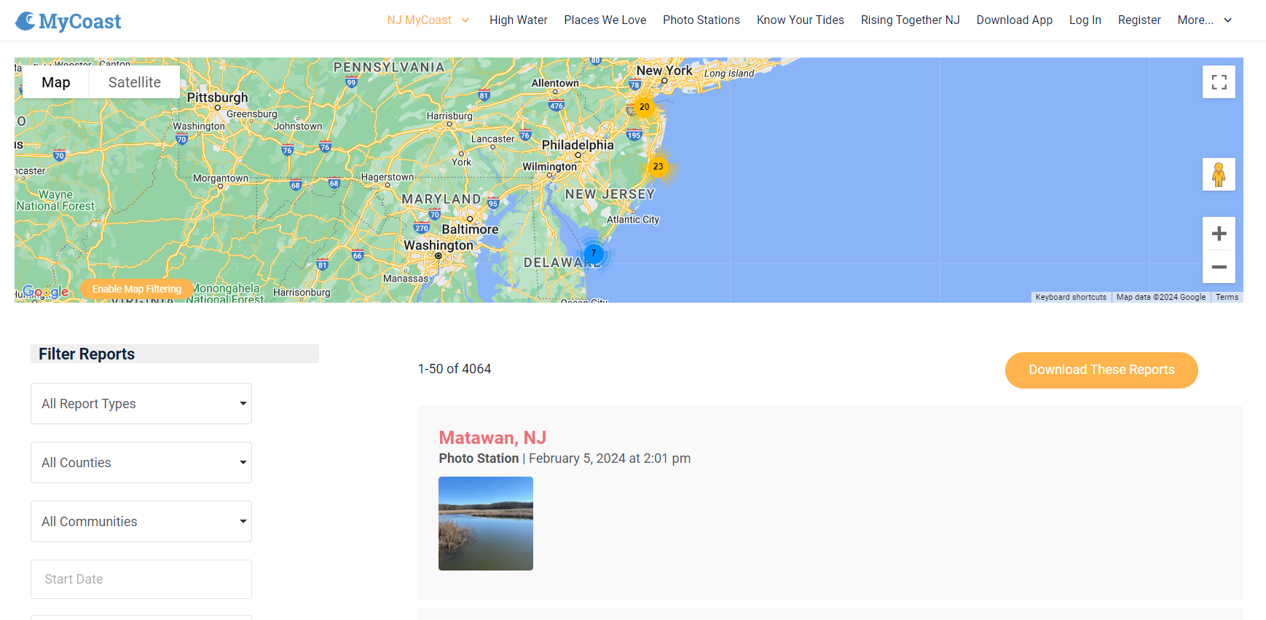

Slide 16
User Analytics & Feedback
"I love citizen science projects. Seeing changes over time in our coast is so impactful. I would love to find more ways to use it in my classroom."
700 users with an account
4,064 reports submitted
15 NJ flood notifications sent in 2023
"Thank you for informing us about the app and ability to inform the community about our changing environment related to storm impacts"
~ 2023 TOTE Workshop

Slide 17
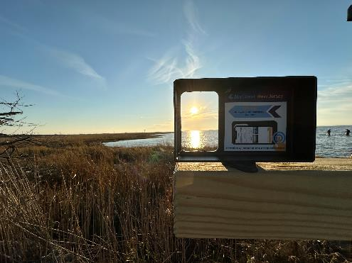
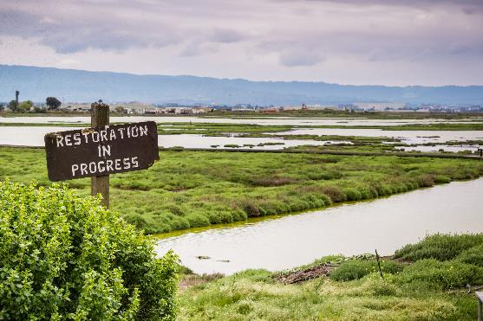

What is to come?
Continued use of this platform to go beyond coastal flooding
Work with partners to install more photo stations to document shoreline changes
Use citizen reports to document changes to habitat restoration sites
Engage educators to use MyCoast: New Jersey in classrooms as a local, on-the-ground climate change education tool

Slide 18
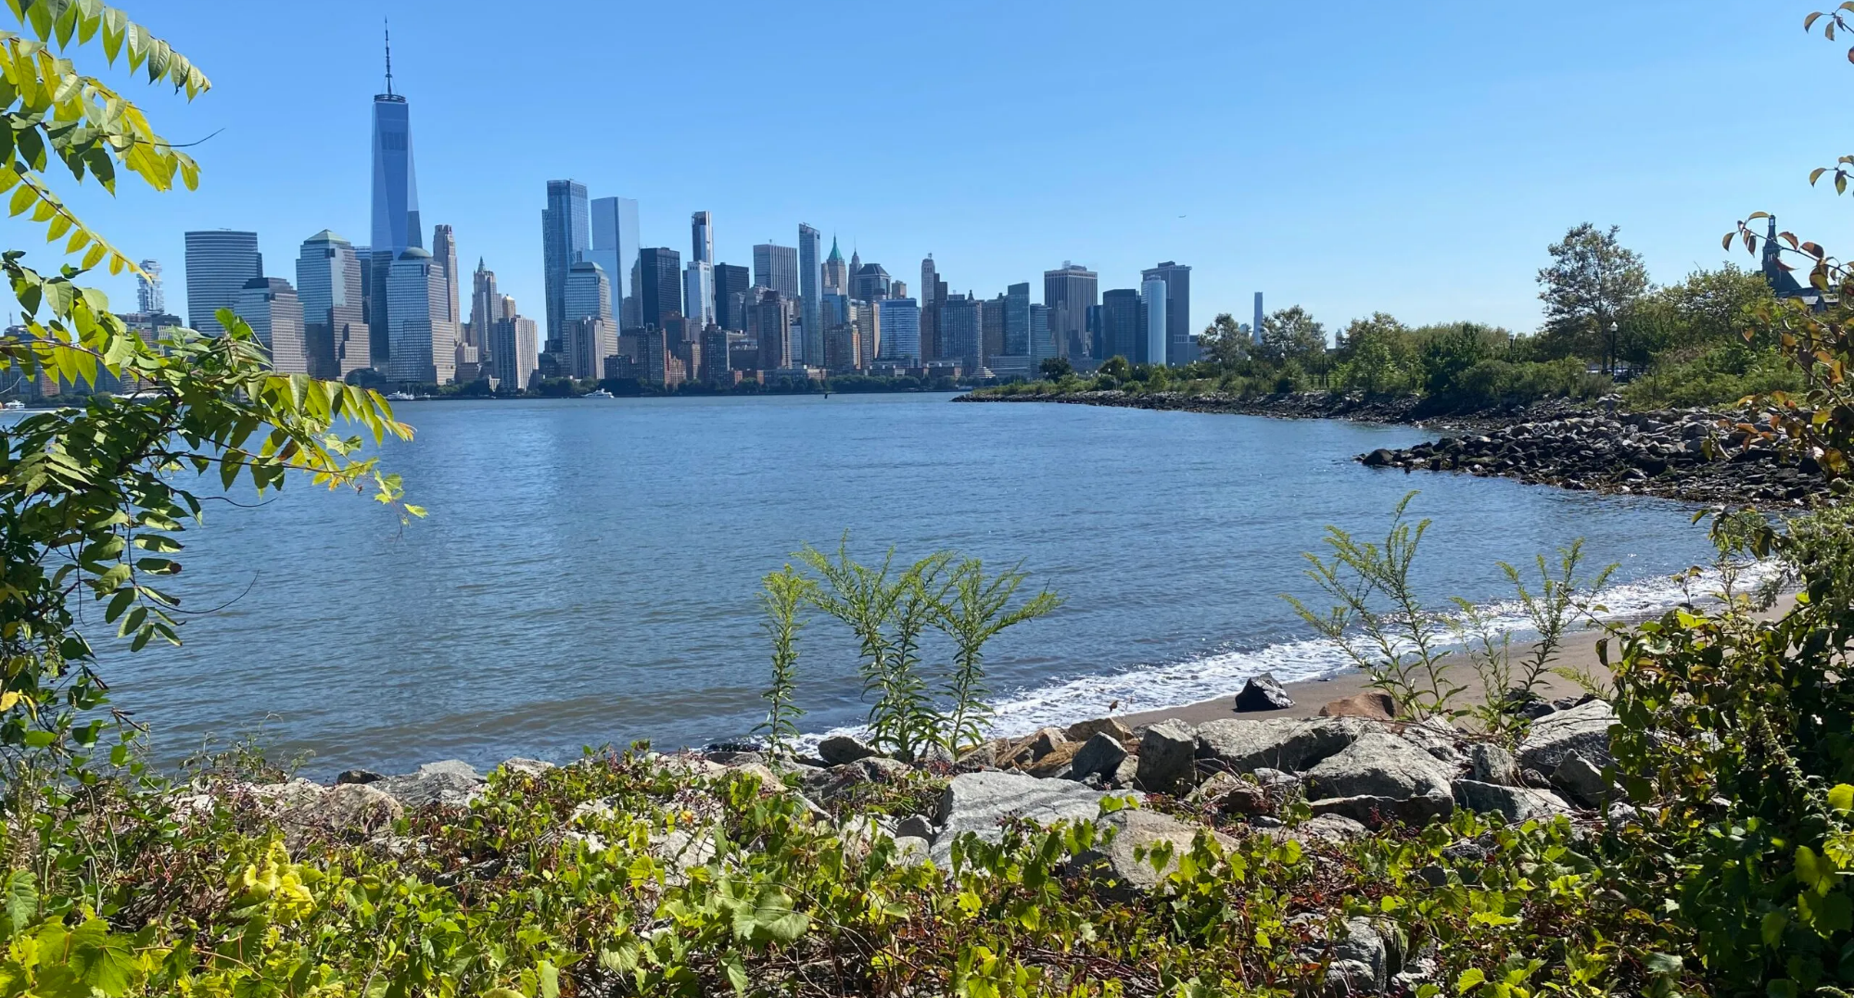
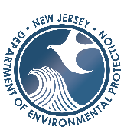



Contact
Questions?
Amanda Archer | amanda.archer@marine.rutgers.edu

Slide 19
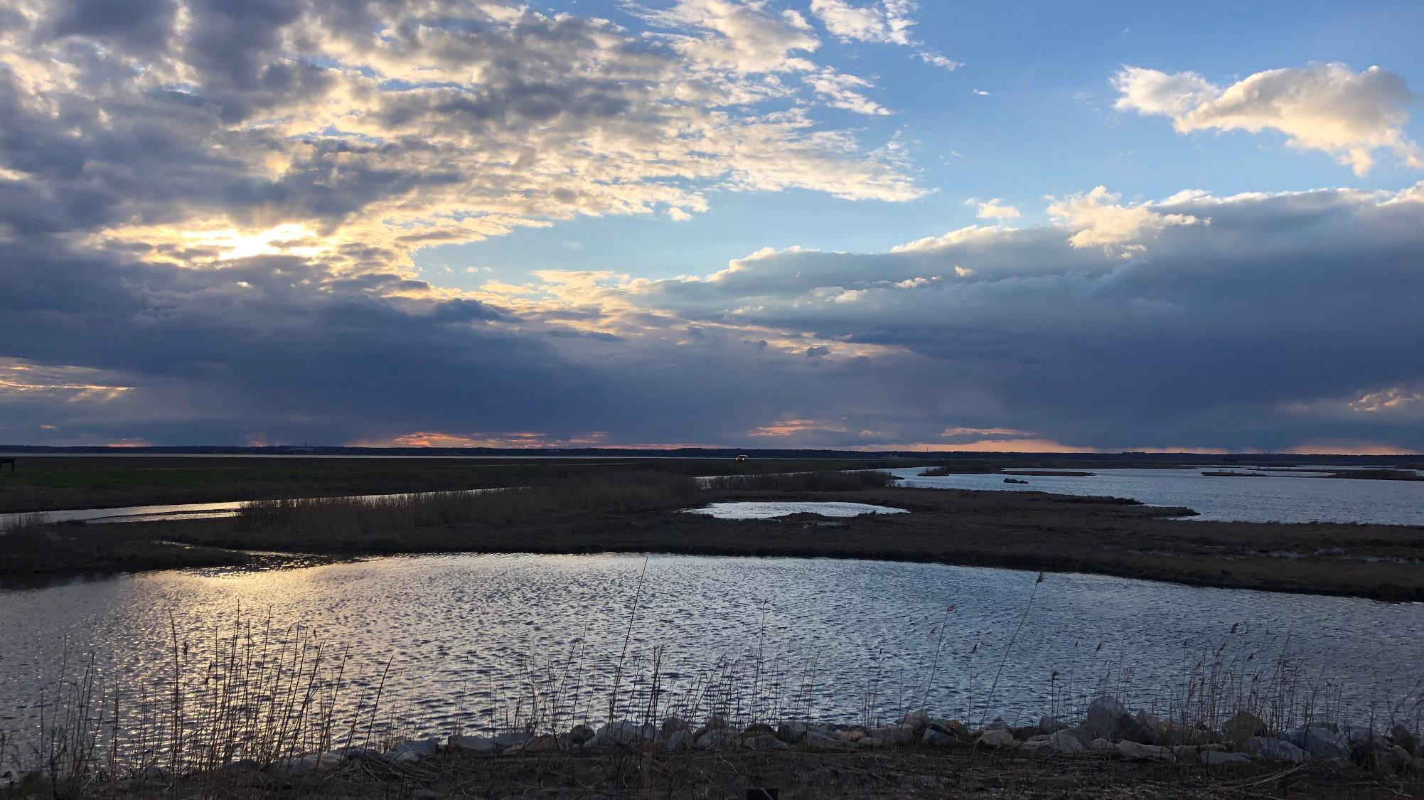
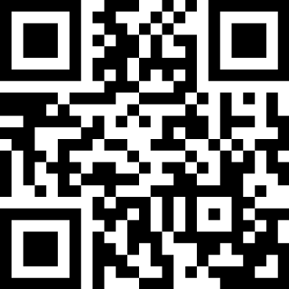

Stay in the know!
Sign up for access to upcoming events, trainings, webinars, articles and more.
Amanda Archer, Coastal Training Program Coordinator
amanda.archer@marine.rutgers.edu

