Slide 1
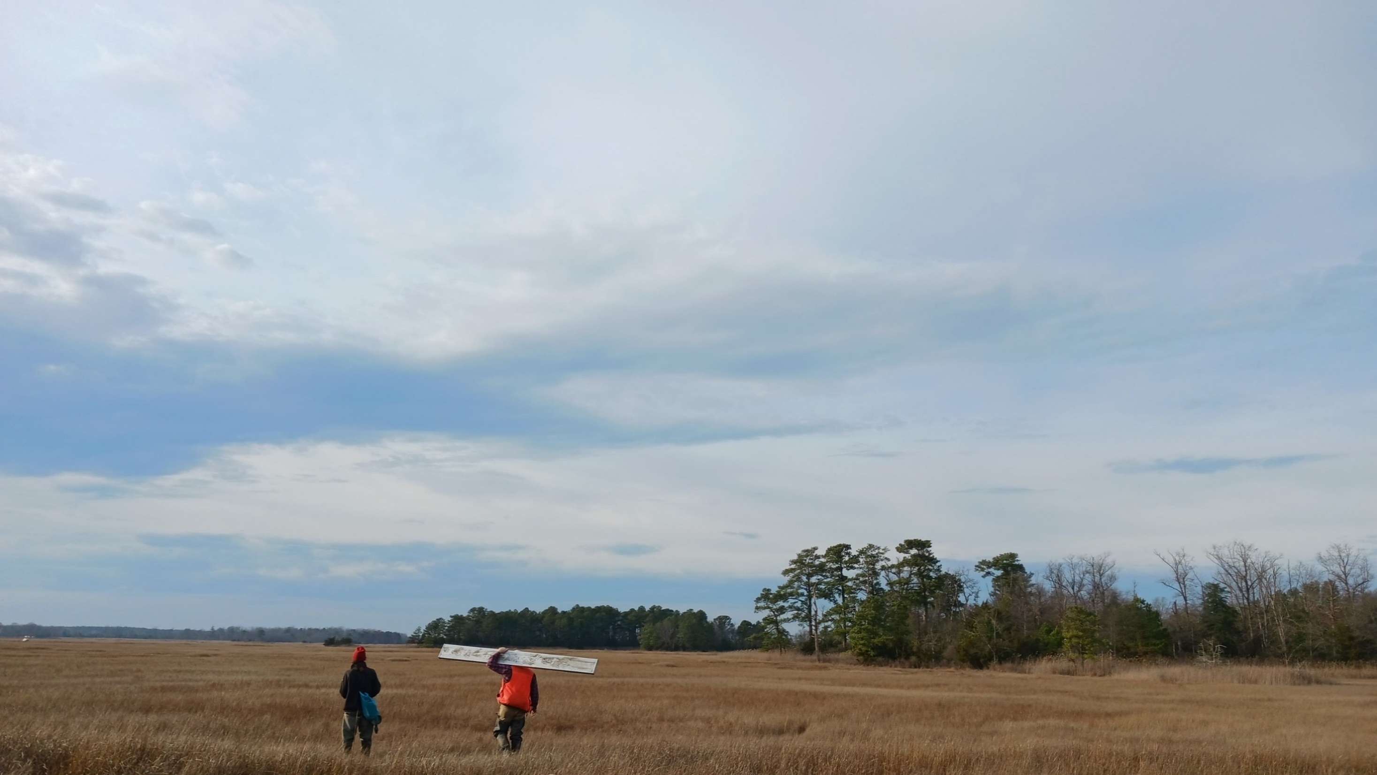

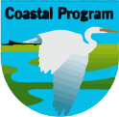

Programmatic approach to assessing salt marsh in Delaware and New Jersey for utilizing low-cost low-disturbance methods for enhancing resilience
Brian Marsh, USFWS Delaware Bay Coastal Program
Kaity Ripple, USFWS Delaware Bay Coastal Program
Jim Feaga, Ducks Unlimited, Inc.
Cedar Creek Unit, Milford Neck WA, DE

Slide 2
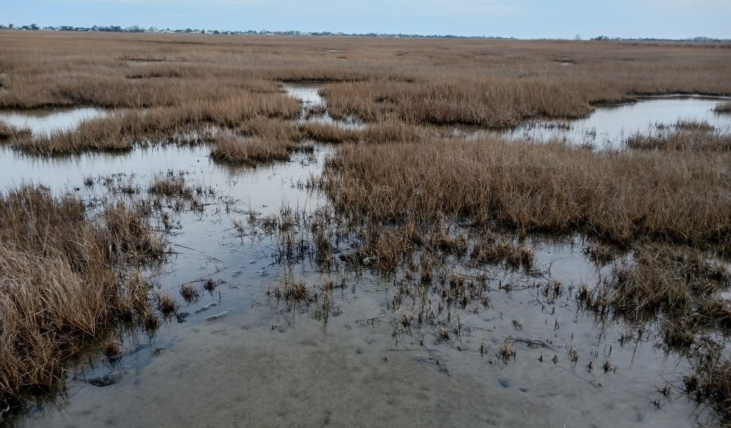

What we are doing
Assessing salt marsh sites to:
  find sites suitable for a suite of restoration measures
  gather data useful for design
  gather baseline data

Slide 3
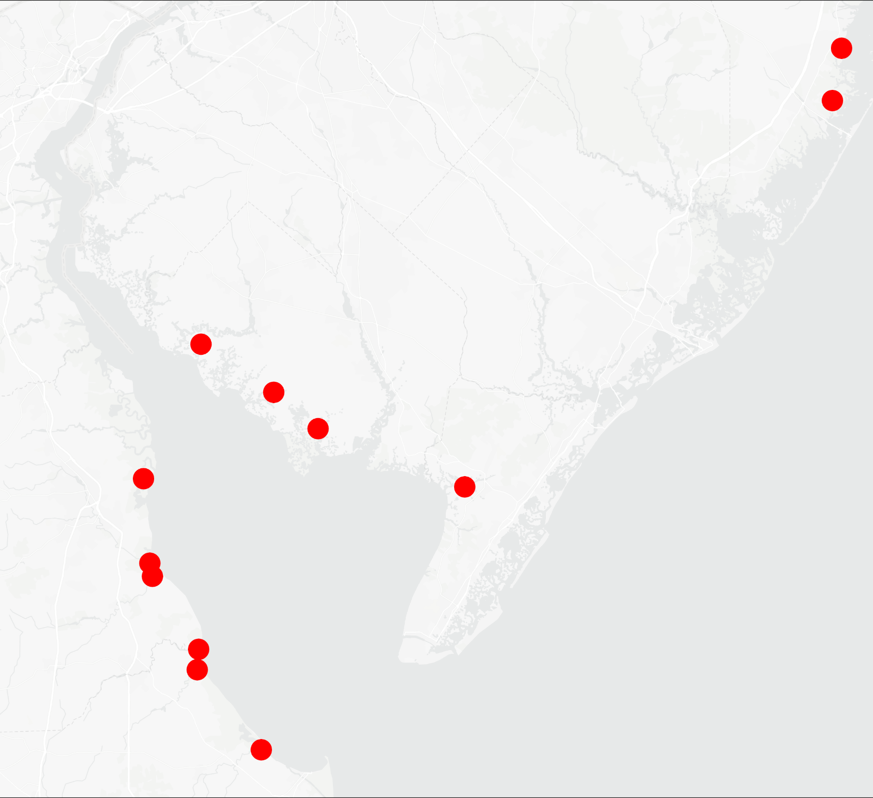
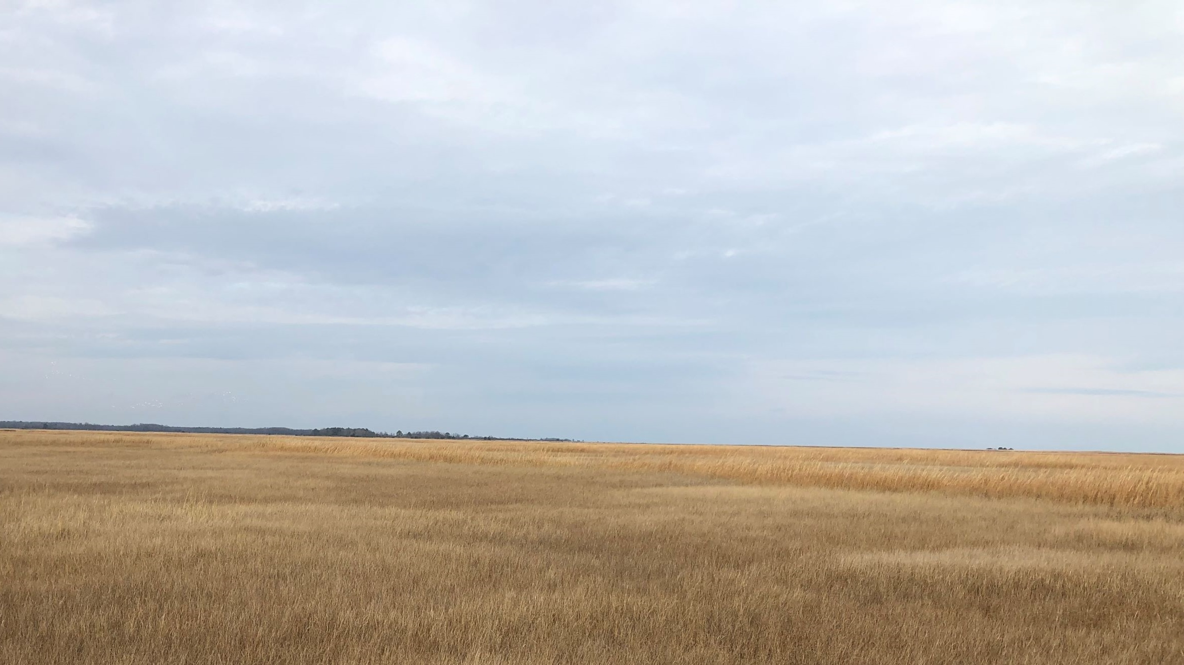
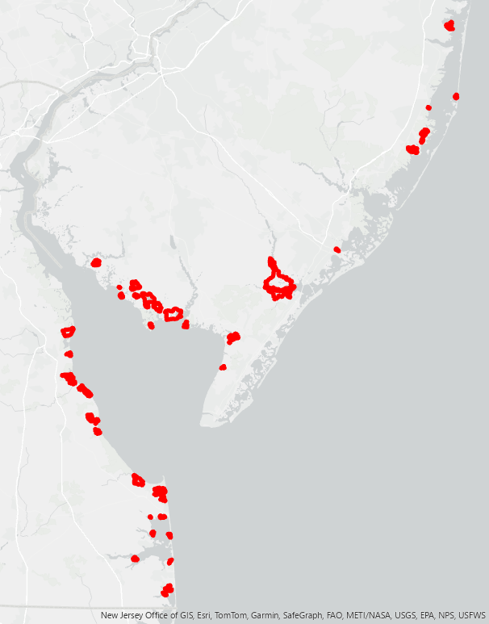
Where we are working
ASSESSMENT SITES
2023-2024
Lighthouse Center
AT&T Tract
AREAS OF INTEREST
2022 and onward
Dix
Nantuxent
Garrison
Port Mahon
Dennis Creek
Buckaloo
Murderkill
Mispillion
Cedar Creek
Delaware Watershed Conservation Fund - 2022
2023 first field season
2024 second field season
Prime Hook Unit IV

Slide 4
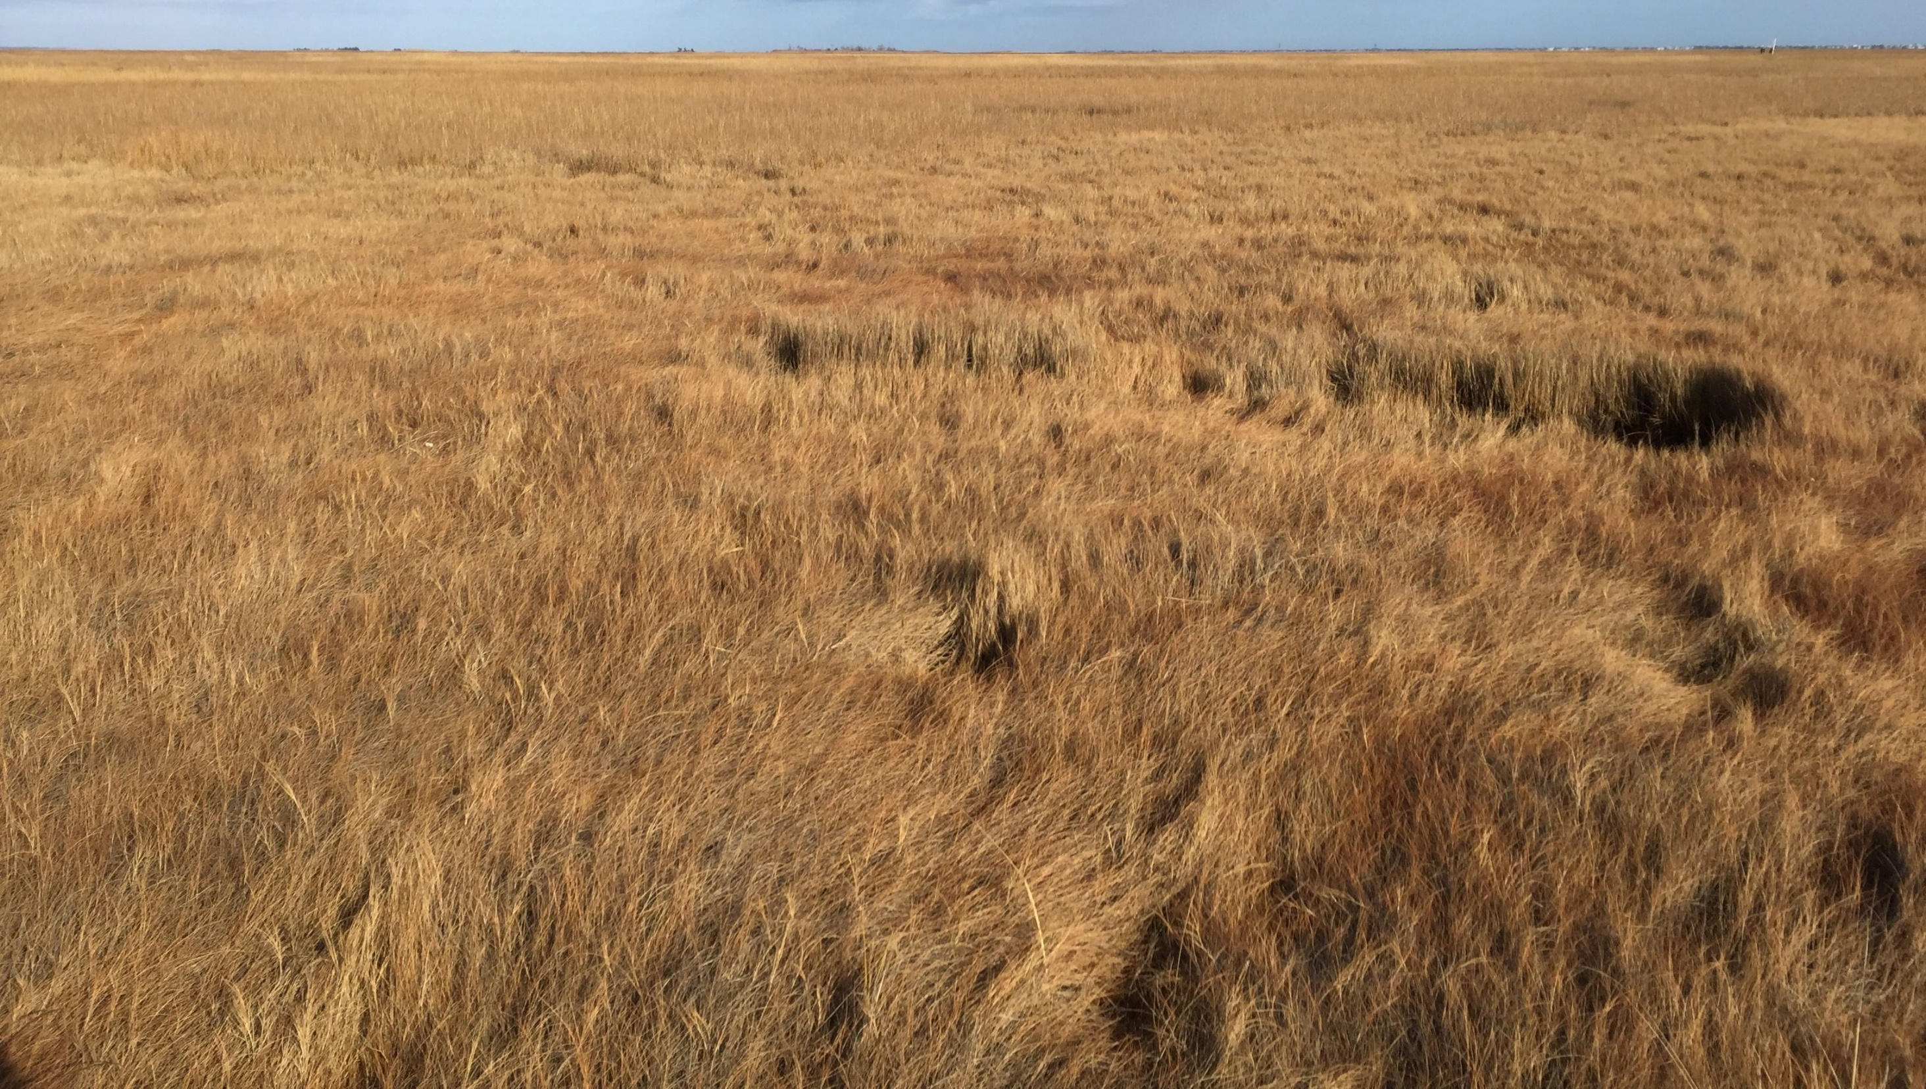
What do we mean by programmatic approach?
  team approach to developing similar projects across a landscape scale
  economy of scale
  efficient data collection
  standardized protocols
  informed perspective
  sustained partnerships
  learning network
  project pipeline
identify sites
completed projects
assessment
other restoration methods?
adaptively manage
low-tech design
monitoring
permitting & funding
installation

Slide 5
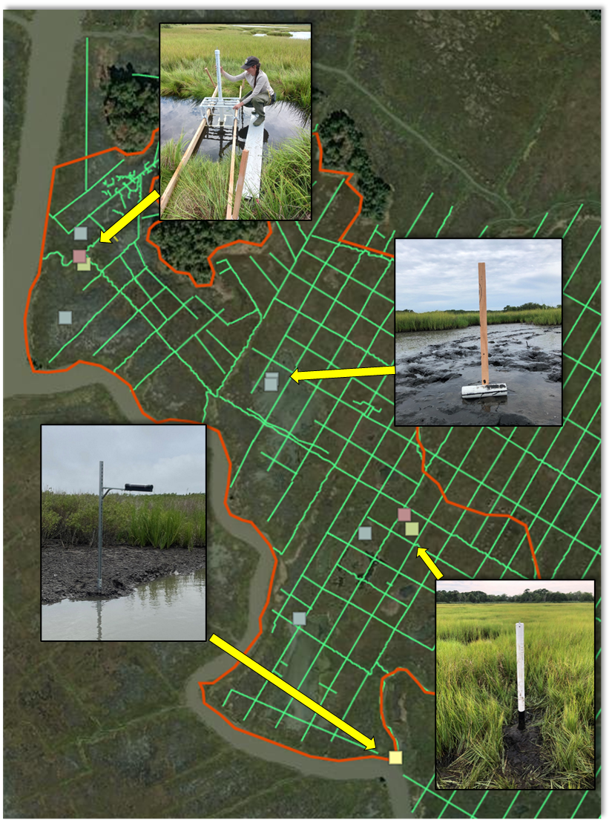
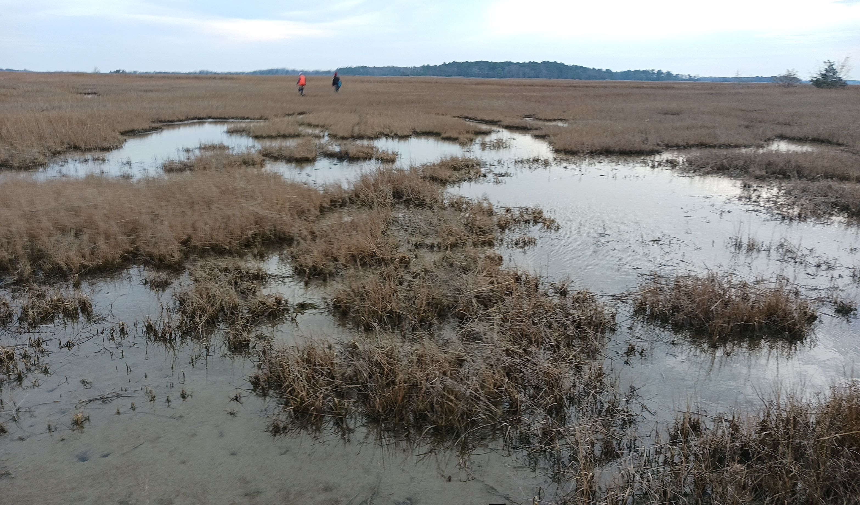
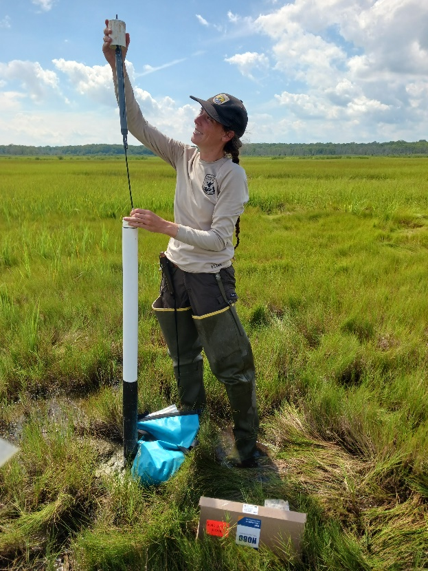
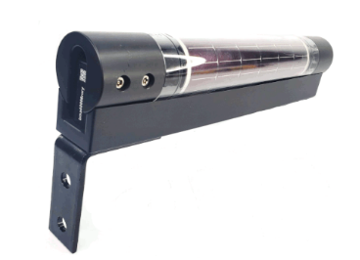
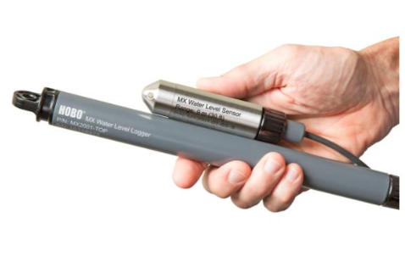
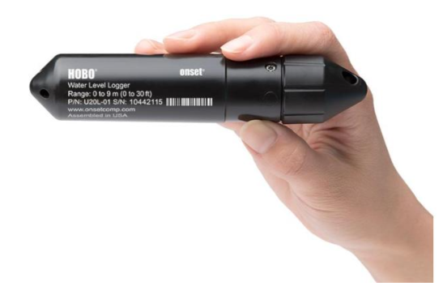
What we are assessing
HYDROLOGY
water levels
local tidal datums
inundation frequency
saturation rate
groundwater level
ditch networks
tidal lag and restriction
trapped hydrology
channels
surface water
Hyfi
Onset HOBO
reference creeks
groundwater

Slide 6
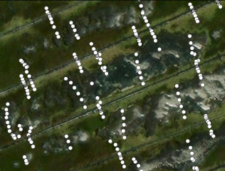
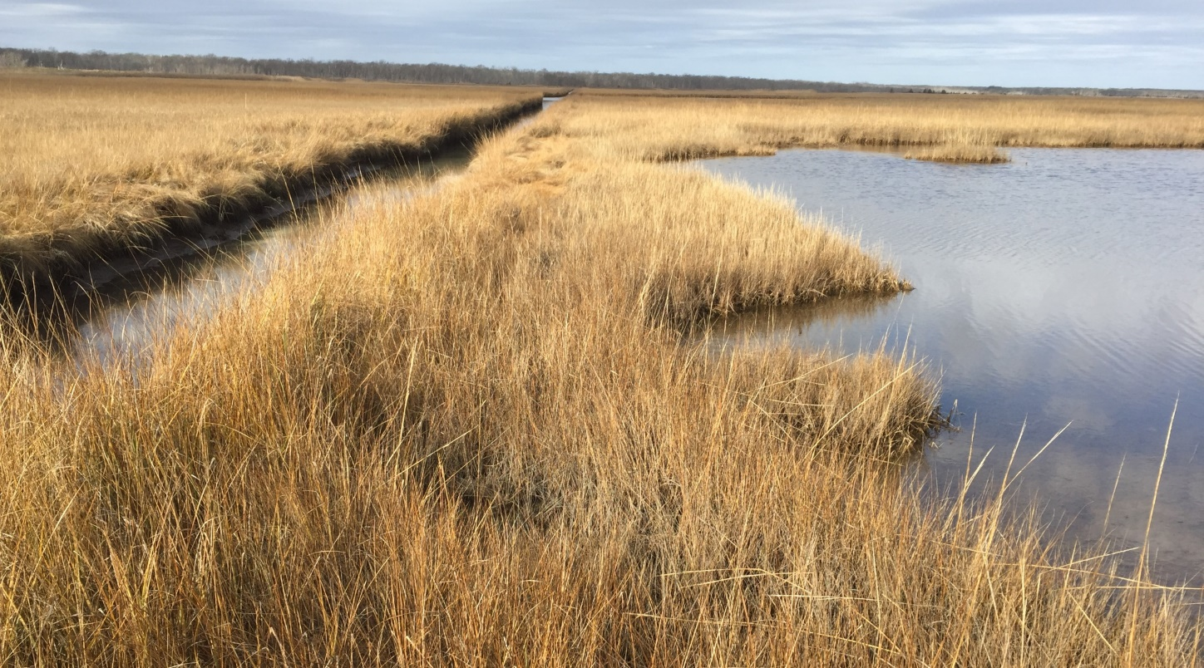
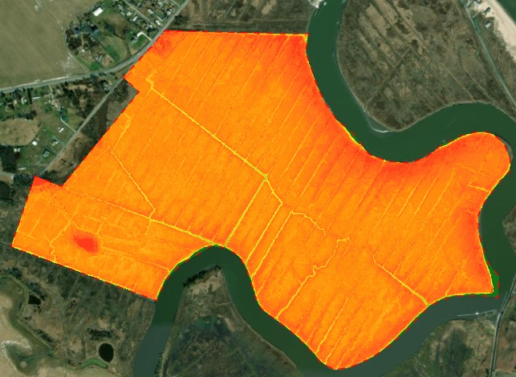
What we are assessing
RTK
ELEVATION
RTK and LiDAR data
predicting inundation patterns
revealing elevation deficits
determining if elevation capital is present
LiDAR
1.1 ft
microberm
0.5 ft
-1.5 ft
inundated
marsh
ditch

Slide 7
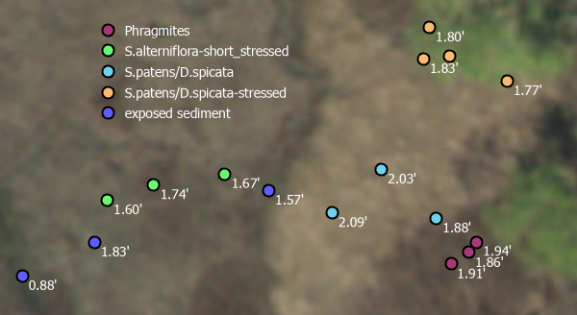
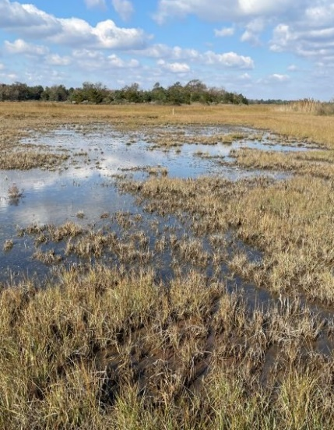
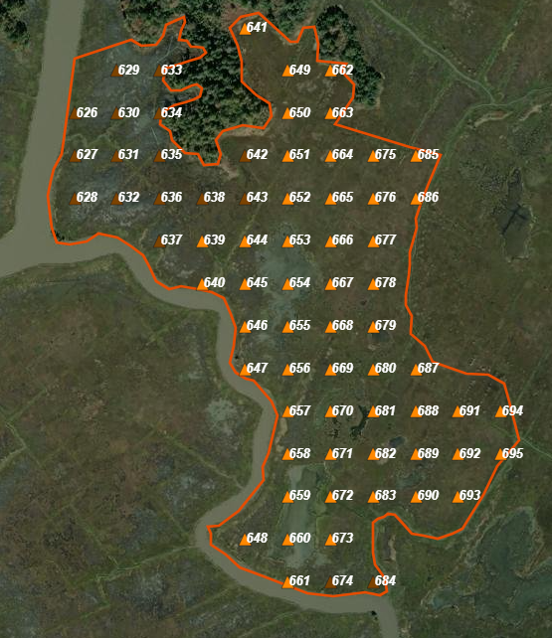
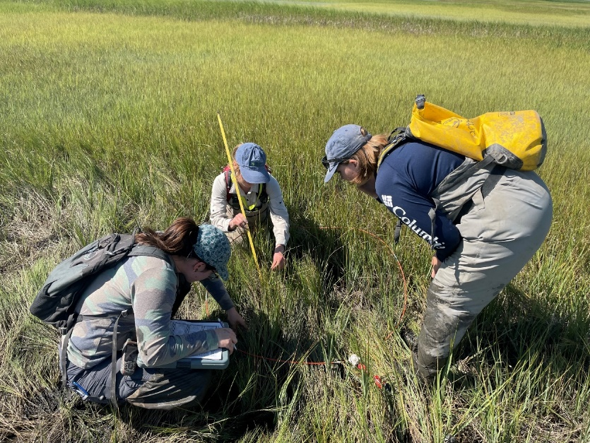
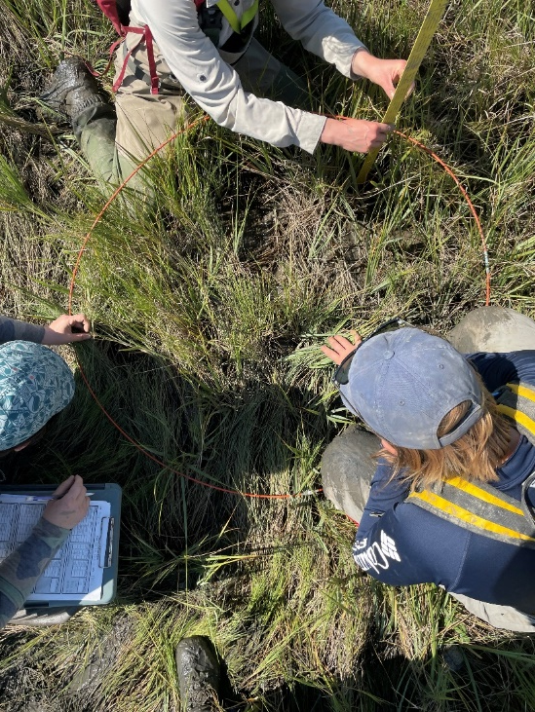
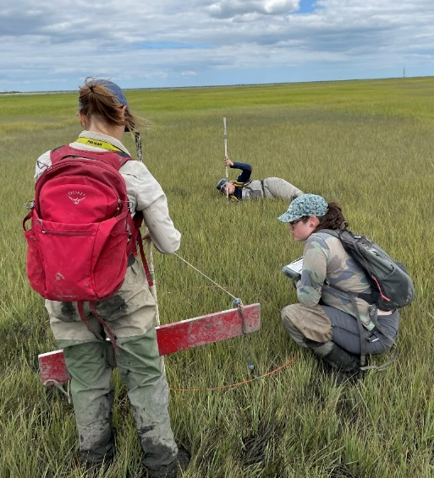
bio-benchmarks
What we are assessing
VEGETATION
composition, density, condition
indicator of hydrology
indicator of trajectory
% cover and composition
predetermined point grids
horizontal vegetation
obstruction
vegetation height

Slide 8
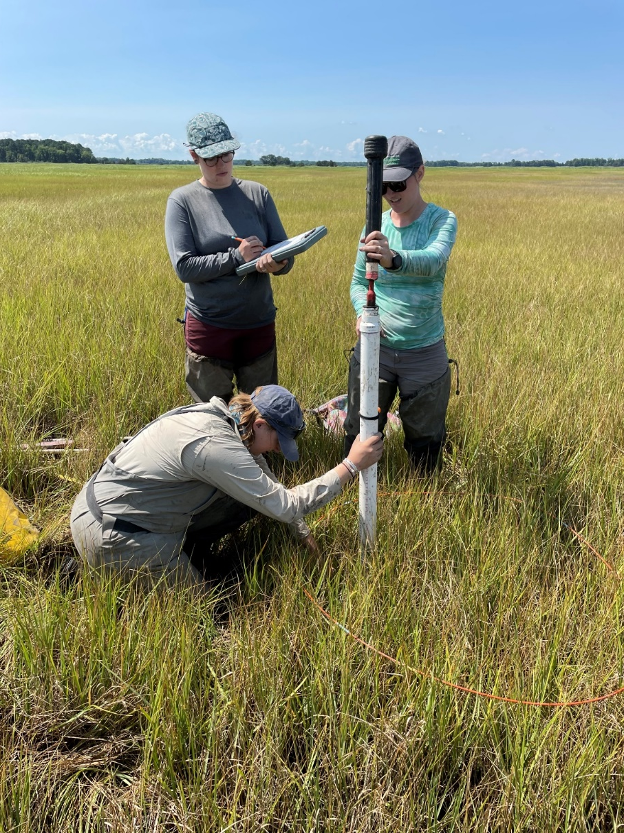
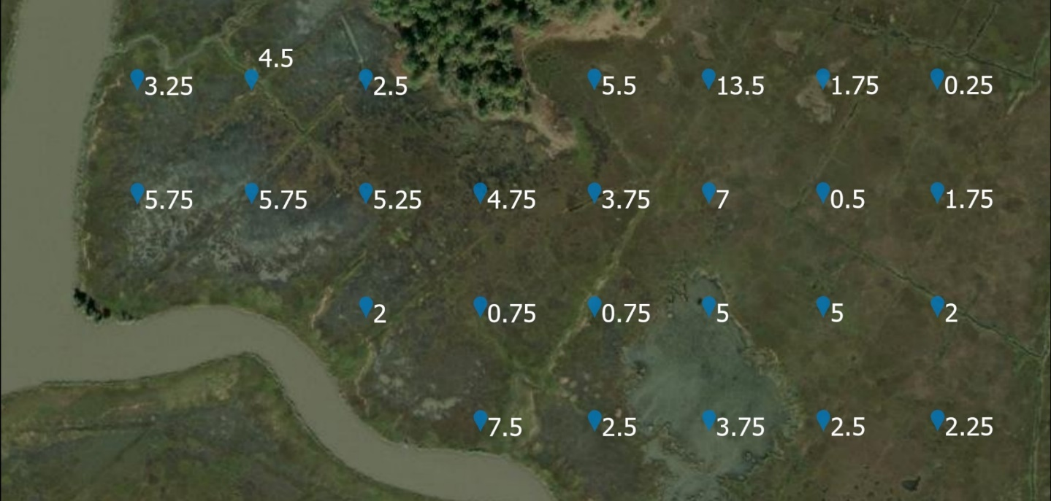
What we are assessing
BEARING CAPACITY
centimeters of penetration depth
indicator of peat and root condition with greater penetration depths suggestive of peat breaking down and poor root vigor
capabilities of substrate to support restoration features

Slide 9

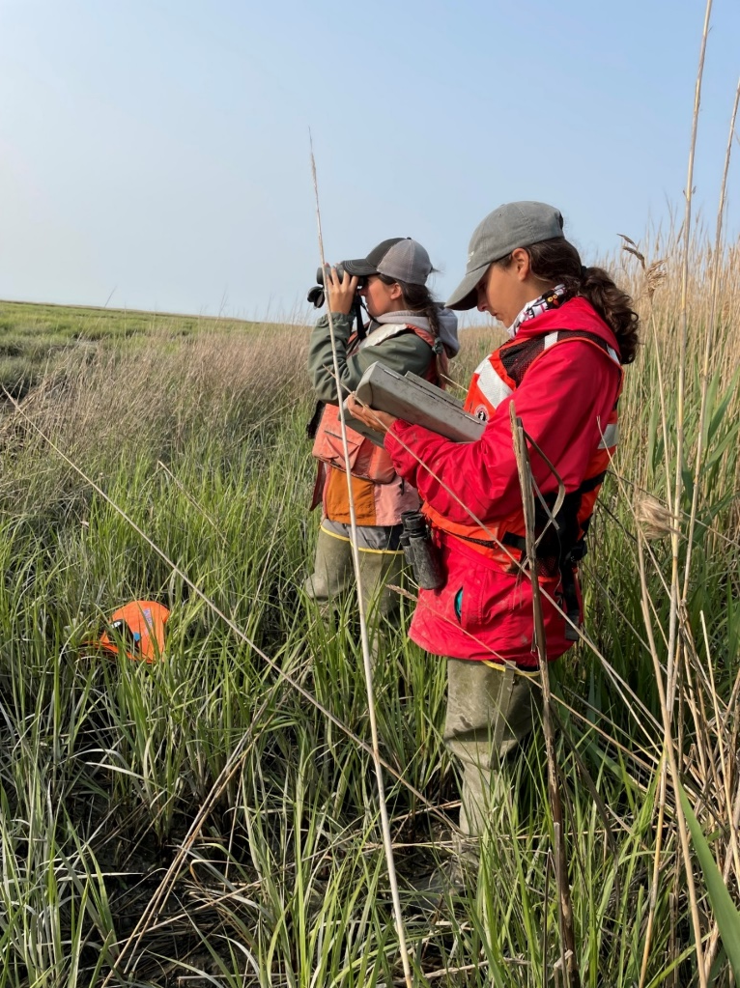
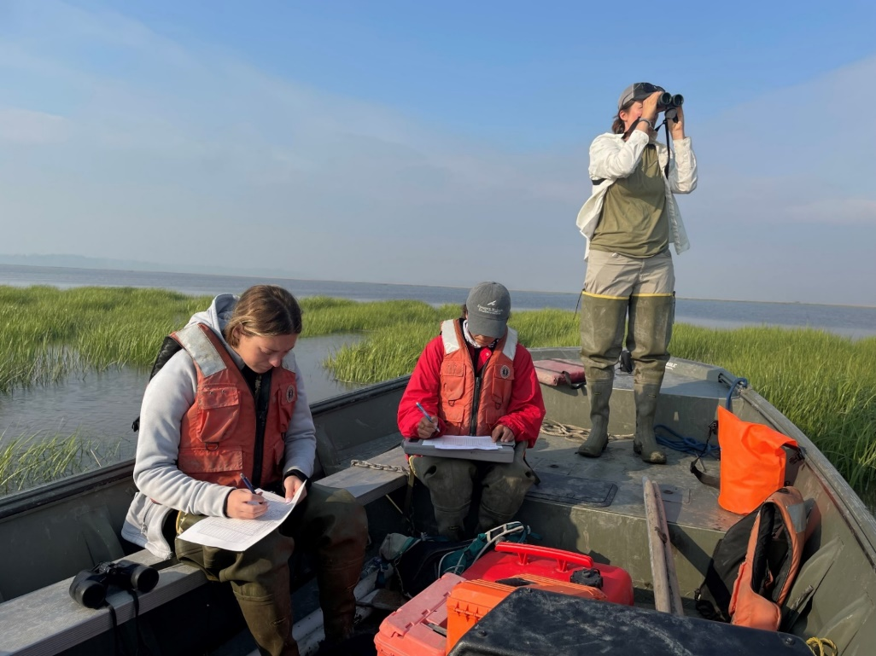
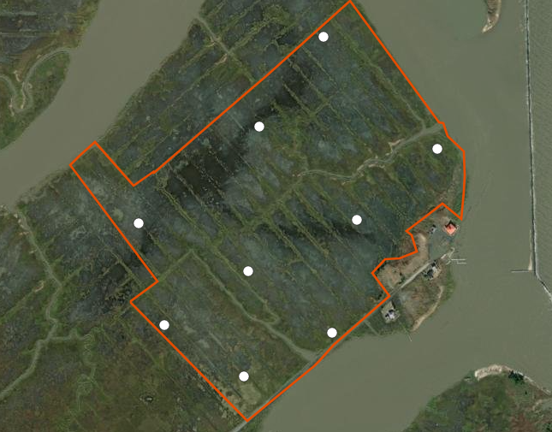
What we are assessing
AVIAN COMMUNITY
tidal marsh bird point counts
habitat indicator
important conservation species

Slide 10
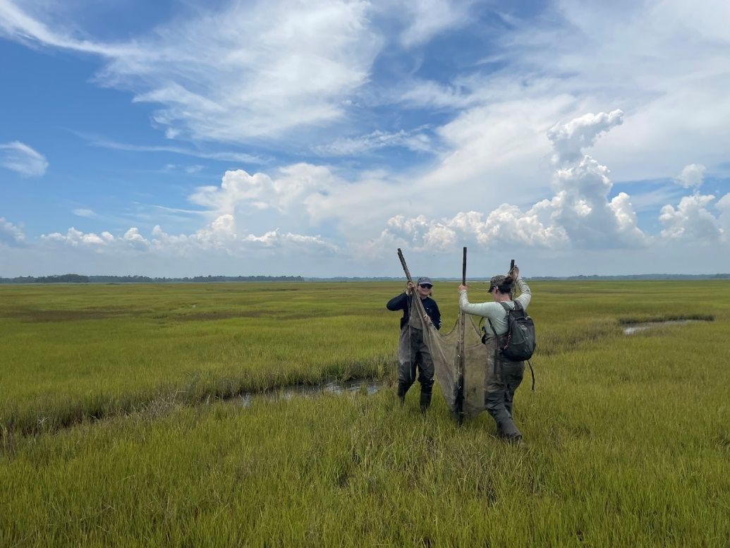
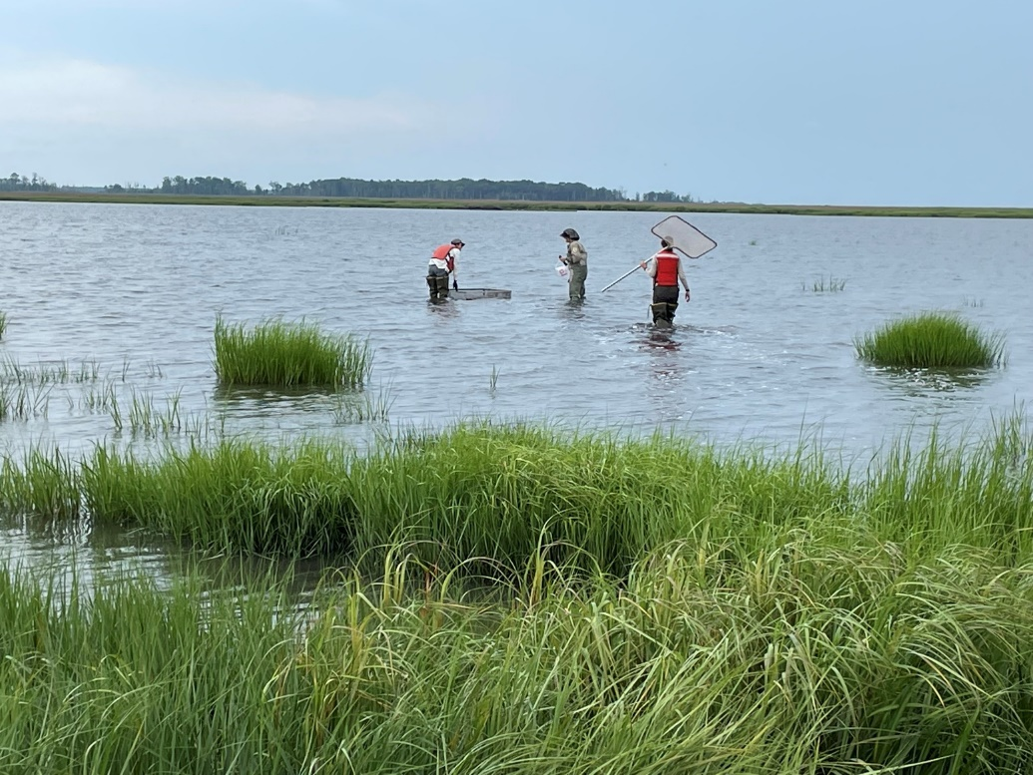
What we are assessing
NEKTON COMMUNITY
community coming off the marsh on ebb tides
habitat indicator
important trophic species

Slide 11
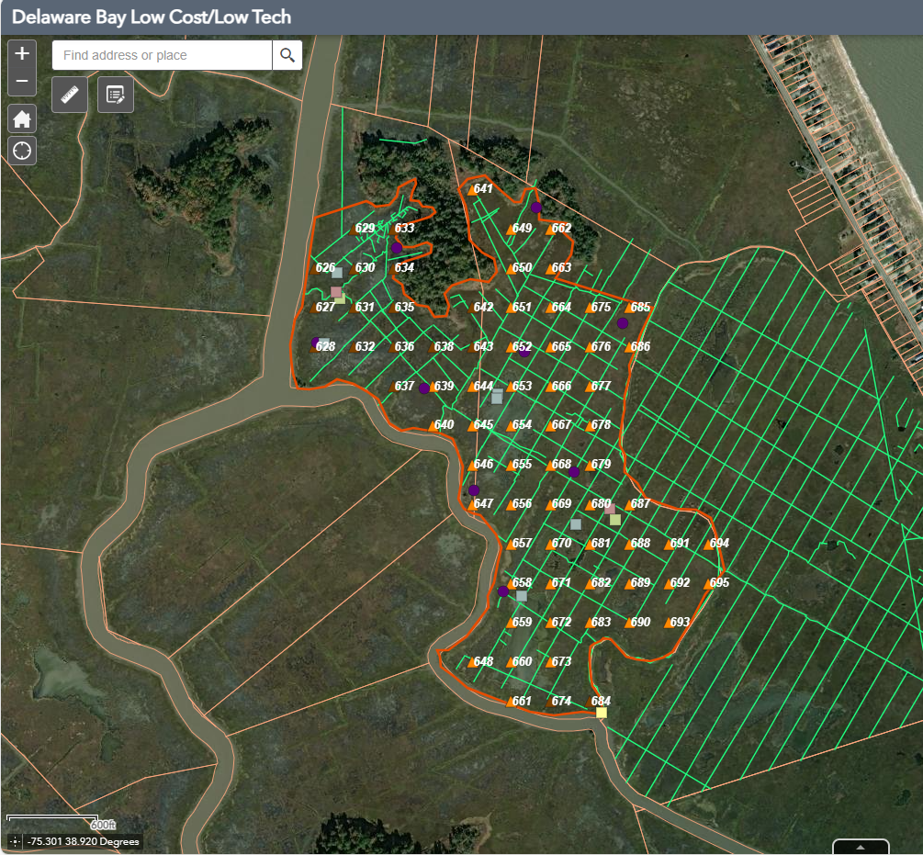
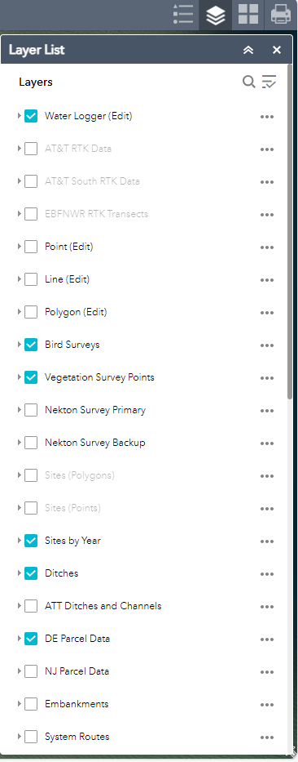
How the data is being gathered
ONLINE GIS TOOL
Used For
planning surveys
evaluating data and designs collaboratively
final designs exported to design plans/specs for permitting and construction
Incorporates
ownership
marsh features
remote sensing data
field data
georeferenced site pictures

Slide 12
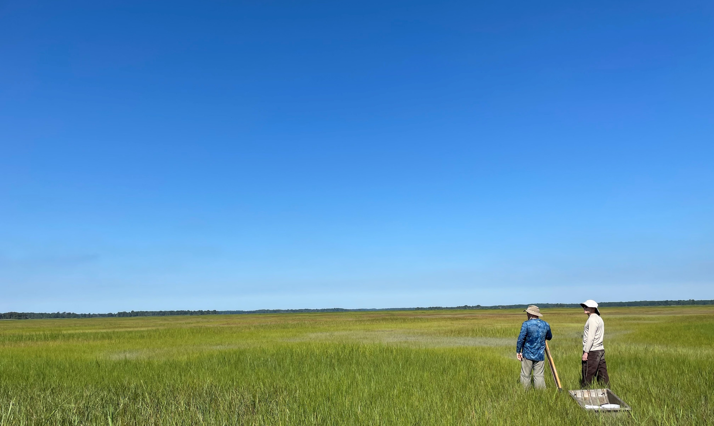
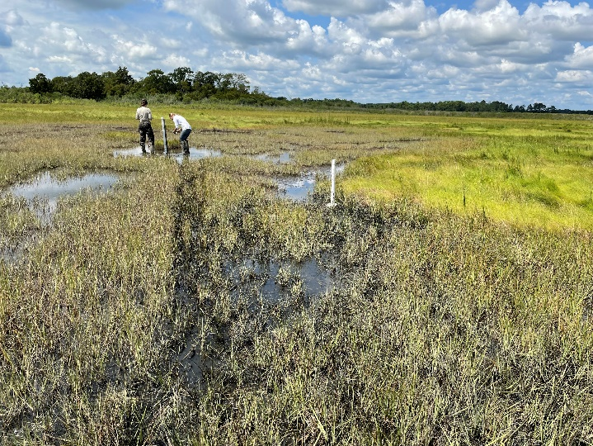
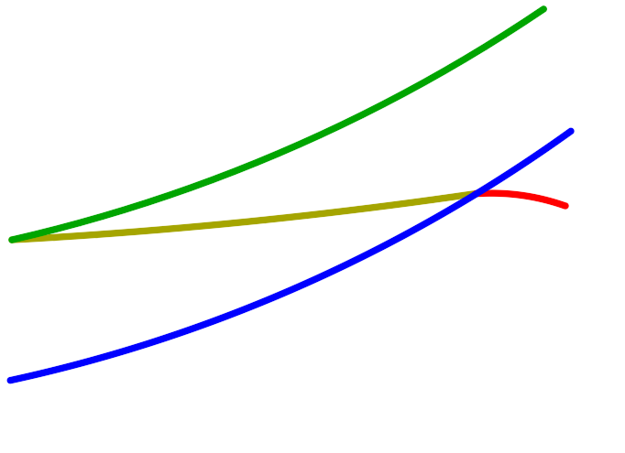
What are low-cost low-disturbance restoration methods
  “low-tech” approaches enhance resilience and habitat by improving salt marsh vegetation via minor changes to hydrology, elevation, and other parameters
push marsh towards self-healing
potential stopgap measures
low-cost
low-disturbance
rapid implementation
allow for in-field decisions
rapid results
integrable with other methods
scalable, replicable
low risk
easy adaptively managed
healthy marsh
ELEVATION
lost marsh
degrading marsh
mean sea level
TIME

Slide 13
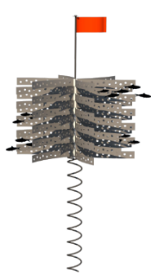
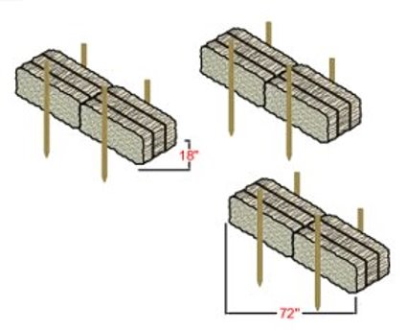
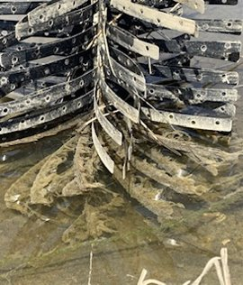
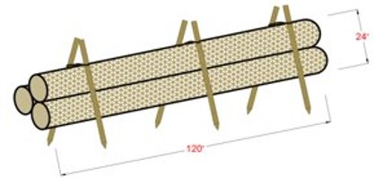
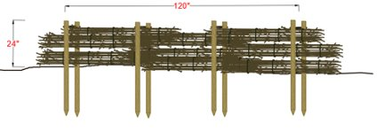
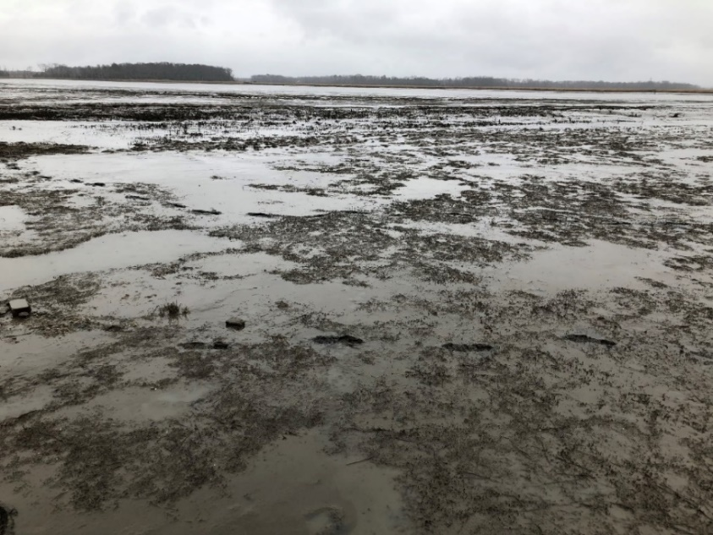
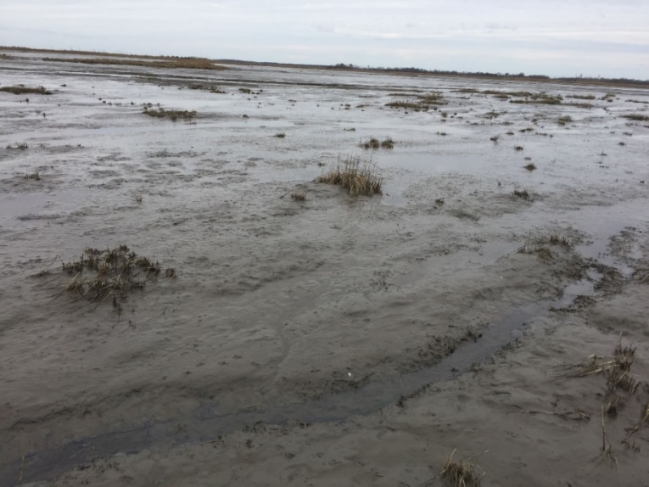
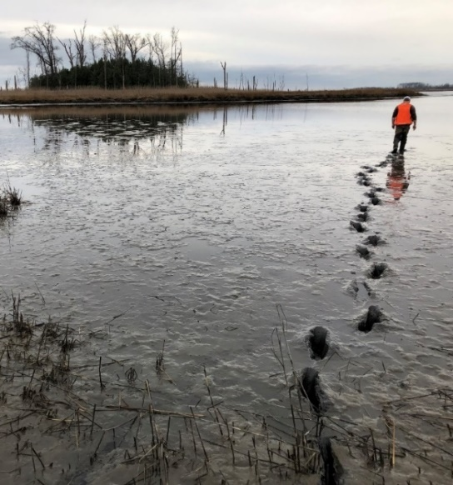
Technique: Biodegradable and temporary structures
features placed along eroding edges or across expanding mudflats within salt marsh to:
MarshGuards
haybales
  reduce fetch
  attenuate wave energy
  promote sediment accretion
  allow revegetation
coir logs
brush fences
Dennis Creek WMA
Natural Lands’ Garrison Tract
Dix WMA

Slide 14
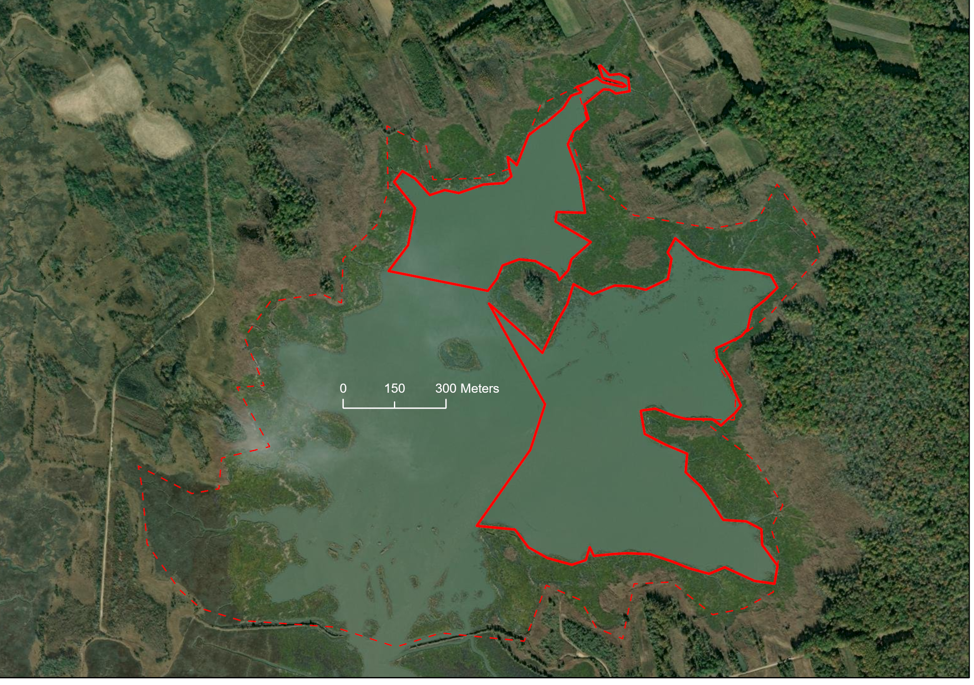

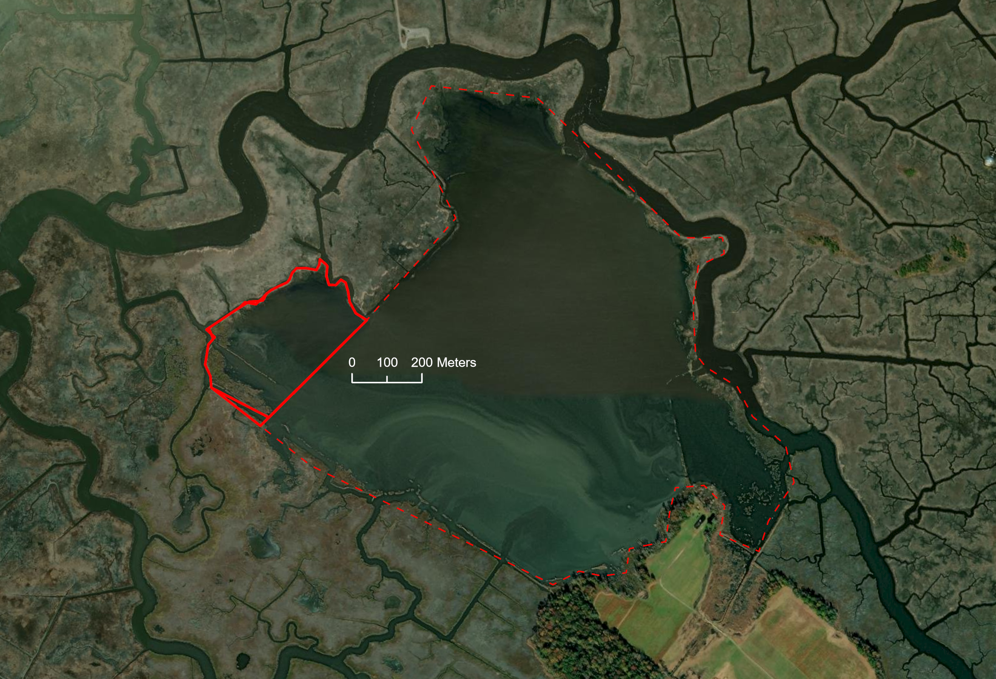
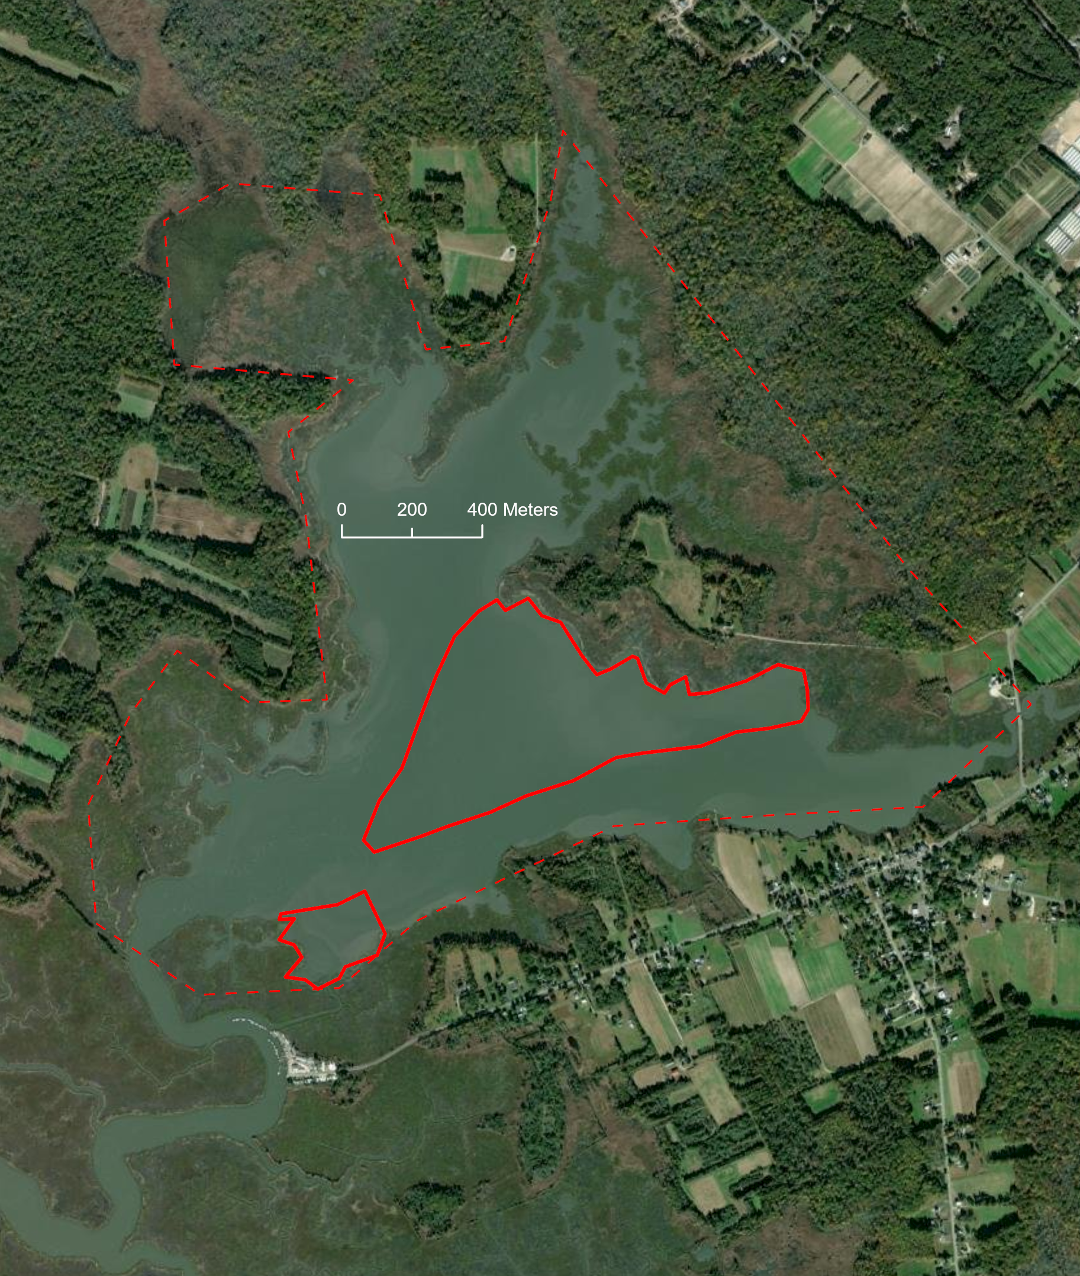
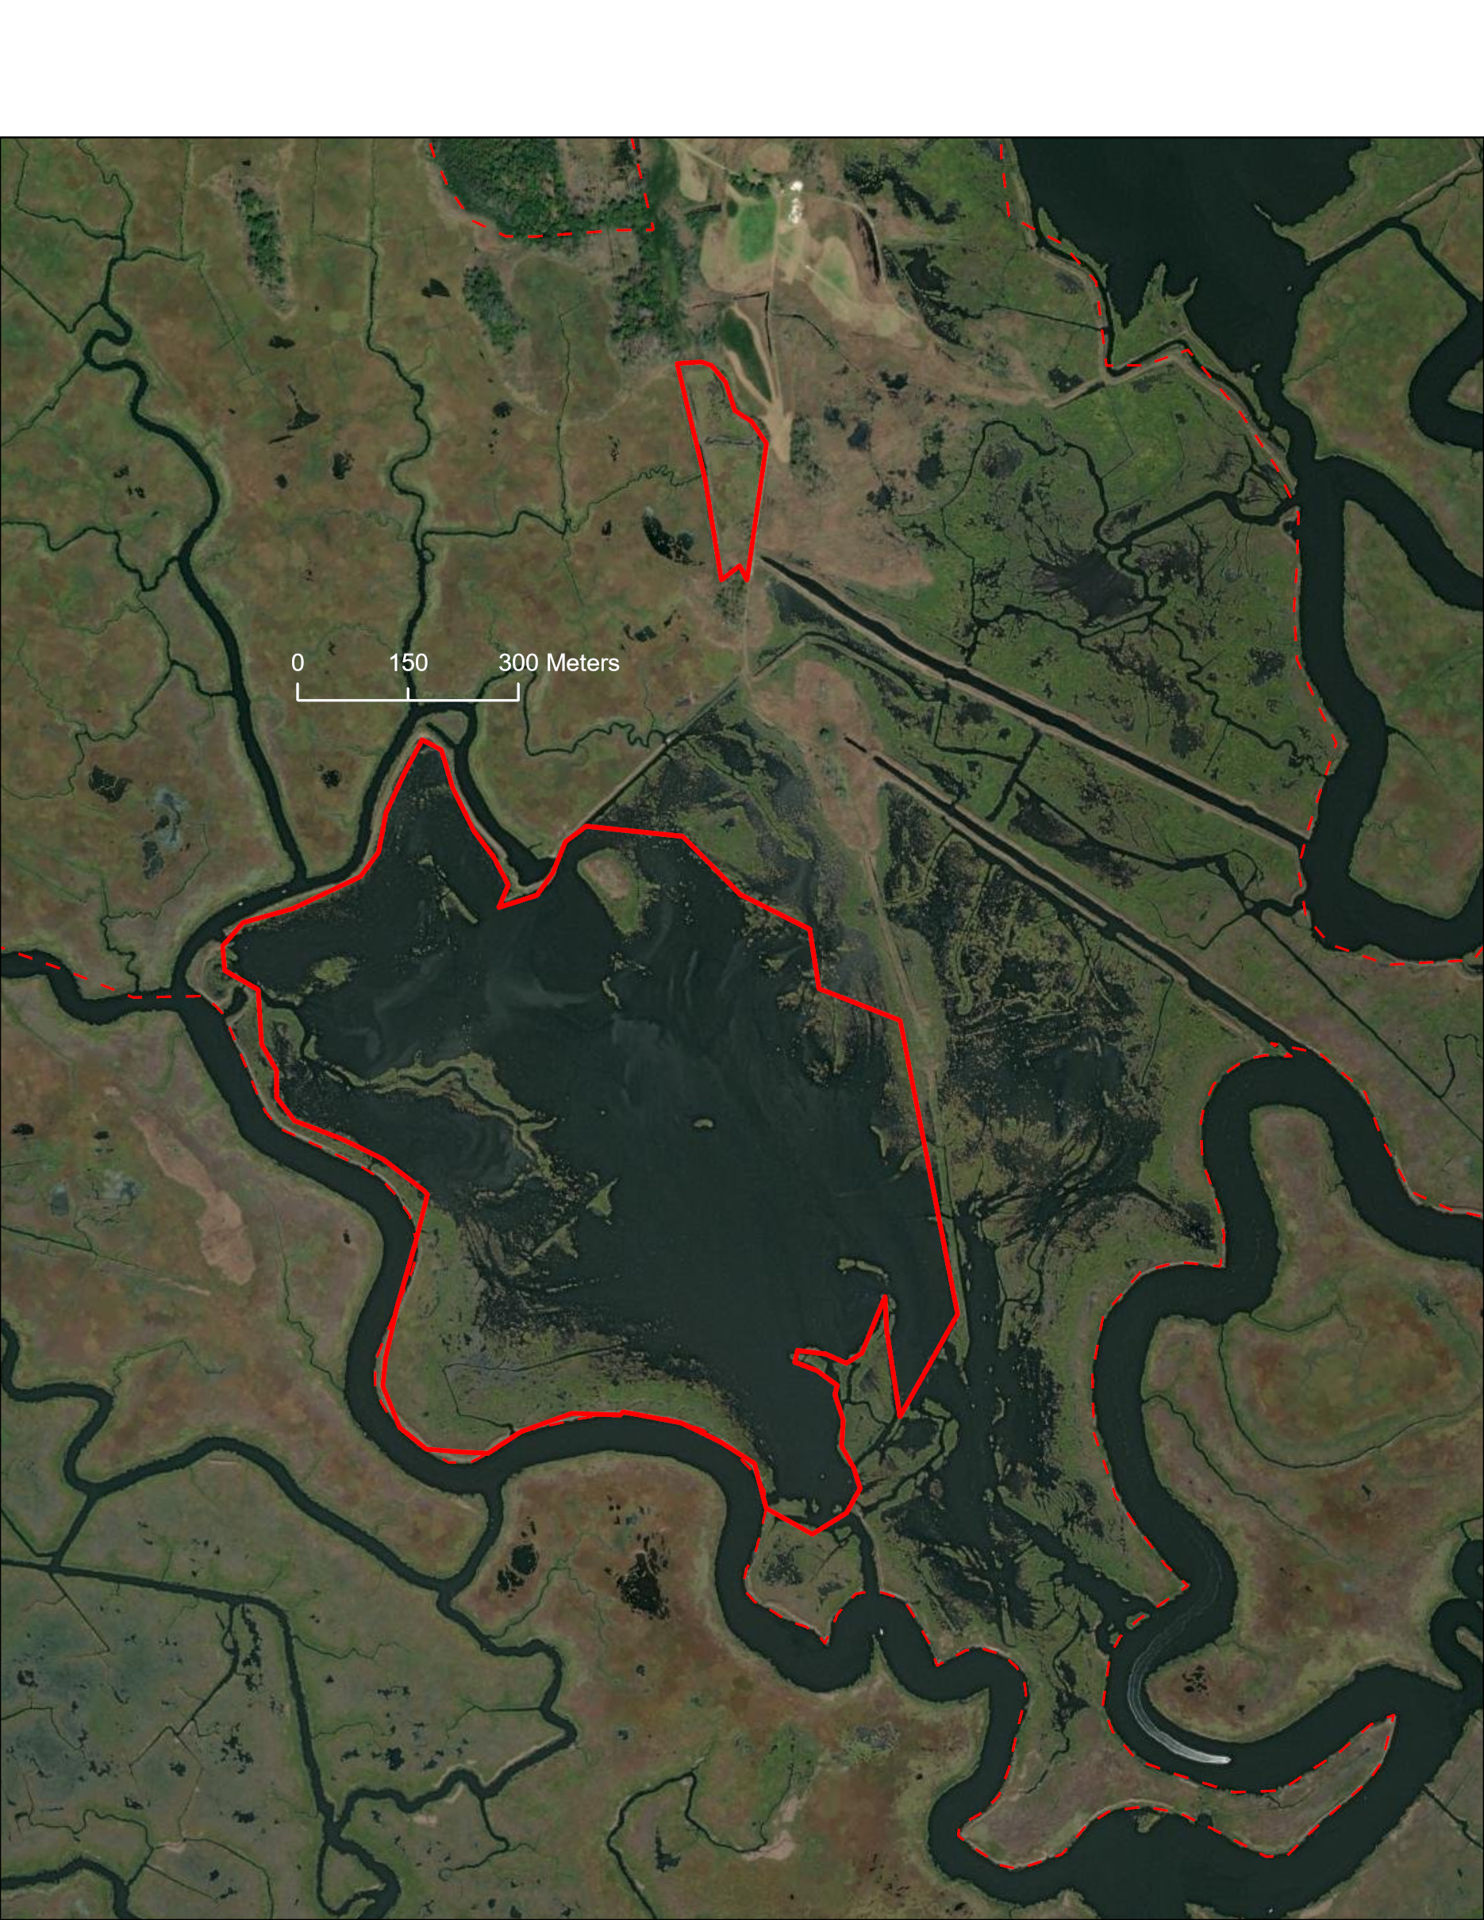
Dix WMA
Technique: Biodegradable and temporary structures
Bayshore mudflat sites, Cumberland and Cape May Counties, NJ
remnants of impounded marsh
intertidal
unstable edges
mobilized sediment and loss
vegetation struggling to reestablish
Nantuxent
Dix
Garrison
Dennis
Dennis Creek WMA
Nantuxent WMA
Natural Lands’ Garrison Tract

Slide 15
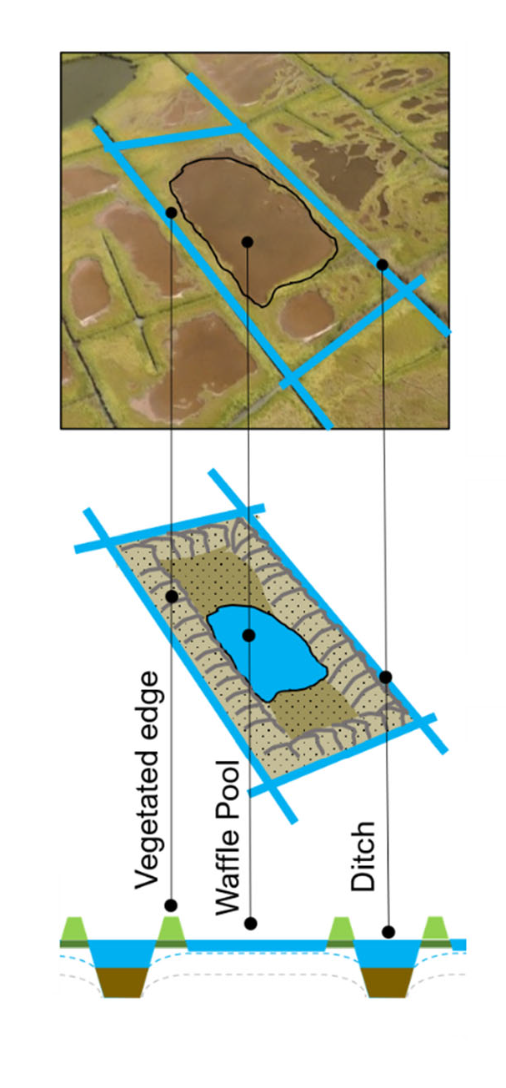
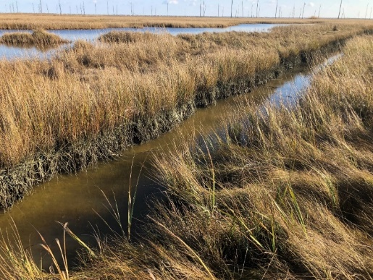
Ditches initially cause oxidation and loss of elevation -> higher water table and microberms lead to a hypersaturated marsh surface -> vegetation die-off, accretion lag, and pool formation -> pool expansion and merging of neighboring pools.
Technique: Runnels
functional intertidal channel
Water trapped on surface
Low berm allowing water to come in on flood tide but preventing water from leaving during ebb tide
Smith et al. (2021)

Slide 16
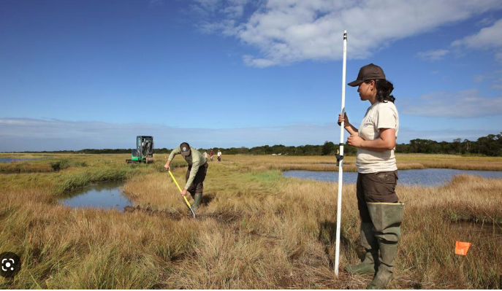
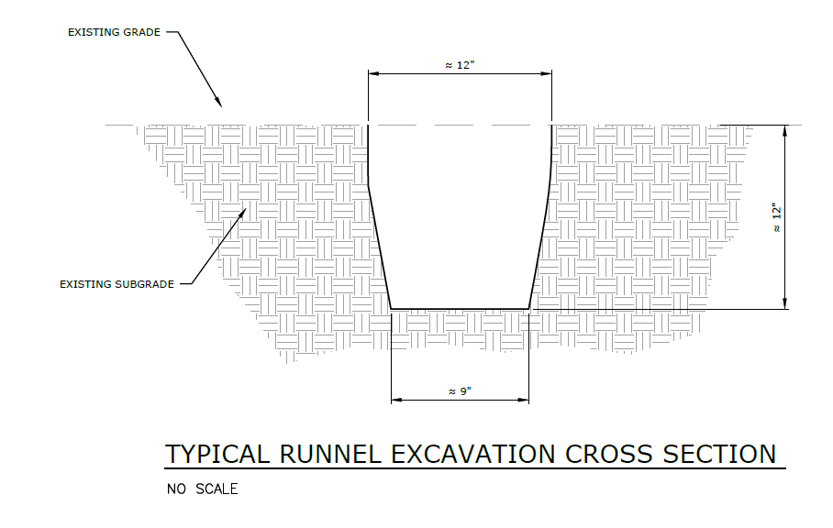


Technique: Runnels
Reconnecting saturated marsh to functional tidal channels
Reduces platform saturation or inundation
Reintroduces tidal cycle
Increases vegetation vigor
Allows revegetation
Great Marsh, Parker River NWR
Wenley Ferguson 2020
Rum Pointe, MD

Slide 17


Technique: Runnels
Great Marsh, Parker River NWR
AT&T Tract, EBF NWR, Manahawkin 2022

Slide 18




Technique: Runnels
Murderkill (Hall Tract), Milford Neck Wildlife Area, DE
1936
Murderkill
saturated areas but still with elevation capital

Slide 19




Technique: Ditch remediation
Natural tideshed
Strategic full or partial filling of sections of ditch to promote a more natural network of tidesheds and channels.
Decreases channel overlap
Increases channel efficiency
Grid ditching

Slide 20


Technique: Ditch remediation
Ditch remediation adds vegetation and elevation
Burdick et al. (2020): Mitigating the Legacy Effects of Ditching in a New England Salt Marsh

Slide 21



Technique: Ditch remediation
AT&T Tract
AT&T Tract, Edwin B. Forsythe NWR, Ocean County, NJ
long mosquito ditches draining towards multiple directions creating low energy ineffective channels

Slide 22


Technique: Ditch maintenance
Removing naturally formed ditch plugs to reopen select ditches
Restore tidal flow
Reduce impounded water
Reduce saturation of neighboring marsh
DU - Parker River NWR
Natural Ditch Plugs

Slide 23



Technique: Ditch maintenance
Mispillion Marine Reserve, DE
Mispillion
ditch ponding

Slide 24


Technique: Substrate and elevation enhancement with organic material
  Small-scale use of material to increase marsh platform elevation heterogeneity and substrate suitability to enhance marsh vegetation
Increase positive relief to restore flow off the marsh
Increase productivity
Increase habitat heterogeneity
????
Good Luck Point, EBF NWR

Slide 25




Technique: Substrate and elevation enhancement with organic material
Cedar Creek Tract, Milford Neck Wildlife Area, DE
Cedar Creek
low production
vegetation die-off

Slide 26

This is a partnership-based effort!
New Jersey Fish and Wildlife
Delaware Division of Fish and Wildlife
Partnership for the Delaware Estuary
Conserve Wildlife Foundation of New Jersey
National Fish and Wildlife Foundation
Hyfi
Enostat
Drexel University
National Wildlife Refuge System
The Nature Conservancy
Delaware Center for the Inland Bays
Lighthouse Center for Natural Resources Education
NJDEP Division of Science and Research
Coastal Technologies Corp
Delaware Mosquito Control Section
New Jersey Mosquito Control Commission
…and future partners

Slide 27

Kaity Ripple: kaitlyn_ripple@fws.gov
Brian Marsh: brian_marsh@fws.gov
Jim Feaga: jfeaga@ducks.org
Kaity Ripple/USFWS

