Slide 1
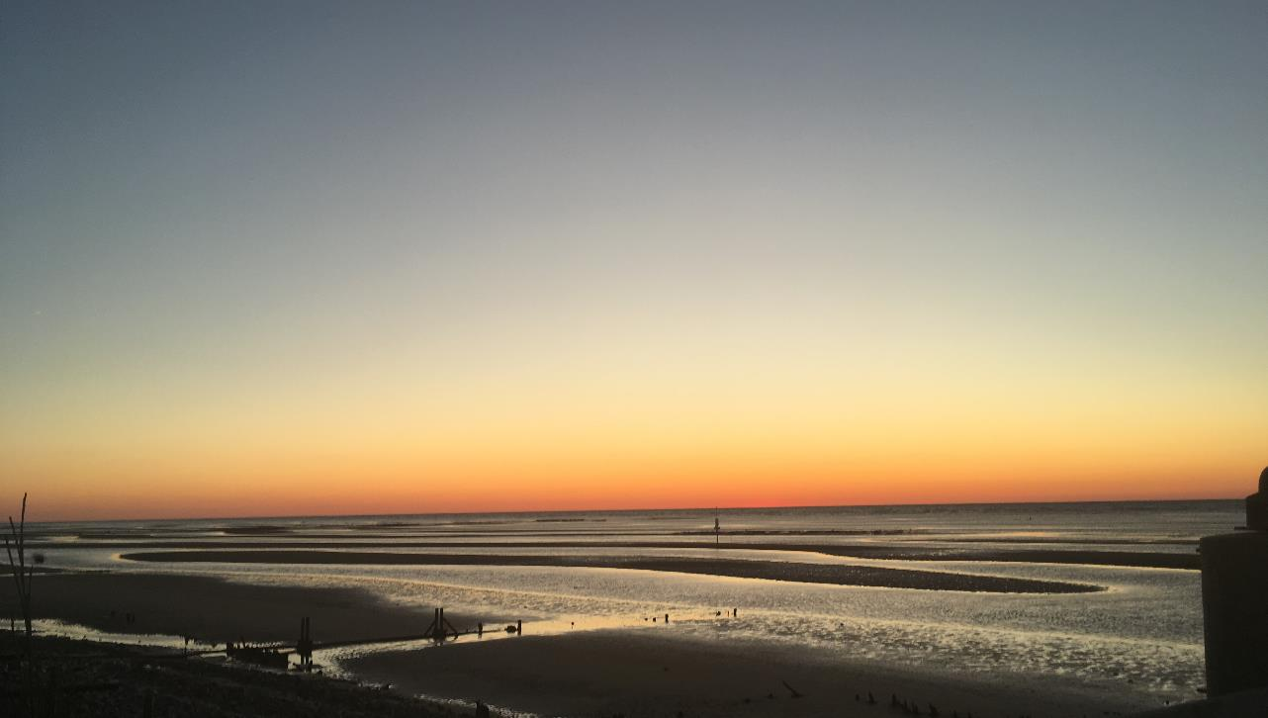
Stakeholder Engagement in New Jersey Ocean Acidification Mitigation and Adaptation Planning
2024 New Jersey Coastal & Climate Resilience Conference
- March 12, 2024 -
Janine Barr, Dr. Grace Saba, Jeanne Herb, Kirstin Wakefield,
Megan Rutkowski, and Robert Schuster

Slide 2
Overview
Driver of Stakeholder Engagement Process
Stakeholder Engagement Methods
Key Takeaways
Introduction
Engagement Methods
Takeaways
Notes:
Key takeaways – will cover some of the substantive feedback we heard from the stakeholders through the stakeholder engagement process, and some will be highlighting the methods that worked well to obtain such helpful feedback.

Slide 3
“Many coastal communities have commercial and recreational use of local waters incorporated in their economies and cultures at the foundational level. If OA depresses or drives the collapse of fisheries and negatively impacts environmental conditions to the point that it affects social and recreational activities (water quality, fish kills, human health, etc.), it could drastically re-write the state's economy, culture, and charm.”
-New Jersey OA Stakeholder, 2023

Slide 4
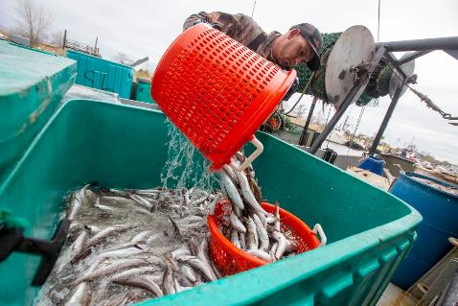
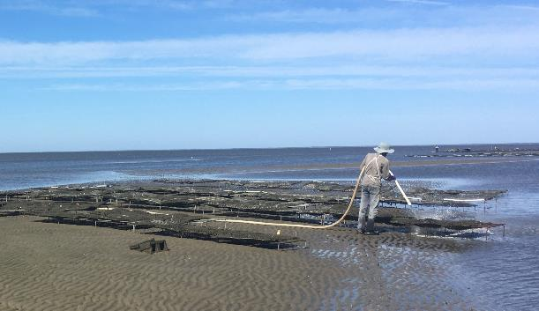
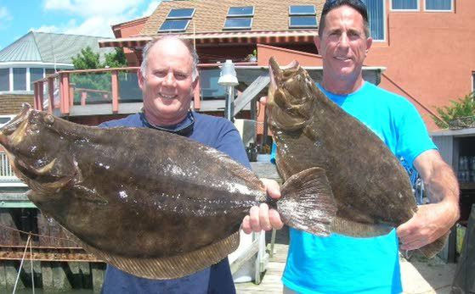
Mills – NJ.com
Economic and social connection to New Jersey coastal waters
2021 New Jersey Climate Change Resilience Strategy
2023 Stakeholder Engagement Process
Downbeach Buzz
Notes:
https://www.nj.com/news/2021/01/njs-sinking-fishing-industry-nabs-11m-life-raft-from-state.html – fishermen in Middletown, NJ dock in 2020.
https://downbeachbuzz.com/2021-nj-saltwater-recreational-fishing-limits-fluke-vs-flounder/ - recreational fishermen with their doormat summer flounder – one of the most popular fish to catch in Jersey for it’s mild, flakey white fish you can fry, bake and boil
------
New Jersey’s commercial fishing industry is the fifth largest in the United States and provides more than 50,000 jobs. This includes finfish like the Atlantic menhaden, summer and winter flounder, Atlantic herring and black sea bass….and shellfish like the Atlantic sea scallop, ocean quahog, Atlantic surf clam, blue crab, and Eastern oyster. There are also aquaculture operations along the coast of the state – like this picture of an oyster farm in the Delaware Bay on New Jersey’s southern coast. In addition to a booming commercial industry, there are more than 200,000 registered marine vessels in New Jersey with approximately 67% of these vessels used for fishing. Over 1.2 million recreational anglers are estimated to fish New Jersey’s marine waters each year. Commercial fishing, recreational fishing, and aquaculture contribute more than $2.5 billion annually to the state’s economy.
2021 Strategy – committed the State to developing an OA Action Plan to address OA impacts to fisheries, aquaculture, and ocean resilience.

Slide 5
Stakeholder Engagement Overview
Stakeholder Engagement Goals
Learn stakeholder concerns and priorities regarding the threat of OA
Use stakeholder input to inform elements and content of a statewide OA Action Plan
Three Elements of Success
Project team with range of expertise was crucial
Including decision makers in the stakeholder engagement process was beneficial
Engaging with stakeholders formally multiple times was helpful
Introduction
Engagement Methods
Takeaways
Notes:
….our guidelines to conduct this stakeholder engagement were that we aiming to identify ~15 stakeholders to engage and that we could hold up to three in-person or virtual meetings to obtain the input we needed.
I’ll walk you through these three elements of success in the next few slides…..

Slide 6
Project Team Experience
Regulatory and policy
New Jersey Department of Environmental Protection
Monitoring and science
Rutgers University
Mid-Atlantic Coastal Acidification Network (MACAN)
Mid-Atlantic Regional Association Coastal Ocean Observing System (MARACOOS)
Stakeholder engagement
Rutgers University
Introduction
Engagement Methods
Takeaways

Slide 7
Identifying Stakeholders
Academia
Coastal Advocacy & Restoration Groups
Coastal Management & Education Groups
Industry Members
Secondary Organizations
State Government
Federal Government

Slide 8
Identifying Stakeholders
Academia
Coastal Advocacy & Restoration Groups
“Stakeholders”
Coastal Management & Education Groups
Industry Members
Secondary Organizations
State Government
Federal Government
“Decision Makers”

Slide 9
Engagement Process
Readings
Workshop 1
Activity – "OA Basics" and background information
Homework – Survey on OA concerns and ranking exercise.
Workshop 2
Activity – Deep dive discussions
Homework – Identify goals to achieve in the next five-years
Workshop 3
Activity – Preview of recommendations and opportunity for final thoughts
Review of final report
Introduction
Engagement Methods
Takeaways

Slide 10
Overview of Stakeholder Input
Fishery-dependent communities are already living with remnant fisheries and want to be part of the solution to OA
Enhancing New Jersey’s monitoring network and conducting OA research is important and should not preclude taking OA mitigation actions now
Establish an OA Workgroup/Coordination Committee to serve as the primary communicator with the NJ Department of Environmental Protection and serve as a consulting body for future OA mitigation and adaptation decisions.
Introduction
Engagement Methods
Takeaways
Notes:
The “part of the solution” comes with the concern that their scientific credibility has been challenged in the past
Monitoring network notes: …..monitoring network should collects data on representative taxa and habitats. “representative” taxa and habitat here refers to the idea that while stakeholders agree that knowing every impact OA will have to each marine critter, plant, and habitat – there will never be enough funding for that.
Participants expressed concern that the establishment of an OA monitoring network and research efforts may preclude the State from taking immediate OA mitigation actions while those efforts spin up. Participants agreed there is sufficient existing data and knowledge about the negative impacts of OA, especially about the environmental conditions that could exacerbate OA, to take action now. Participants therefore agreed it would be valuable for an OA Action Plan to identify immediate actions that could be taken to mitigate the threat of OA in New Jersey waters.

Slide 11
Reflections on Methods
Successful Elements:
Daytime and evening sessions
Round robin introductions at start of meeting
Debriefing at start of each meeting
Verbal and written input opportunities
Parallel check-ins with State experts (NJ OA Team)
Stipend for stakeholders
Challenges:
Live surveys are difficult unless they are short
Time constraints on secondary organizations
Introduction
Engagement Methods
Takeaways
Notes:
Beyond the three elements of success discussed earlier in this presentation, I wanted to go into a bit more specificity on what worked and didn’t work for us…..

Slide 12
Janine Barr janine.barr@rutgers.edu Rutgers University Bloustein School of Planning and Public Policy Environmental Analysis and Communications Group

