Slide 1
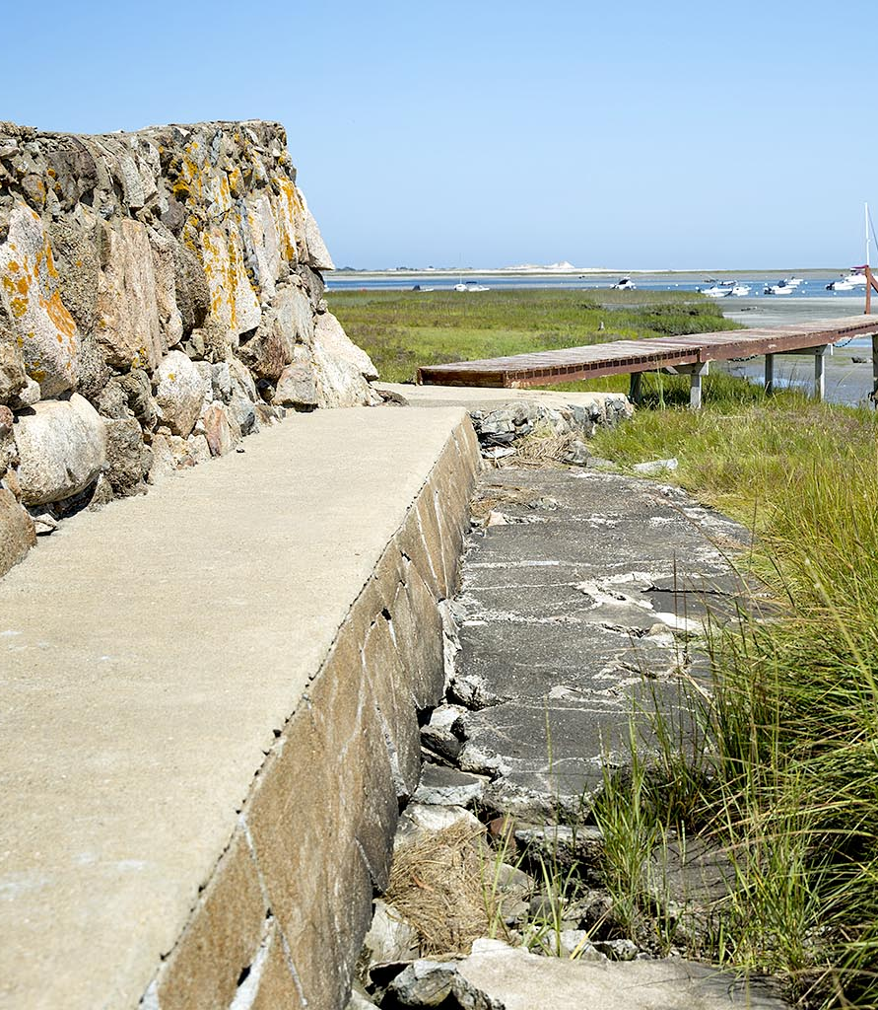
Optimized Desing Parameters of Hybrid Vegetation-Seawall Coastal Systems to Enhance Robustness and Flood Serviceability
Marsooli Research Lab
Stevens Institute of Technology
Dept. of Civil, Envir., and Ocean Eng., Hoboken, NJ
rmarsool@stevens.edu | www.marsooli.com
Reza Marsooli, PhD., Assistant Professor (Stevens Inst. of Tech.)
Erfan Amini, Graduate Research Assistant (Stevens Inst. of Tech.)
Bilal Ayyub, PhD., Professor (University of Maryland)
2024 NJ Coastal and Climate Resilience Conference, March 13
Credit: Robin Lubbock/WBUR (www.wbur.org)

Slide 2
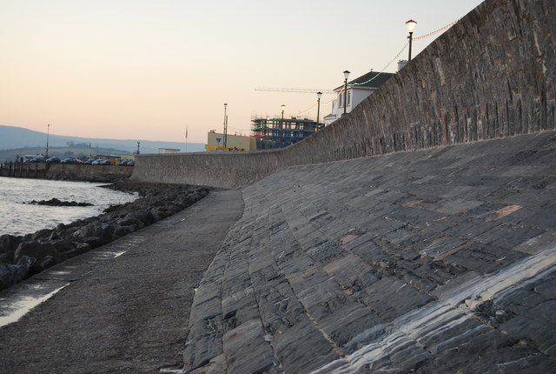
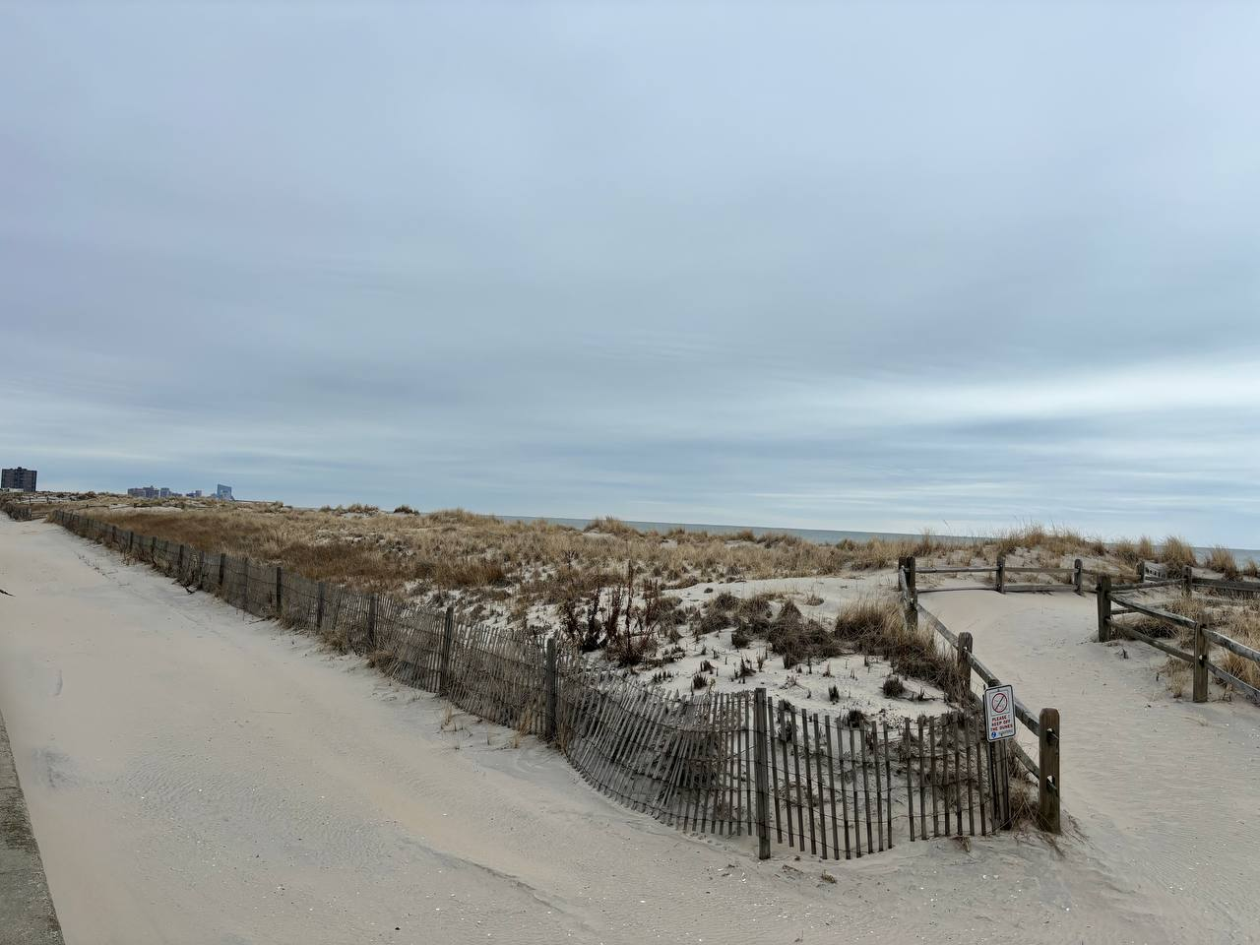
Motivations
Growing coastal flood hazards, and potential environmental impacts of gray (hard, engineering) solutions
Limited capacity of green (soft, natural, nature-based) solutions to mitigate hazards associated with extreme events
Ability of hybrid solutions to benefit from flood reduction benefits of both green and gray solutions and co-benefits of green solutions
Less established design methods for green and hybrid solutions compared to gray solutions (such as seawall)
This Photo by Unknown Author is licensed under CC BY-SA
Long Port, NJ, Jan 2024

Slide 3
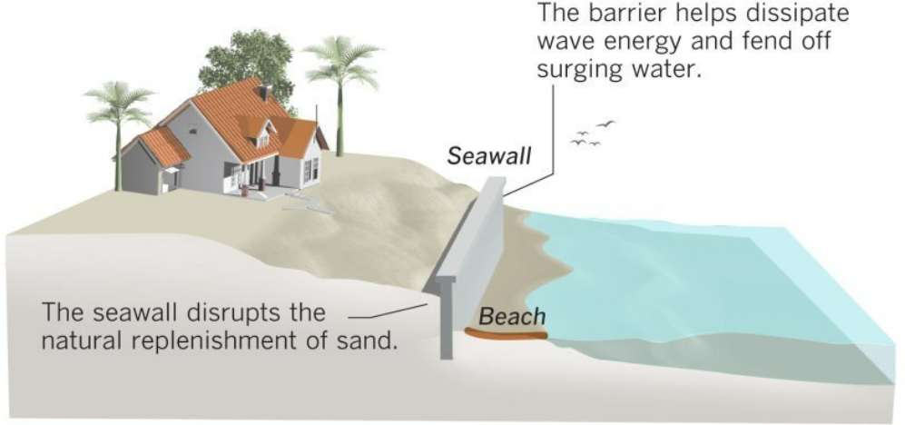
Project Goal and Objectives
Goal: to advance understanding of the flood reduction benefits of hybrid seawall-vegetation systems and to develop resilient-based design approaches for such systems.
Objectives:
Adopt and define practical metrics to quantify the robustness and flood serviceability of the system.
Assess the impact of environmental conditions and vegetation characteristics on the performance of the system.
Find the optimized vegetation characteristics to design effective and efficient hybrid seawall-vegetation systems.
Effect of vegetation?
Overtopping
Wave runup
Vegetation

Slide 4
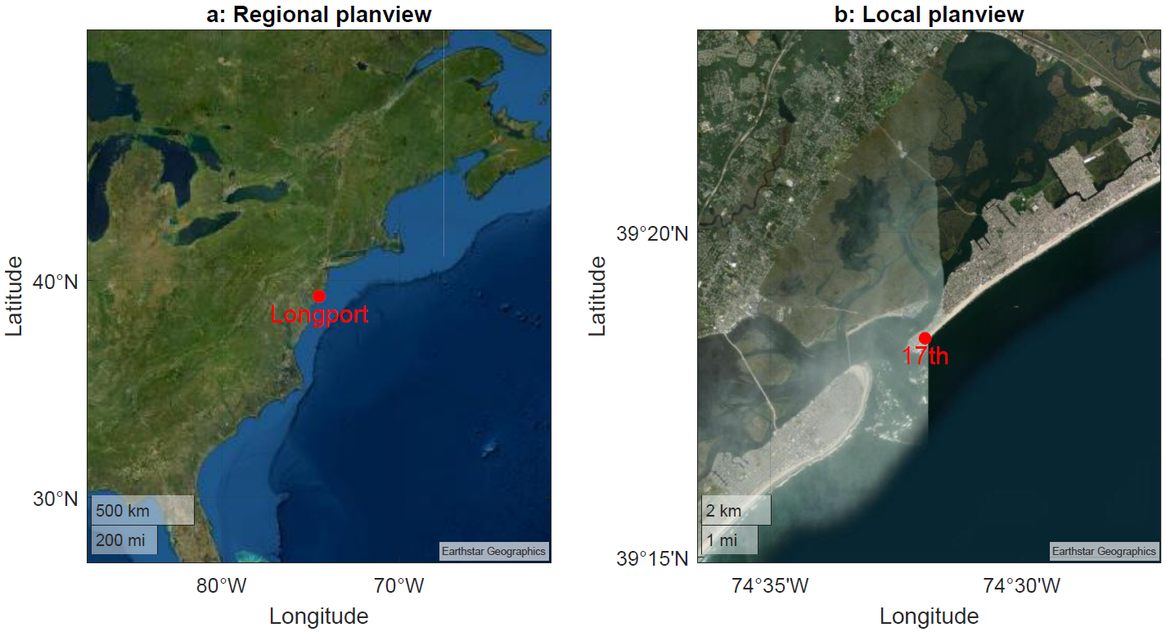
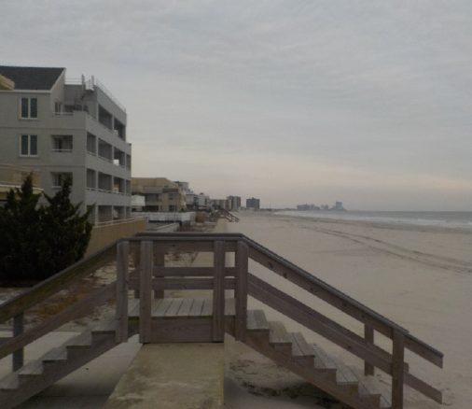
Case Study: 17th St. Longport, NJ –profile line# 126
- The beach profile is from the New Jersey Beach Profile Network (measurements from the Stockton University Coastal Research Center & NJ Department of Environmental Protection)
c: December 20, 2017
Atlantic
ocean
Atlantic
city
Ocean
city

Slide 5
Methods

Slide 6
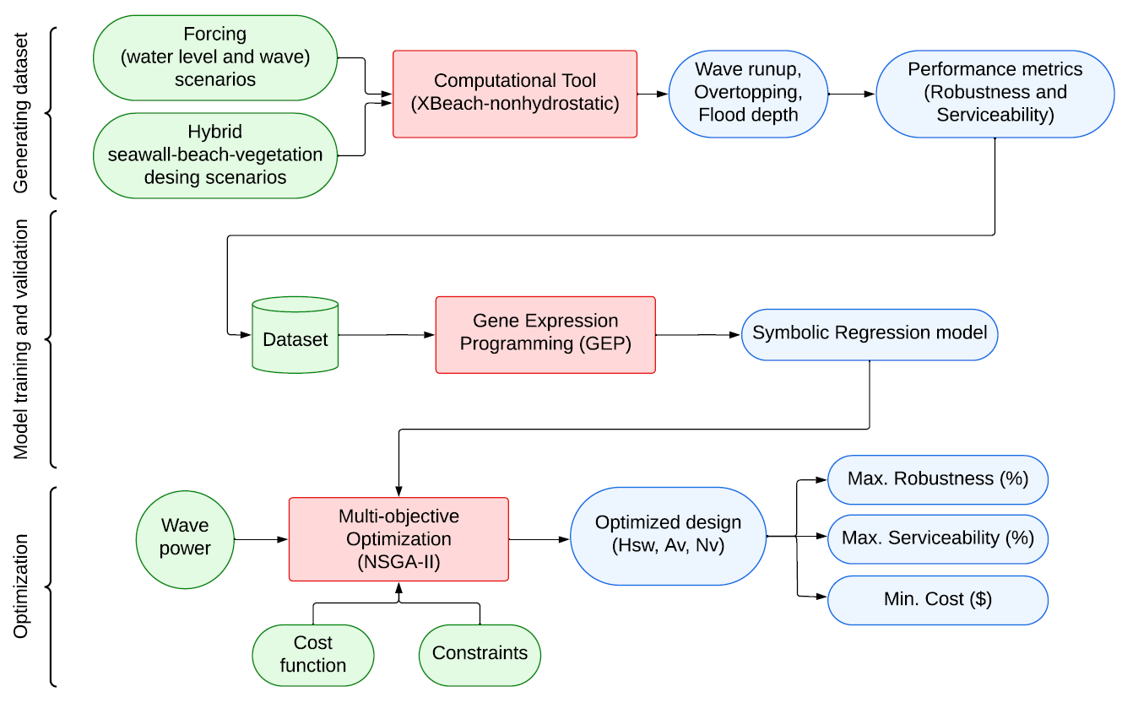
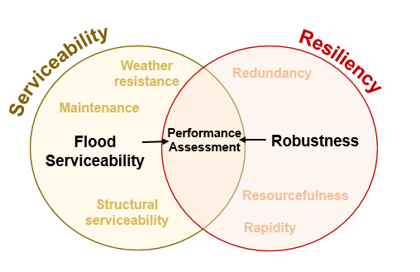
Framework
Performance Metrics

Slide 7
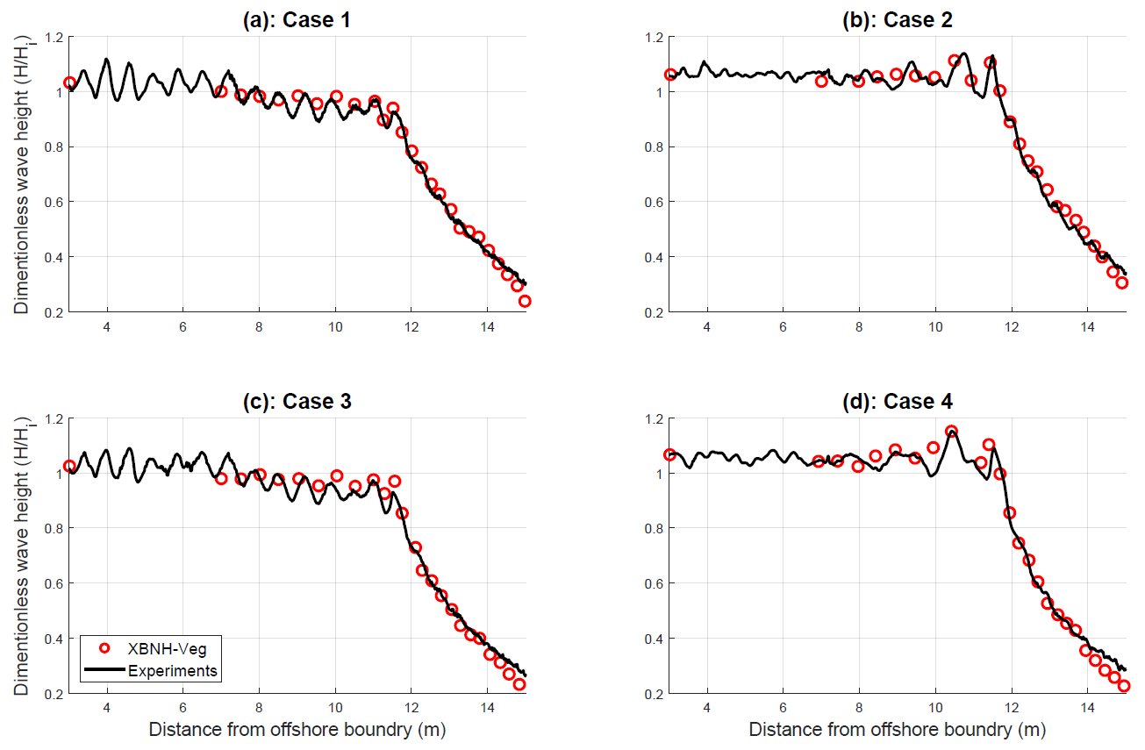
Dataset – Computational Tool
The XBeach-nonhydrostatic model is utilized for modeling wave runup and overtopping of seawall-vegetation systems.
Model validation against experimental datasets

Slide 8
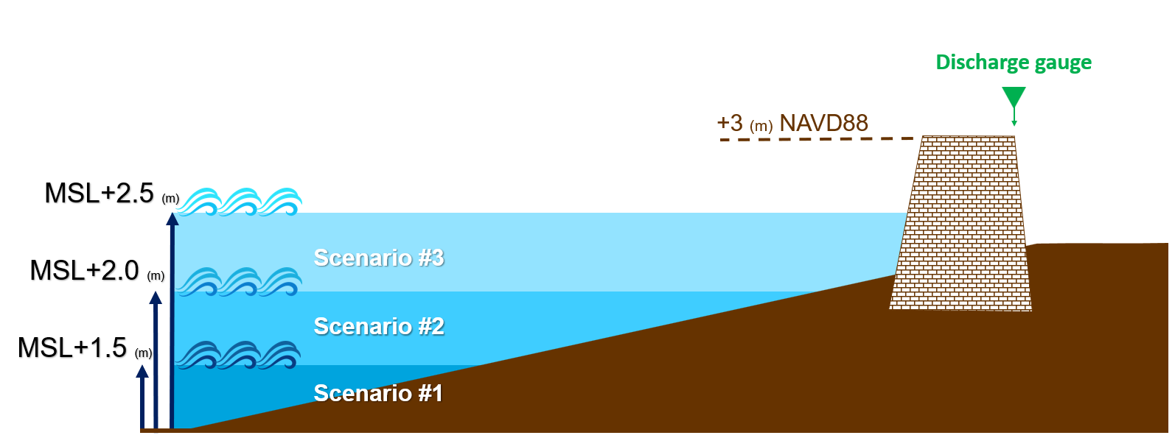
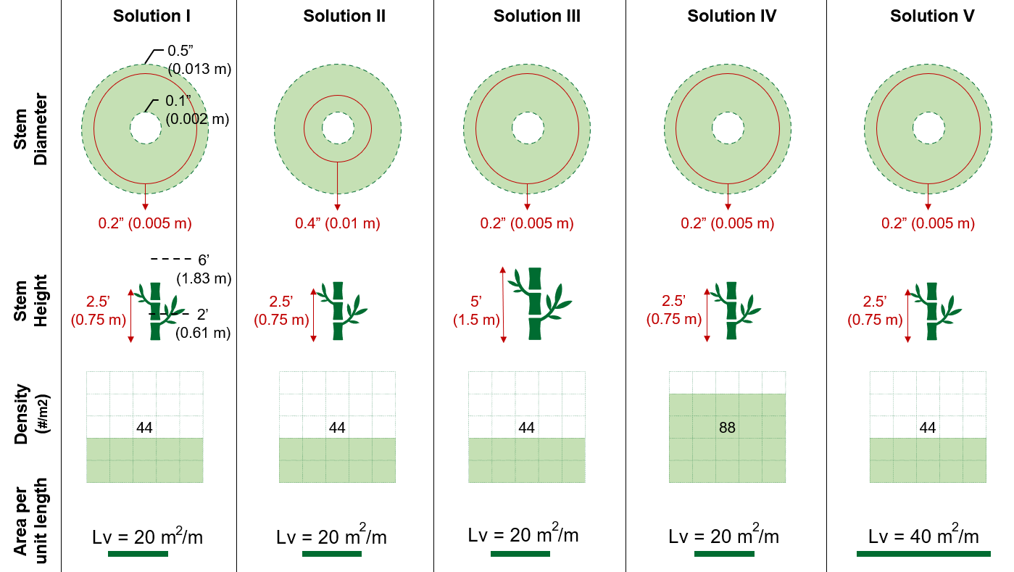
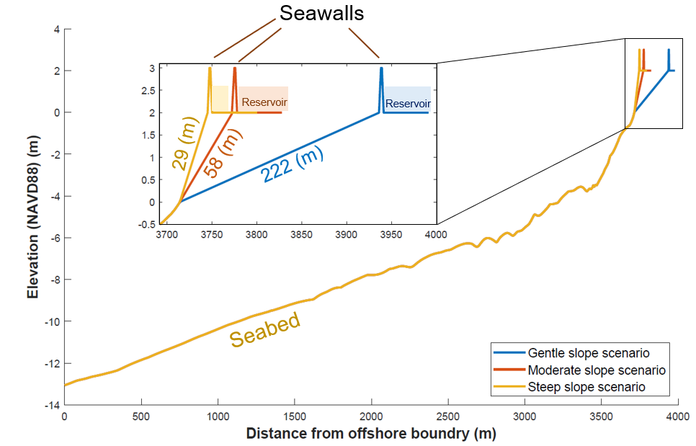
Dataset – Numerical Experiments Scenarios
Beach Slope Scenarios
5th, 50th, and 95th percentile of measured beach slopes are selected for numerical simulations.
Storm Tide & Wave Scenarios
Three storm tide scenarios.
A synthetic storm dataset (Marsooli et al. 2021) was used to select 50 wave scenarios.
Vegetation Scenarios
Based on the characteristics of spartina alterniflora, five scenarios of vegetation is defined, in which each characteristic was changed by doubled.

Slide 9
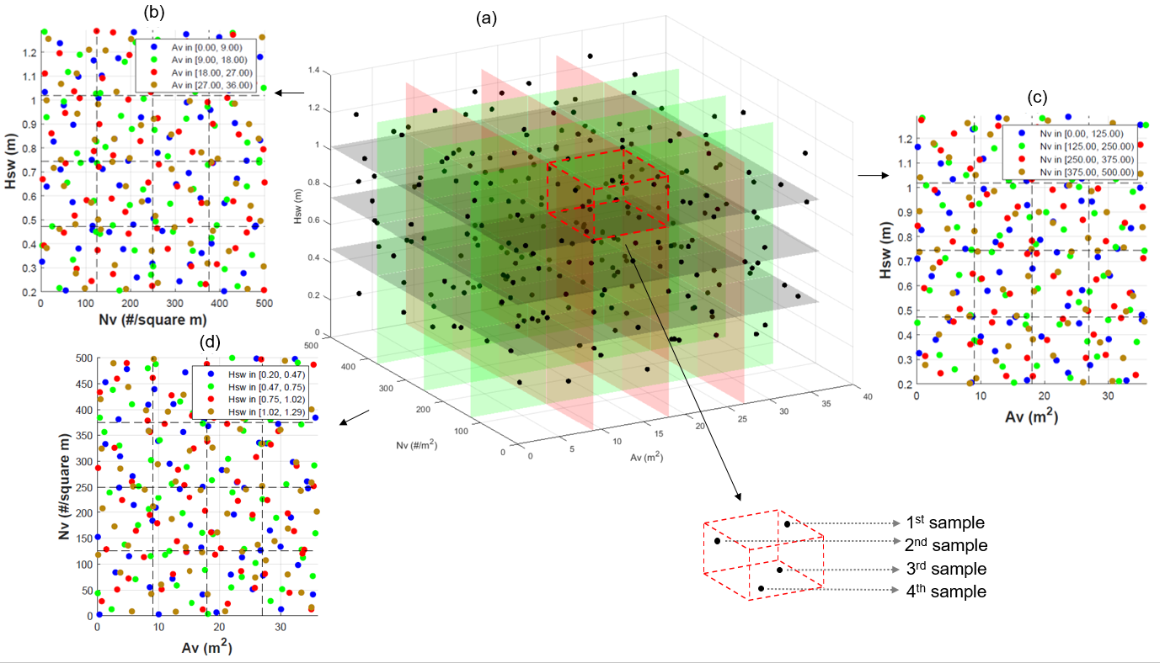
Dataset – Decision Variables and Sampling Space
Decision variables are vegetation area (A_{v}), vegetation density (N_{v}), seawall height (H_{sw})
The Full Factorial Experiment Design method is adopted, by dividing the feasible range for each variable into four equal levels.
The Latin Hypercube Sampling is used to sample scenarios for each of the four levels
3D Sampling Space

Slide 10
Dataset – Performance Metric (Robustness)
The system can maintain its functionality as long as the overtopping is not occurred.
The robustness of a seawall against a storm event can be quantified by normalized available dry height during the storm.
BFE

Slide 11
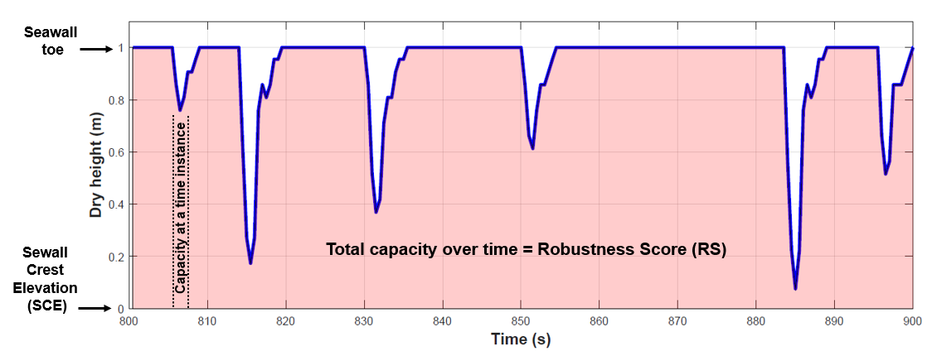
Dataset – Performance Metric (Robustness)
$$Robustness Score \left(RS\right)=\left\{\begin{matrix}0 & Runup≥SCE \\ \int_{t_{1}}^{t_{2}}{Dry height} & Runup<SCE\end{matrix}\right.$$
$$Robustness = \frac{RS}{∆T×Seawall height}×100\%$$

Slide 12
Dataset – Performance Metric (Serviceability)
When the flood level behind the seawall exceeds a threshold (e.g., BFE), the system is no longer capable of providing its intended flood protection, i.e., not serviceable.
BFE
BFE
BFE
BFE
BFE
BFE
$$Flood Serviceability=\left\{\begin{matrix}min{\left(\frac{BFE−Flood depth }{BFE}\right)}_{i}×100\% & before the total failure \\ 0 & after the total failure\end{matrix}\right.$$

Slide 13
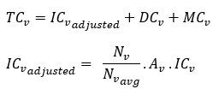
Optimization – Objectives and Constraints
Objectives and constraints: maximize robustness, minimize costs, and ensuring economically efficient and reliable designs (considering penalties for solutions with serviceability < 50%).
Cost analysis is based on the costs of the hybrid vegetation-seawall system using a methodology outlined in (Greenway et al., 2012) and data from 16 projects in Coastal New England, detailed in (CCRM, 2014).
Total Cost - seawall
Total Cost - vegetation
Total Cost - hybrid

Slide 14
Optimization – Algorithms
Train a Gene Expression Programming (GEP) tool for symbolic regression to predict model responses as a non-linear polynomial for untested inputs.
Non-dominated Sorting Genetic Algorithm II (NSGA-II) for multi-objective optimization.
Dataset
GEP
NSGA-II
Optimized Design

Slide 15
Results

Slide 16
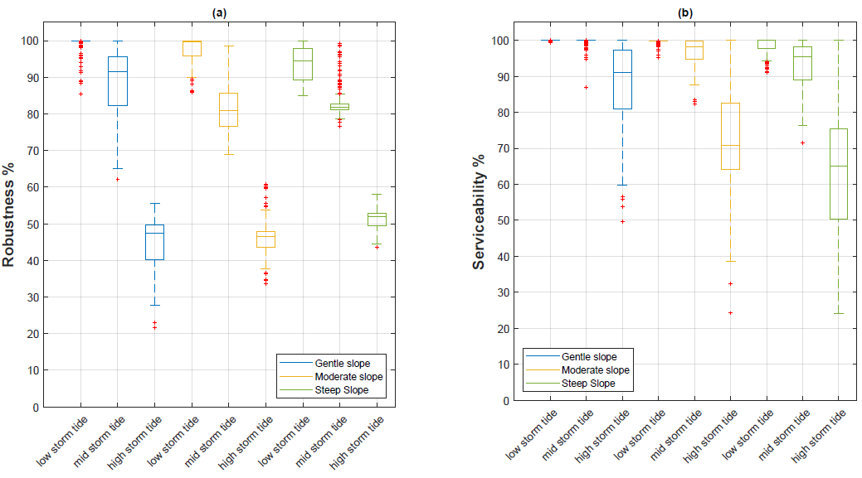
Effects of Beach Slope and Storm Tide
System’s robustness and serviceability are highly sensitive to storm tide across all cases, much more than the beach slope.

Slide 17
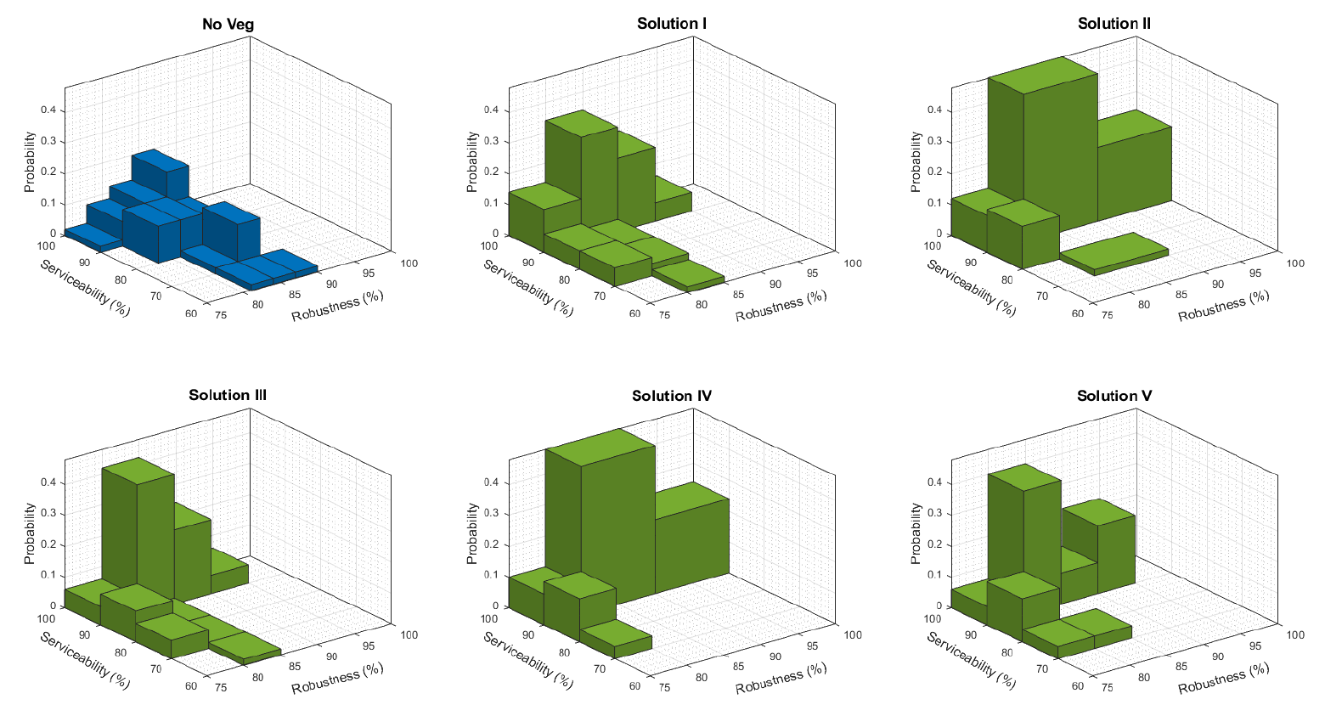
Effects of Vegetation Characteristics
Increasing the stem diameters (Solution II), or enhancing vegetation density (Solution IV), increases the probability of achieving larger robustness and serviceability.
Sol. I: Control scenario
Sol. II: Larger stem diameter
Sol. III: Taller stem height
Sol. IV: Higher density
Sol. V: Larger area

Slide 18
Optimized Combination of Features (Green/Grey)
The effect of the seawall is more pronounced on the overtopping and robustness of the system.
Increasing the vegetation height can boost the flood serviceability and limit the runup.
Seawall height
Vegetation characteristic

Slide 19
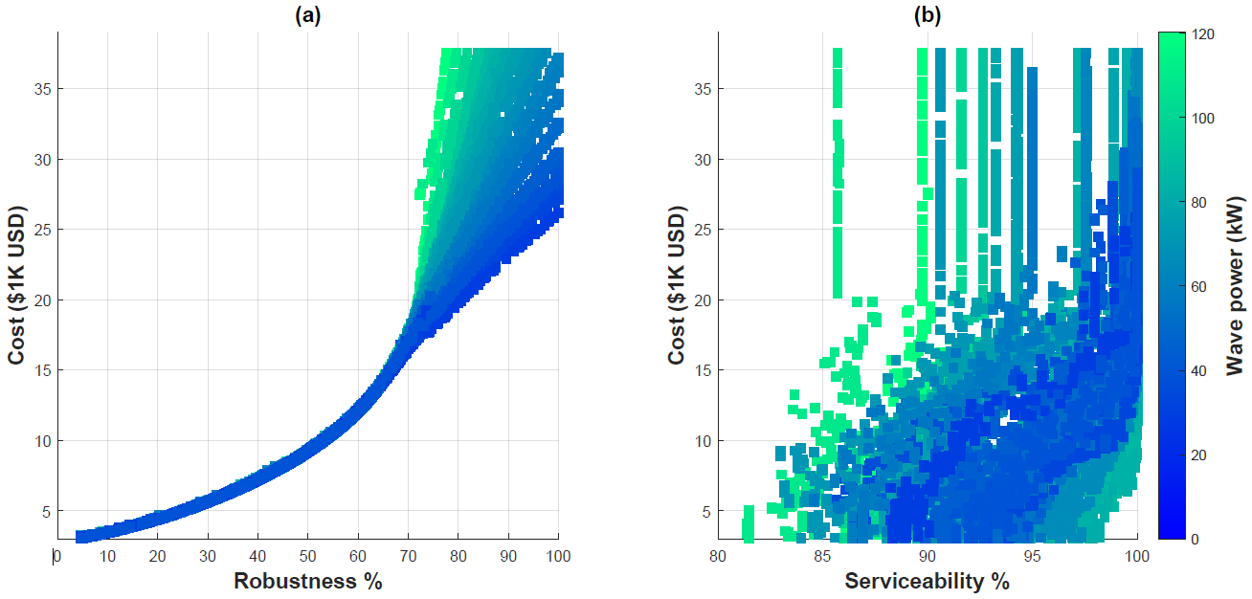
Optimized Combination of Features (Green/Grey)
There might be an optimum point for design where the maximum performance and minimum cost happens.
The algorithm finds the best solution (design parameters) to maximize the robustness while limiting the total cost.
Final design solutions are different per wave scenario, resulting in an optimized range for each variable.
Possible optimized design:
Hsw = 1 m
Av = 32 sm
Nv = 90 #/sm

Slide 20
Conclusion:
A multi-objective optimization algorithm integrated with proper system performance metrics can provide a powerful approach to designing effective and efficient hybrid systems for flood adaptation.
Suggestions for the future work:
Including beach erosion in the performance assessment using morphodynamic models.
Assess the effect of vegetation damage during extreme event on the system robustness and flood serviceability.

Slide 21
Thank you!
Acknowledgement
This project is funded, in part, by the US Coastal Research Program (USCRP) as administered by the US Army Corps of Engineers® (USACE), Department of Defense. The content of the information provided in this publication does not necessarily reflect the position or the policy of the government, and no official endorsement should be inferred. The authors acknowledge the USACE and USCRP's support of their effort to strengthen coastal academic programs and address coastal community needs in the United States.
Contract No. W912HZ22C0010

