Slide 1
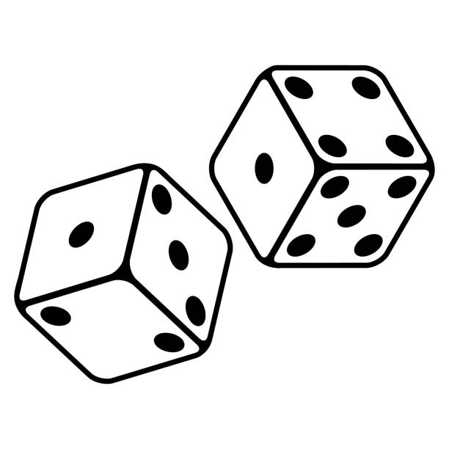
Megan Corby Monmouth University
Rolling Into Rounding
Understandings
Learned the importance of differentiating instruction – crucial in special education.
Learned how to accommodate for IEPs and make modifications – covered in our course.
Saw firsthand how support and accommodations/modifications give students the best chance at success.
Saw how the LRE that has been researched gives students the support they need and the best opportunity for education.
Impacts
Helped strengthened students’ math skills – specifically rounding skills.
Helped them build confidence in their abilities and knowledge.
Practiced their problem-solving skills and following procedures.
Future Goals
I plan to continue to grow by learning and implementing different accommodations and modifications –keeping informed gives me the best opportunity to help my students.
I want to continue working on effectively communicating with my students
Giving clear directions and clear explanations and reasonings for procedures
Growing more confident in my ability to teach and help students – I have seen myself do it, I should be confident I will find a way to help them.
Setting
Overview of Community
Long Branch
Monmouth County
Population: 31,734 (DataUSA 2021)
Poverty rate: 21.4.% (DataUSA 2021)
Citizenship rate : 83% (DataUSA 2021)
Race/ethnicity %: White: 56.8%, African American: 12%, Hispanic: 9.26%, Other Hispanic: 8.85%, and Two+: 4.57% (DataUSA 2021)
Overview of School
Amerigo A. Anastasia School
Grade Range: 1st Grade to 5th Grade
Number of students: 586 (USNews)
Student/Teacher Ratio: 10:1 (USNews)
# of male/# of female students: 49% Female (287) and 51% Male (299) (USNews)
Race/Ethnicity: 71.7% of students are considered minorities. 55.6% Hispanic/Latino, 28.3% White, 10.9% Black, 4.8% Two or More Races, 0.3% Asian/Pacific Islander (USNews)
Description of Students
3 male & 5 female students
All students have disabilities
Variety of disabilities including autism, mental processing delays, etc.
Various academics levels and abilities ranging from 1st math levels to 4th grade.
Course & Project
EDS330 Foundations of Special Education
Focused on math because it is an area of struggle for a few of our students.
Decided to create a set of rounding activities of various levels for students to work on with me every week and see how their understanding of the concept grew over time.
Role
Be a part of morning meetings where we went over daily schedule
Helped students at the carpet station – which became my station for implementing my project
Helped with some writing activities after math
Also helped with some other tasks like decorating bulletin boards
Overview of Classroom
Grade: Fifth Grade
Number of Students: 8
Reading/Math Programs: iReady Math and reading as well as Scholastic.
Contained Environment with a Special Education Teacher and an Instructional Specialist in the room
Desks at the front and back of the room.
Station rotations – small group table, desk activity, and carpet activity.
Technology: Individual Chromebooks

