Slide 1
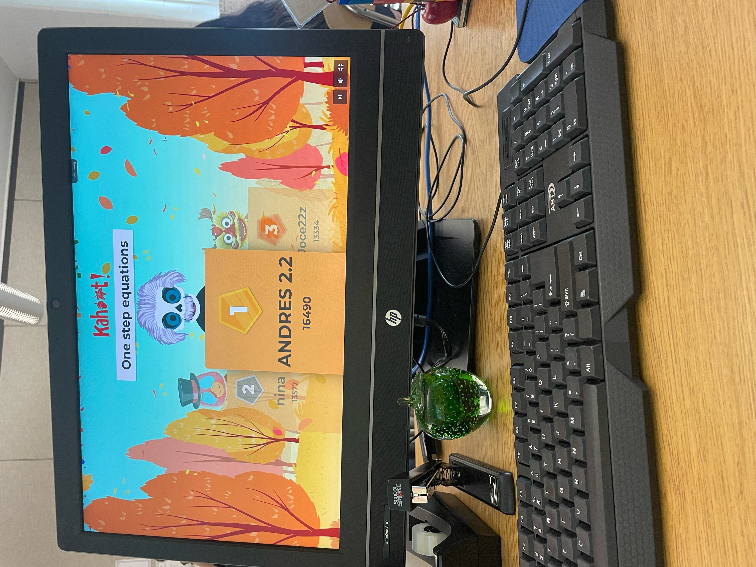
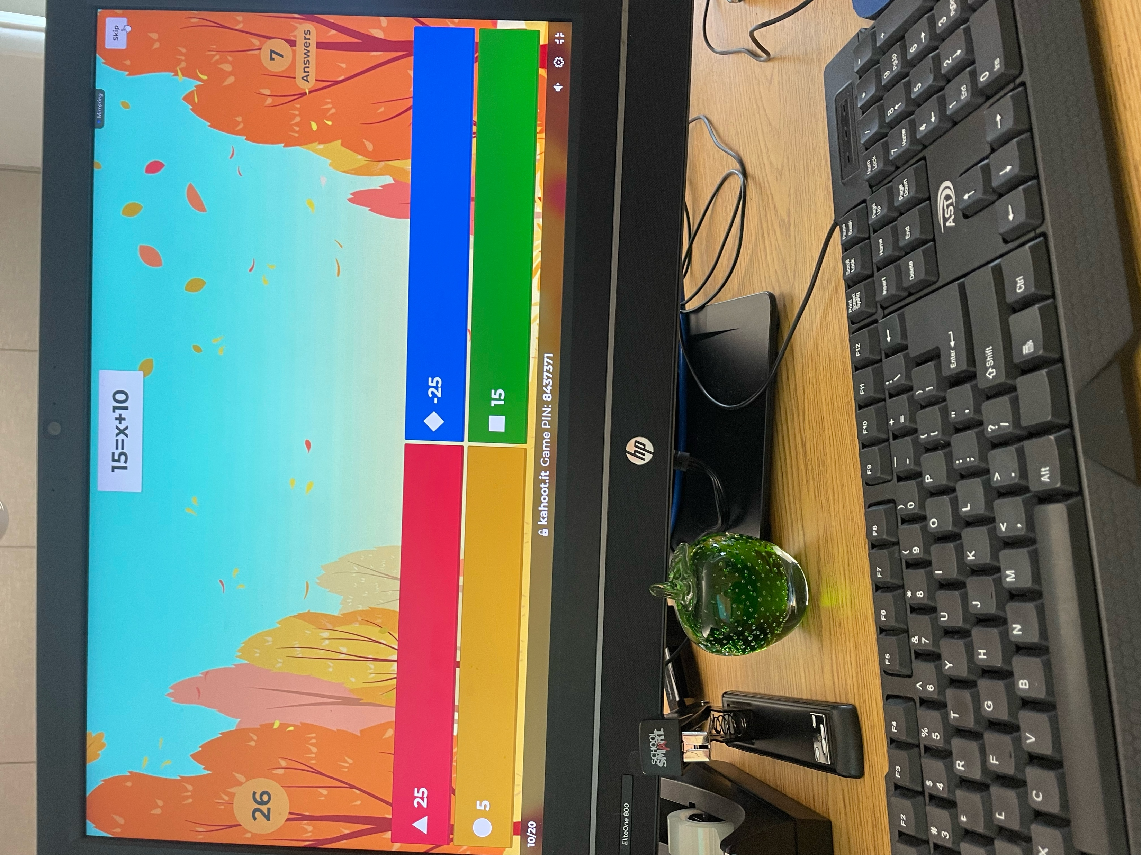
Kasey Sles Monmouth University
Description of Students
3 females, 6 males
9 students with disabilities
Some disabilities are autism, health impaired, communication impaired, and learning disabilities involving reading fluency and math calculation
Course & Project
EDS 330 (foundations of special education) in a 7th grade math class placement
For the project I created a math kahoot game that included previous material that they learned to prep them for state testing
Role
At the field site I acted as a role model and was able to give the students clarification and insight on what they were learning
Math Kahoot
Setting
Overview of Community
Long Branch NJ
Monmouth County
33,210 people (population review 2024)
The median household income is $98,215 and the poverty rate is 19% (population review 2024)
83% of the population are citizens (population review 2024)
64% of the population is white, 13% African American, 10% two or more races, 8% other, 2% Asian and 0.73% native American. (population review 2024)
Overview of School
Long Branch Middle School
6th-8th grade
1,028 students (niche 2024)
10 to 1 (niche 2024)
576 male students and 532 female students (niche 2024)
58% of students are Hispanic/Latino, 24% are white, 13% Black or African American, 3% two or more races and 0.5% Asian (niche 2024)
Overview of Classroom
7th Grade
9
iReady, Big Ideas, Kahoot
Tables consisting of 4-5 students per table
Chromebooks and smartboard
Understandings
My experience broadened my knowledge about teaching students with disabilities and how to support them and their individual needs.
Between observing the class, this project and learning the course content I’ve realized that equity over equality is most import in special education; it’s not about giving everyone the same education it’s about giving everyone access to the same opportunities.
Impacts
Not only did I act as a role model in my service learning, but I also made an impact through this project by making math fun and helping them review for their state testing
Future Goals
I plan on continuing to grow through my future service learning by pushing myself out of my comfort zone in the classroom and becoming more involved in students’ education.
Notes:
Watched them go through multiple chapters teacher mentioned state testing was coming up and she was a little nervous about the older chapters they learned
Perfect opportunity to help the students review before spring break
First lesson done by myself and very rewarding to watch students get the hang of it as the kahoot progressed and I provided them with some extra hints and supports along the way

