Slide 1
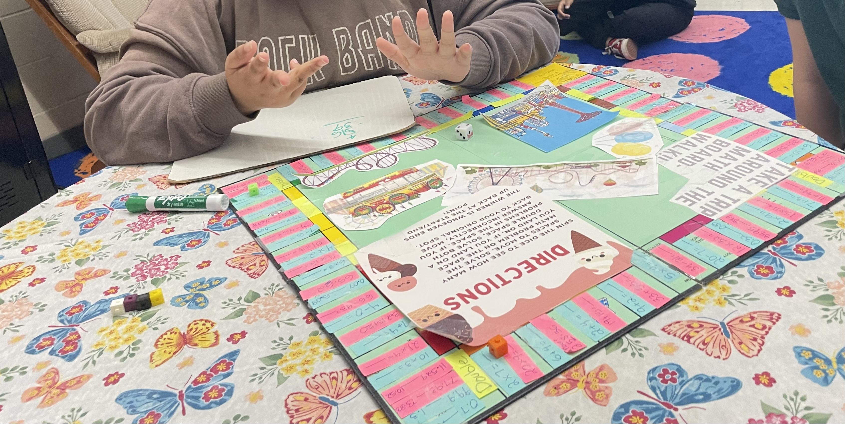
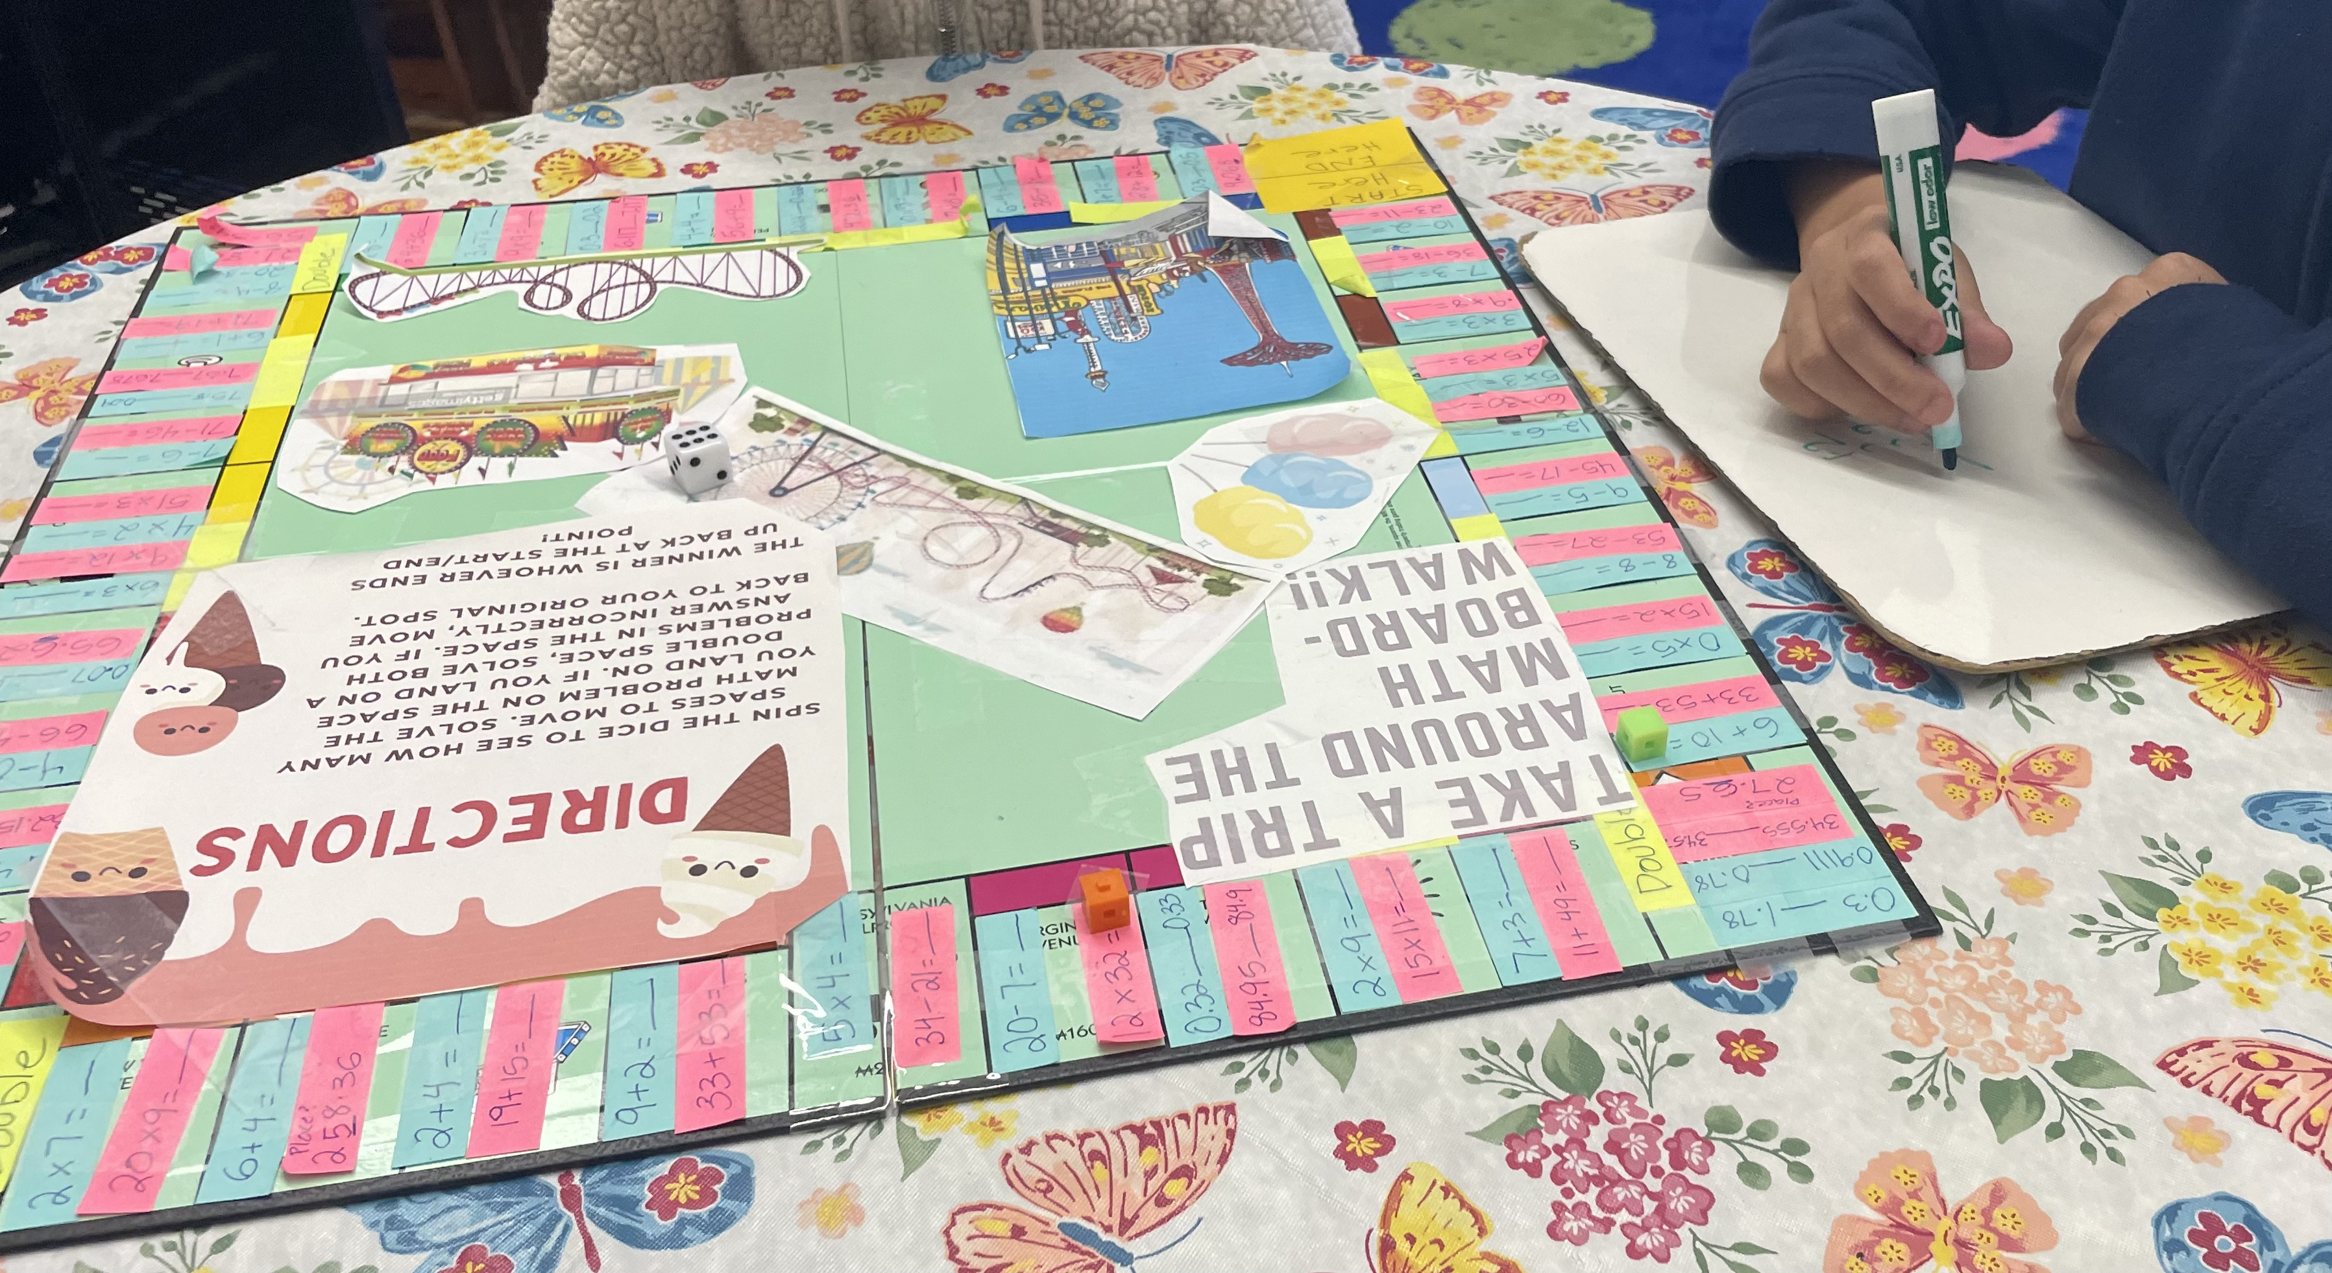
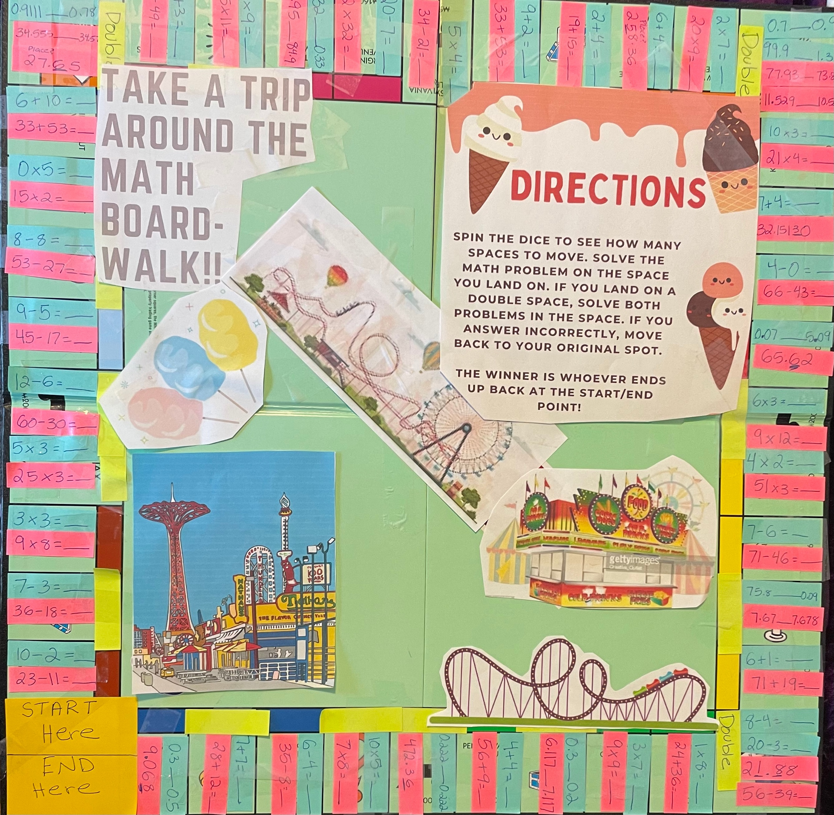
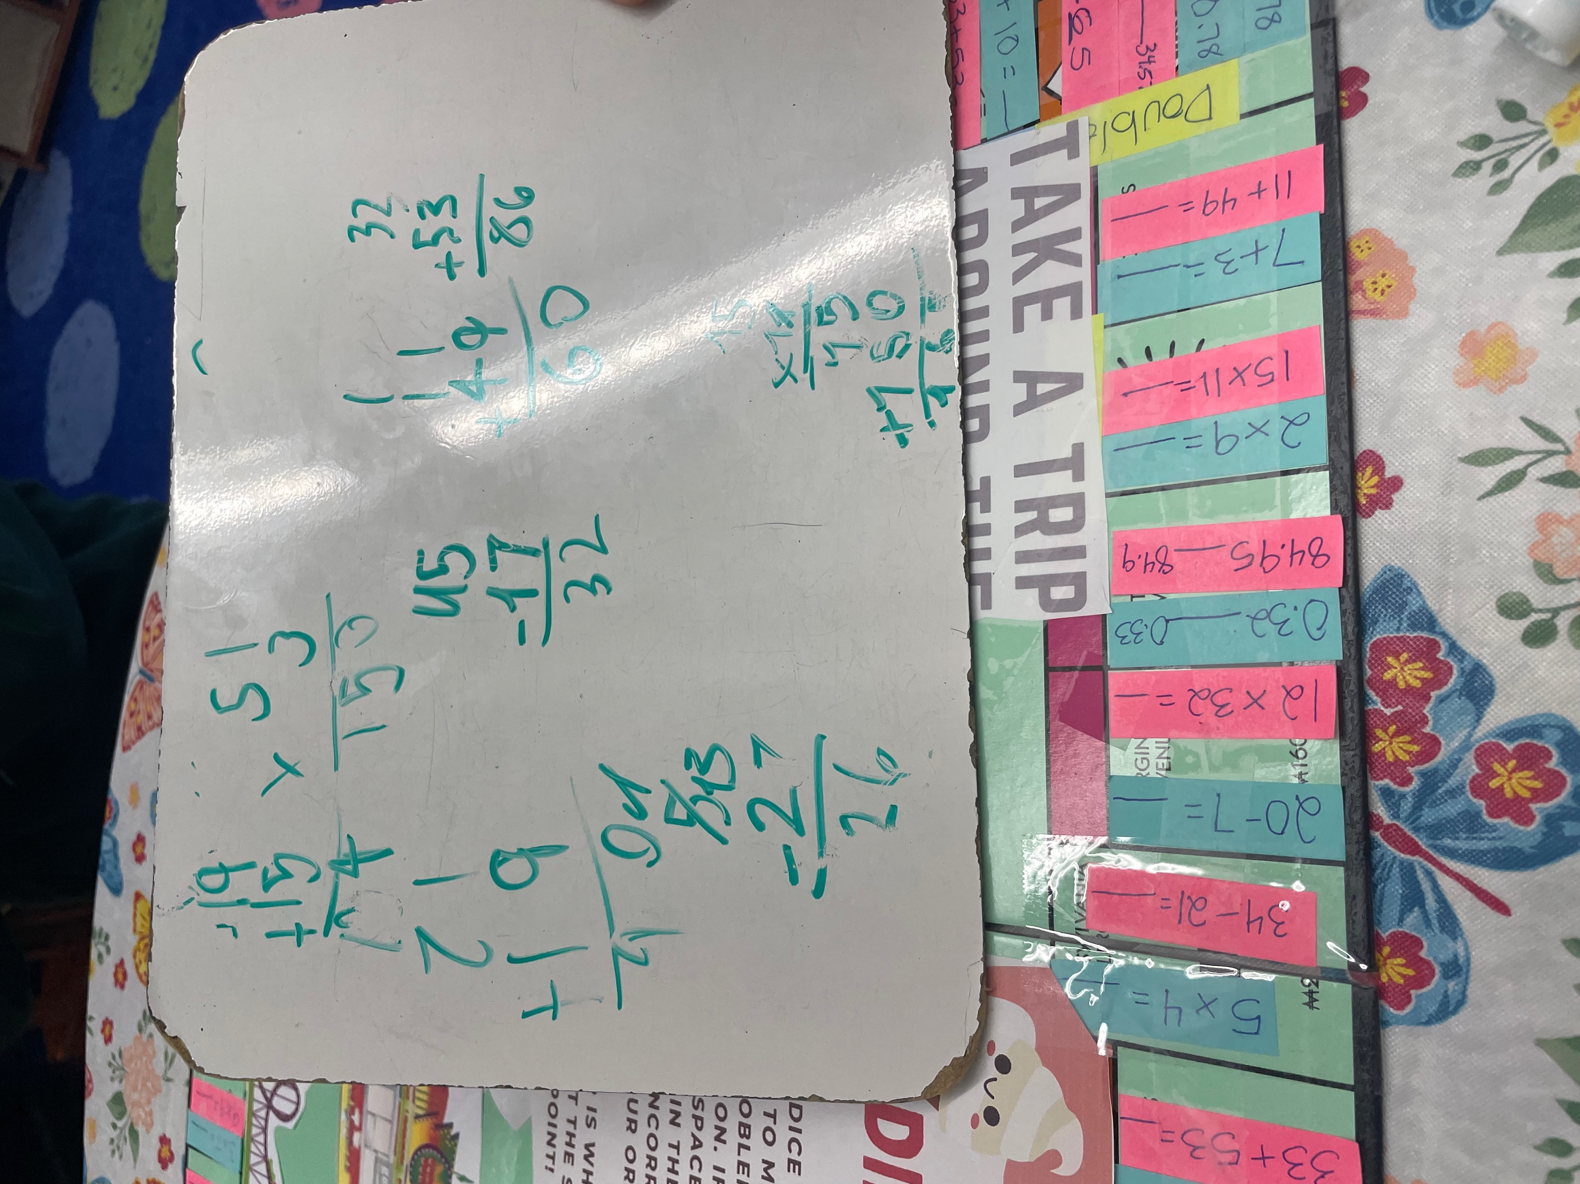
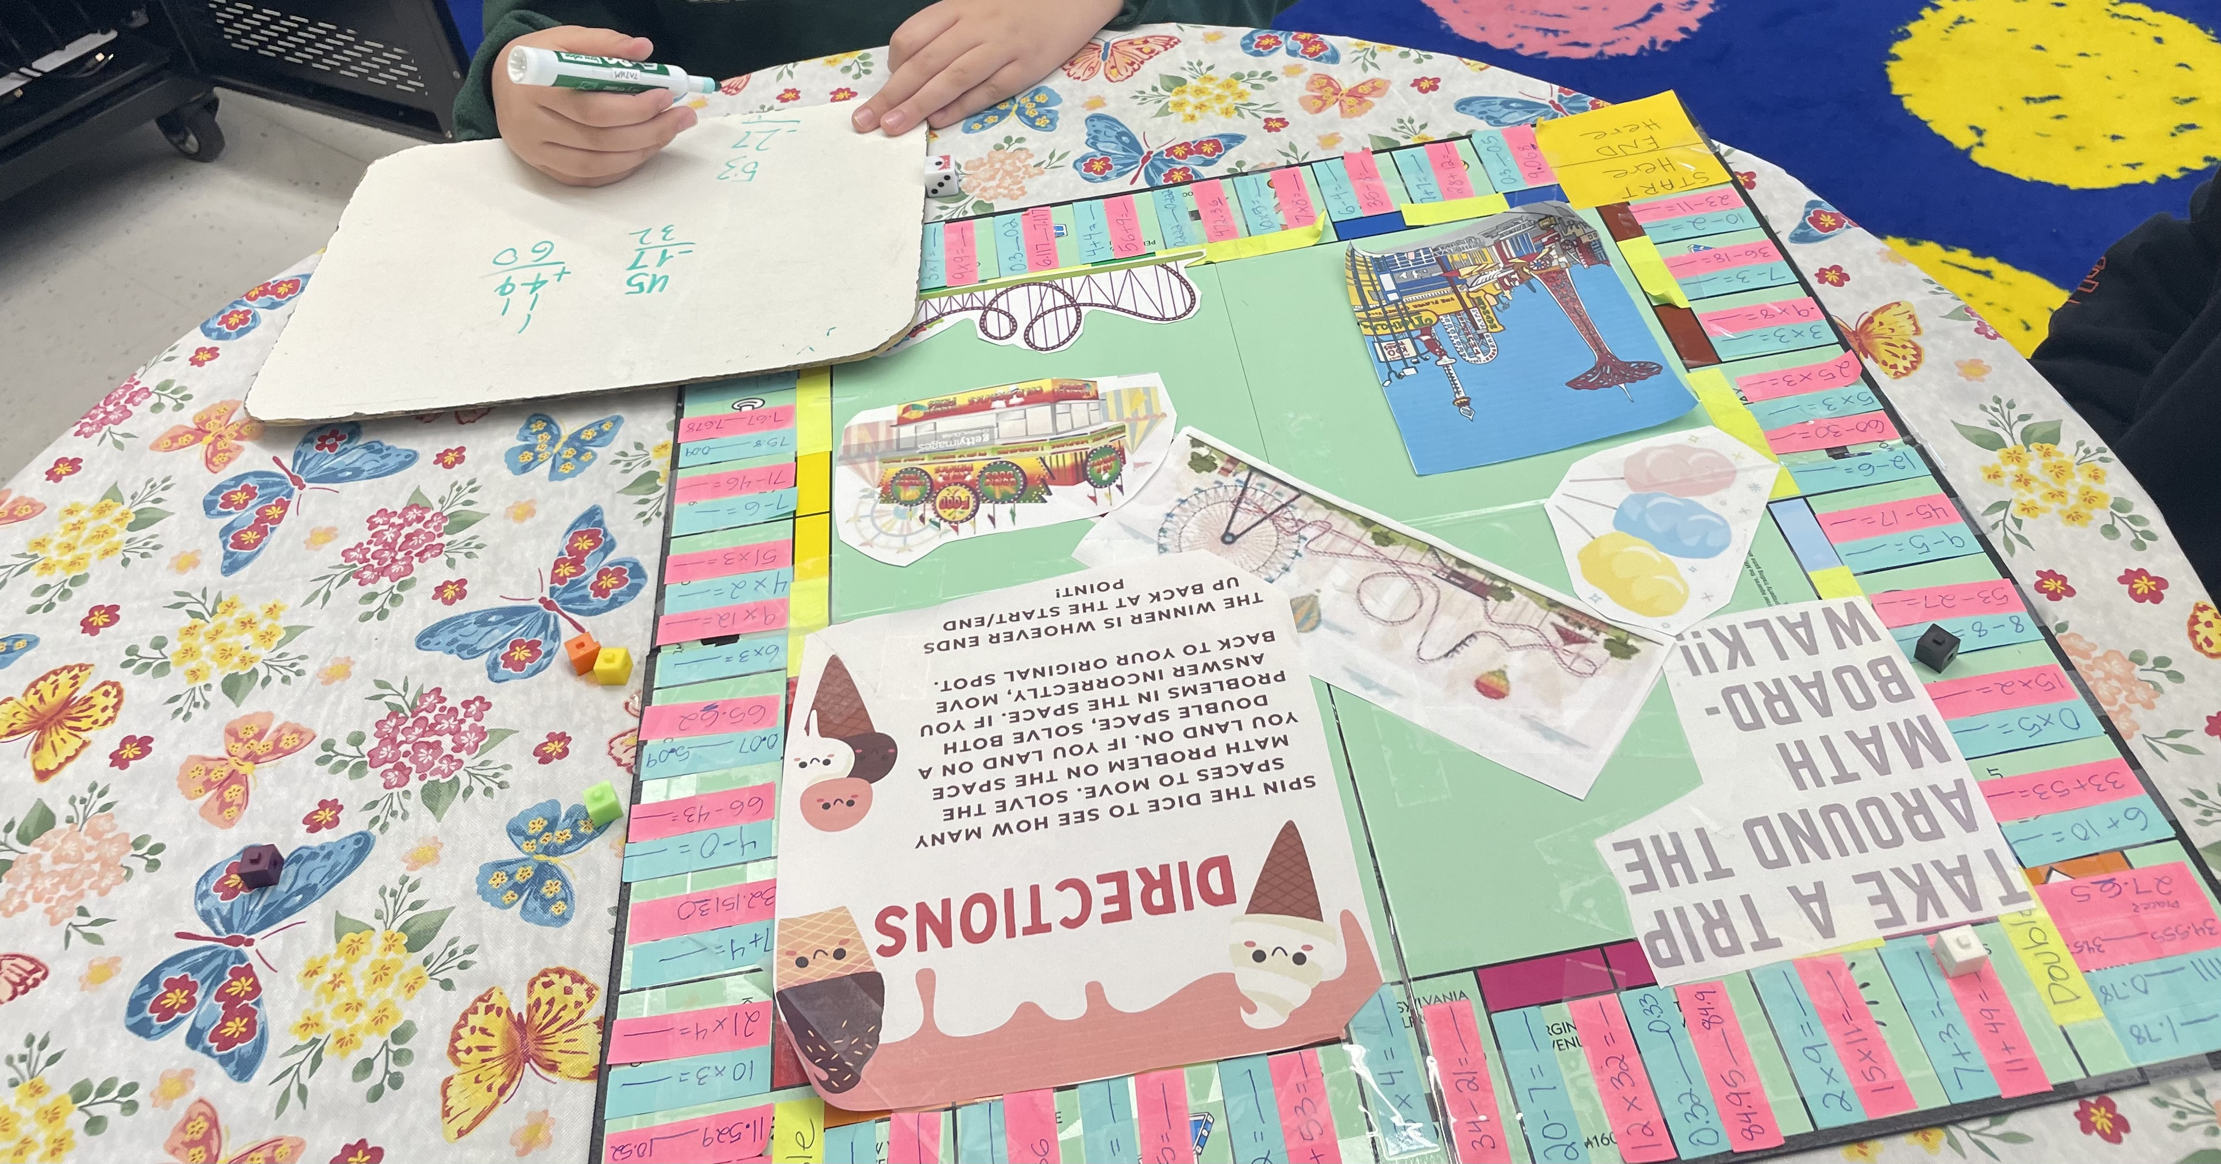
Kylie Roam Monmouth University
Description of Students
Number of male & females:
Male: 7
Females: 8
Number of students with disabilities
15 students (All).
Types of disabilities:
Autism
Learning Disabilities
Communication Impairments
ADHD
Math Boardgame
Setting
Course & Project
EDS 330 50: Foundations of Special Education
Project Details:
Math board game
Worked with Cooperating Teacher to create questions
Action Plan
Role
Group Instruction
Re-Teach instruction to small groups
Work with Students to complete assignments in groups
1-1 help
Help students on assignments after instruction
Redirect Students
Classroom Management
Overview of Community
Name of the town: Long Branch
County: Monmouth
Population: 32, 383 (2021)
Poverty rate: 65.3%
Enrollment Trends by Student Group:
Female: 48%
Male : 52%
Students with Disabilities: 12.6%
English Learners 32.6%
Homeless Students: 5.1%
Students in Foster Care: 0.2%
Migrant Students: 0.2%
Race/ethnicity %:
Hispanic: 62.1%
White: 22%
Black or African American: 12.2%
Asian: 0.6%
American Indian or Alaskan Native: 0.2%
Two or More Races: 2.9%
Overview of Classroom
Grade: 5th
Number of students:
Class A: 8 students
Class B: 7 Students
Reading/Math programs used:
Everyday Math
Read 180
System 44
Layout
Learning Centers
Science, Math, and Social Studies instruction
Two class groups transition and rotate throughout the day
Self-Contained Classroom.
Technology
Computers, Smartboards, online assignments, videos, and more
Overview of School
Name of School:
Amerigo A. Anastasia Elementary School
Grade ranges
Kindergarten – Fifth Grade
Number of students
561 students
Student/Teacher Ratio
10:1
# of male/# of female students
Female: 50%
Male: 50%
Race/ethnicity
Hispanic: 56.3%
White: 27.3%
Black or African American: 11.2%
Asian: 0.4%
Two or More Races: 4.8%
Student Demographics
Students with Disabilities: 20.7%
English Learners: 31.7%
Economically Disadvantaged: 67.7%
Understandings
What was learned during the experience?
Different needs of students
The importance of hands-on learning, interactive learning, and making learning fun.
How did this connect to your coursework?
All students have different needs, and you must provide modifications to assignments to meet those needs.
Characteristics of disabilities
Managing behaviors
How does this connect to the research in the field?
Importance of providing accommodations and modifications to students based on their needs.
Impacts
Helped cooperating teacher
Reinforced and helped teach instruction in math, science, and social studies.
Taught good sportsmanship
Future Goals
How do you plan to continue to grow based on your learning?
Continue gaining experience in special education classrooms as a paraprofessional
Continue research on:
working with students with disabilities
Characteristics of disabilities
Proper modifications and accommodations for students needs
References:
Data Commons Place Explorer. (2021). https://datacommons.org/place/geoId/3441310?utm_medium=explore&mprop=count&popt=Person&hl=en
New Jersey Performance Report : A A Anastasia Elementary School. (n.d.). https://rc.doe.state.nj.us/2021-2022/school/detail/25/2770/065/demographics?lang=EN
New Jersey School Performance Report. (2022). https://rc.doe.state.nj.us/2021-2022/district/summary/25/2770

