Slide 1
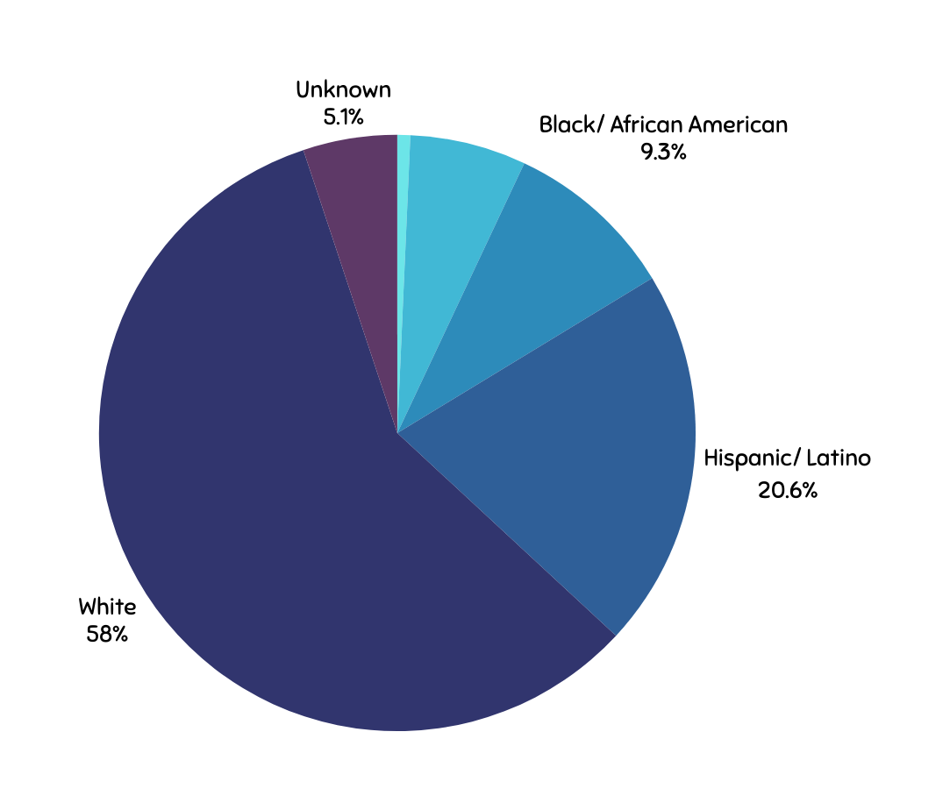
“HERE WILL GET YOU THERE”
Reflections Internship in Higher Education
01
IMPACT OF EXPERIENCE
“Interning at Brookdale Community College has broadened my view on student services. In this internship, I had the privilege of working with students of various ages, majors, and walks of life.
Brookdale accommodates every student no matter their educational journey. The Community College Opportunity Grant (CCOG) has helped me learn more about community outreach and utilizing school resources to help students. Many students are unaware of the available support systems and the services go underutilized. My team and I prioritized how to promote these opportunities to students while helping them manage their academic needs.”
“Interning at MONMOUTH UNIVERSITY in their EOF program helped me evolve my student mentorship and supervision practices. I primarily worked with students under their Academic Improvement Plan (AIP) initiative, to help students who fell under the program's required GPA of 2.5. While broadening my scope of student services at the university, I depended on my supervisor’s knowledge and seasoned skills. As her experience in working in multiple areas of student affairs at the university and her role as director, my supervisor was a great and qualified resource in our initiative to help assist students in their academic plan to improve their grades.”
Brookdale Community College
03
A 2-year institute of higher education.
Serving 20,000 students per year with associates and certificate programs.
This poster will describe the clinical reflections and experiences of a master’s student in the Educational Counseling program. This intern has completed her internship at Brookdale Community College as a Pathway Mentor and is currently at Monmouth Unversity as an EOF Advising Intern.
This role of a Pathway Mentor was created by the Office of Governmental Affairs & Community Relations and supervised by the director of Diversity and Inclusion. In this internship, the intern developed new skills and strategies for mentoring within the campus and out in the local community.
As an EOF advising Intern, the role required knowledge of both, the government-funded program and academic advising. The combination of the historical financial assistance grant also provides academic support, mentorship and funding for the awarded scholars.
Both internships involve bridging academic and financial assistance to create equitable opportunities for students. These internships required creating student retention initiatives for various student populations. In this role, knowledge of campus community services are helpful in providing wholistic care to students and their diverse needs. Implementing mentorship workshops, college transfer preparations, and one-on-one advising.
The counseling intern gained insights into the impact of quality supervision and mentorship on student success and discovered how they enhance engagement and retention by building interpersonal rapport.
* Enrollment data as of 2022 *
CCOG Pathway Mentor
04
Pathway Mentors will be designated to offer support to Brookdale students, with a particular focus on addressing the needs of students at regional locations.
Moreover, Pathway Mentors will be assigned to actively engage in community events and outreach initiatives during weekdays, evenings, and weekends, facilitating workshops and group sessions.
Monmouth University
02
4 year private institution of higher education.
Serving approximately 5,000 students, 3,800 undergrads and 1,100 graduates.
99% received financial aid.
About 98% got scholarships or grants.
Average scholarship/grant: $30,204.
Average aid package: $44,144.
Benefits of Mentorship
05
Guided pathways to desired goals, opportunities, and personal interests.
Partnership with the student to curate academic plans beyond their time at Brookdale.
Having positive engagements with students to support them and recommend supports needed.
Helping students optimize their capabilities by recommending extracurricular participation (i.e internships, clubs, sports, and research)
Creating programs and events to help student retention.
Equal Opportunity Fund Program
06
The New Jersey Educational Opportunity Fund (EOF) provides financial assistance and support services to students from disadvantaged backgrounds at eligible higher education institutions. Services include counseling, tutoring, and developmental coursework. EOF grants for undergraduates range from $200 to $3,050 annually based on financial need and institution type, with grants renewable contingent on continued eligibility.
(Raposa et al., 2021)
Quality of Supervision
Basic qualifications
Credentialing and experience
Employment status
Task expectations
Primacy of role
Coordination with university/college
Structure of internship
Student evaluation
Related literature
Brookdale Fast Facts - Brookdale Community College. Brookdale Community College -. (2023, January 5). https://www.brookdalecc.edu/about/about-the-college/brookdale-fast-facts/
Hinton, J., Smith, R., Allsop, J., & Lozano, D. L. V. (2023). Quality Internship Development and Supervision: Raising the Bar in Therapeutic Recreation Internships. Therapeutic Recreation Journal, 57(3), 256-270.
Monmouth University. (12AD). About. https://www.monmouth.edu/about/
Raposa, E. B., Hagler, M., Liu, D., & Rhodes, J. E. (2021). Predictors of close faculty−student relationships and mentorship in higher education: findings from the Gallup−Purdue Index. Annals of the New York Academy of Sciences, 1483(1), 36–49. https://doi-org.ezproxy.monmouth.edu/10.1111/nyas.14342
State of New Jersey, Office of the Secretary of Higher Education. (1996). Official site of the State of New Jersey. Office of the Secretary of Higher Education- EOF Eligibility. https://www.nj.gov/highereducation/EOF/EOF_Eligibility.shtml
(Hinton et al., 2023)
Author Faculty Advisor
Julia Krampah Dr. Alyson Pompeo-Fargnoli

