Slide 1
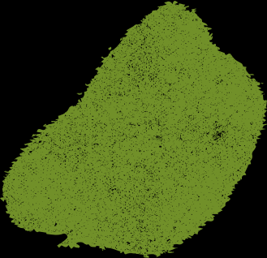






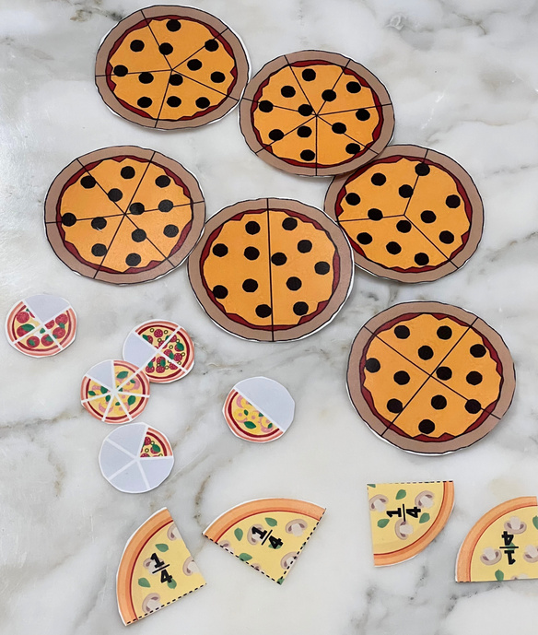
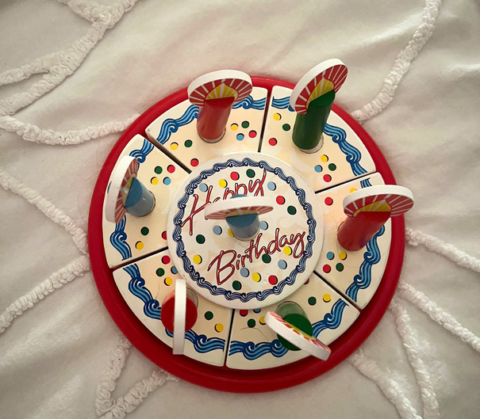



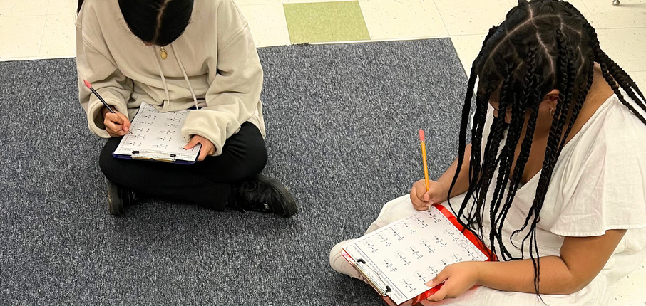



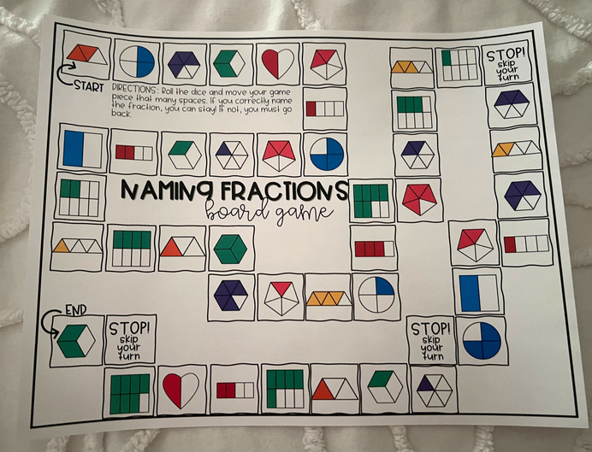




Engaging Activities for
Mastering Fractions
Setting
Overview of Community
Long Branch, New Jersey
Monmouth County
Population: 31, 734
Poverty Rate: 21.4%
Citizenship: 83%
Race/ethnicity: White (56.8%), Black or African American (12%), White (Hispanic): (9.26%), Other (Hispanic) (8.85%), and Two+ (Non-Hispanic) (4.57%)
(Data USA, 2021)
Overview of School
Amerigo A. Anastasia Elementary
Serves K-5
Student Population: 586 students
Student/Teacher Ratio: 10:1
Male to Female students: 51%, 49%
Race/ethnicity: 71.7%. Minority Enrollment... Hispanic/Latino: (55.6%, White (28.3%), Black or African American (10.9%), Two or more races (4.8%), Asian or Asian/Pacific Islander (0.3%)
(U.S. News & World Report)
Data is based on the 2020-2021 and 2021-2022 school years
Overview of Classroom
Grade: 5
Number of students: 15 - She sees two groups of students a day. The first group has 8 students and the second group has 7.
Reading/Math programs used: Everyday Math, Read 160, System 44
Layout: There is a teacher's desk and an instructional aid's desk nearby. Student desks are set up in pairs for collaboration, with two designated spots for carpet time. The walls are decorated with lots of student work displayed proudly.
Technology: The classroom is equipped with a projector and screen and chromebooks for each student.
Description of Students
Number of male & females: 7 boys, 8 girls
Number of students with disabilities: They all have disabilities.
Types of disabilities: Autism, learning disabilities, communication impairments, ADHD
The teacher has a wearable microphone that connects directly to a student’s hearing aids.
KATHRYN GIOIA
Monmouth University
Understandings
What was learned?
  The importance of hands-on teaching and tailoring lessons to meet the diverse needs of students in a self-contained classroom. Collaborating with special education students provided valuable insights into their learning styles and strategies for academic growth.
Connection to coursework?
  My placement emphasized consistency in routine activities and maintaining a positive approach for students with exceptionalities.
  It supported the right to LRE by creating an inclusive learning environment and incorporated rookie tips from the course, such as recognizing "teachable moments,"
Connection to the research in the field?
  This experience fostered a supportive learning environment and showed measurable increases in students' math skills. It added to my understanding of what it means to be a patient, compassionate, and dedicated teacher.
Impacts
  I created educational resources,
  I showed my students I cared so they felt motivated and encouraged to excel at the center.
  My presence not only facilitated academic growth but also instilled a sense of confidence and enthusiasm among the students the more I spent time in their classroom.
Future Goals
1. Furthering my understanding of TSD certification: I want to delve deeper into the specific requirements and responsibilities associated with the TSD certification in order to become a more knowledgeable and effective teacher in that field.
2. Exploring self-contained classrooms: I am intrigued by the idea of having more freedom as a teacher in a self-contained classroom. I plan to learn more about how these classrooms operate and how they can benefit students who may be at risk of overlooked in traditional classroom settings.
3. Developing strategies for helping students know they matter: There is no end to the importance of making sure every student feels valued, supported, and sees their worth and potential.
Course & Project
EDS 330 50: Foundations of Special Education
Details about my SL project:
  Monitored students' progress with fraction review exercises and games and catered to various skill levels.
  This project was integrated into the math centers as a regular rotation and offered differentiated instruction.
  During their visits to the fraction review station, students received math sheets matching their skill level, with more challenging worksheets for higher-level groups and basic ones for lower-level ones.
  Activity examples: shading flowers with fractions less than 1/2 worksheet, comparing fractions using tangible pieces from our " pizza and cake party," and playing a colorful fraction board game.
  I regularly assessed students' access to these worksheets and changed them weekly.
  It helped students improve their fraction knowledge and helped me to adjust teaching methods accordingly.
Role
  Built connections with the students and always greeted them with a smile. I
  Facilitated small group activities and provided support during independent work by observing students' progress and helping them organize their thoughts for assignments.
  I took the initiative in leading classroom activities, such as using a timer for different tasks on special days like the 100th day of school.
  Assisted my CT in preparing a routine document for review by another staff member, this one was for her climate and weather unit.
  I prepared stacks of pictures for students to give to their families in white paper frames for Valentine's Day across all grade levels.

