Slide 1
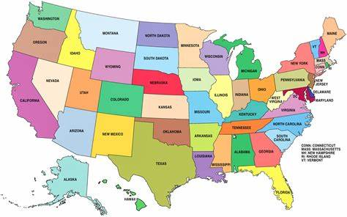
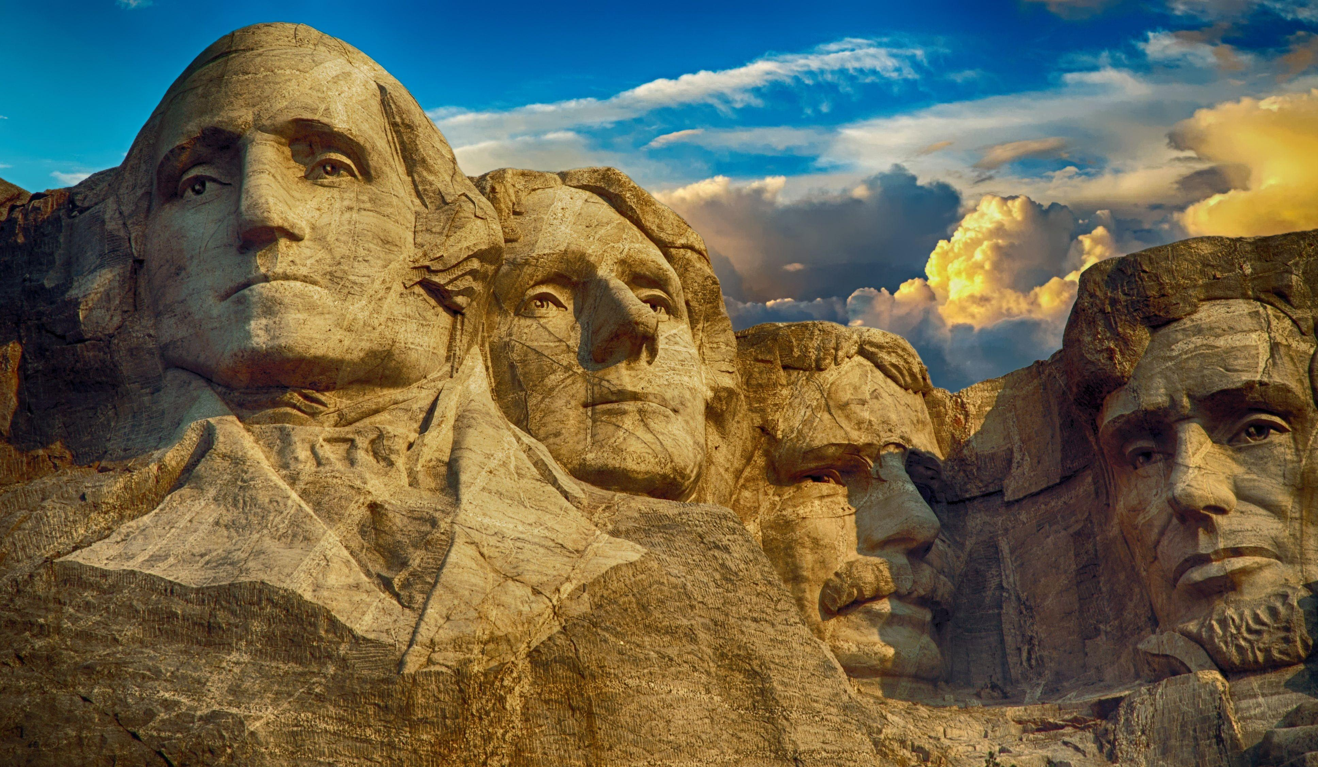
Creating Historical Websites for Service-Learning Experience
By Matthew Cioletti
EDS-330 Student with Dr. Vincent Sasso
What Did I Learn?
Working with students even when I was not the main teacher
All the content area of the classroom culture I applied to give myself the best possible view for what I was seeing
How Was I Impacted?
After every session I felt really good about my progress towards getting a teaching job after college or sooner as a substitute
What Do I Want To Do Now?
To get better on how I react to the students when they talk back to me
To be as engaged as possible with the other students even though I may not be the main teacher
No matter what kinds of students I work with I want to show positive energy, but be respectful to them at all times
Setting
Overview of Community (Stats from World Population Review)
Long Branch, NJ
Monmouth County
Consists of 33,210 residents
19.06% Poverty
74.45% born in US, 54.21% born in Long Branch, 15.36% foreign-born
64.46% White, 13.68% Black, 10.23% multiple-race, 2.21% Asian
Overview of School (Stats from U.S. News)
Long Branch Middle School (6-8)
Consists of 1,028 students
10:1 Student/Teacher Ratio
54% male to 46% female students 58.1% Hispanic, 24.5% White, 13.7% Black, 3.2% multiple-race, 0.5% Asian
Overview of Classroom
Weekly Reading worksheets
Electronic white board
Played music to help students
Class Game with dice
Description of Students
Six Males and Three Females
Every student has a disability tied to attention deficit, such as ADHD and Dyslexia
Placement
8th grade with Mr. Payne along with Mr. Bennett
I assigned a historical website project on google slides, which they completed for a project grade
Role
I walked around the room looking to help any of the students understand the assignment
Assigned historical events for the students at random using a wheel

