Slide 1
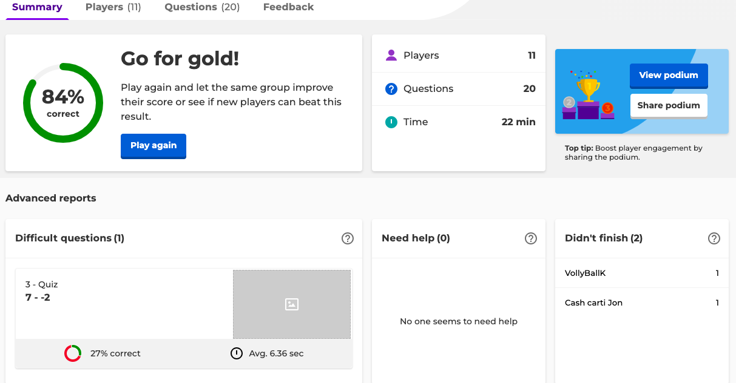
ALEXANDRA GALINDO RODRIGUEZ Monmouth University
A Fun Way To Practice!
Setting
Overview of Community
Long Branch
Monmouth County
Population: 31,932
Poverty rate: 14.5%
Citizenship: 83%
Race/ethnicity:
White: 56.5%
Hispanic/Latino: 21.5%
Black or African American: 12.1%
(Long Branch Demographics - Get Current Census Data for Long Branch, NJ, n.d.)
Overview of School
Long Branch Middle School
Grade levels: 6-8
Number of students: 1,208
Student/Teacher Ratio: 10-1
Students:46% Female and 54% Male
Race/ethnicity:
Hispanic/Latino: 58.1%
White: 24.5%
Black or African American: 13.7%
(Long Branch Middle School in New Jersey - U.S. news education) (
Overview of Classroom
Grade: 8th Grade
11 students
1 teacher and an assistant
Special Education (Math)
Description of Students
10 male students and 1 female student
Course & Project
Throughout the times I went to Long Branch Middle School; I’ve worked with my cooperating teacher to create something for the students. More specifically a project/game that is fun & small and won’t take up most of the time in class. In the end, I decided to create a Kahoot that consists of having questions that tests out their basic math skills (addition, subtraction, multiplication, & division).
Role
With the help of my cooperating teacher, I created a Kahoot with 20 questions and made sure that these questions wouldn’t be hard to the students.
Understandings
I learned that games like Kahoot are fun ways for students to be engaged. The students were motivated to participate and if they got one wrong; they were eager to learn & know why get the question wrong.
After the the game was completed; I learned that the student’s math skills keepings growing higher.
Impacts
When the students played this game; I can see how much they really liked it. These are ways that students get motivated to learn. Not only that, but after playing this game; they now know on what to improve on and what they’re already good at.
Future Goals
I want to create more fun projects/games in the future. Not only that, but I want to help students understand that learning is not just taking down notes, but it can also be fun.
I also want to show that learning math can be fun and interesting, by using games like Kahoot, so the students can be engaged and eager to learn

