Slide 1
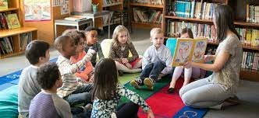
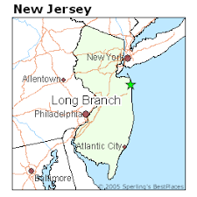
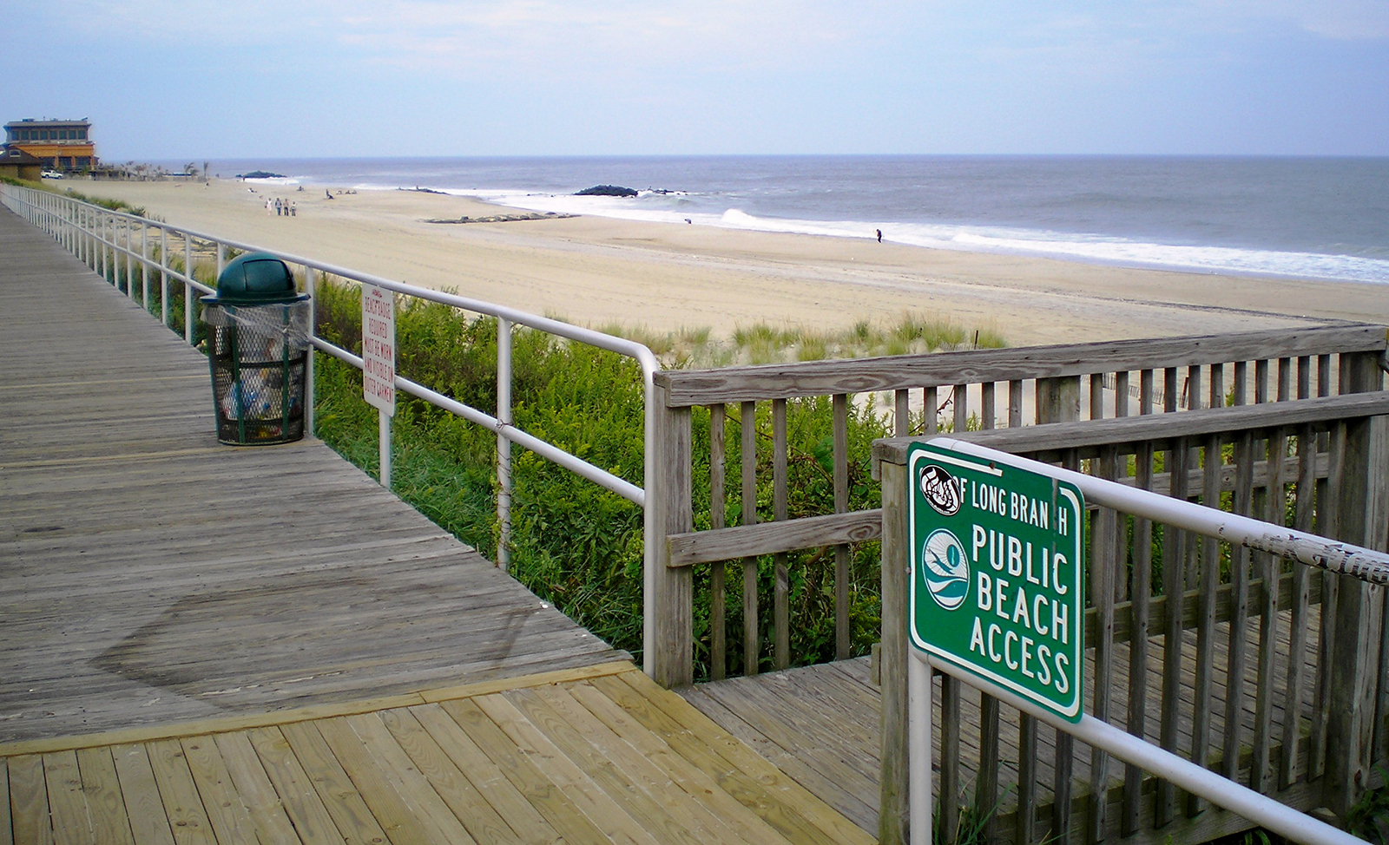
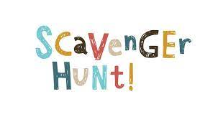
Service-Learning Project
Cecelia Lacovara
Monmouth University
Understandings:
What was learned? I learned ways to manage classroom behavior and I learned how to adjust work given to students of different levels.
How did this connect to coursework? Our course work covered making some areas of content easier for slower paced groups, and I had to connect what I learned in class to what I did during my service-learning project.
Overview of Community:
Town: Long Branch
County: Monmouth County
Population: 30,516 residents
Poverty Rate: 18.7%
Citizenship %: 80.5%
Race and ethnicity %:
- White: 66.98%
- Black/ African American: 15.99%
- Other: 12.75%
Description of Students:
Males to Females: 7:2
Number of students with disabilities: 9
Types of disabilities: Learning Disabled
Other details: Slower paced in reading and writing, and they struggle to sound out words and read out loud.
Course + Project:
Title of class: EDS 330
SL project: My service-learning project was a story scavenger hunt that involved me making a list of items the students needed to find within a story we read together in small groups. This project required the students identify nouns, verbs, characters, main idea, important details, and setting.
Impacts:
Impact at the field site: I feel like I assisted the students with their story elements and reading skills through this project. I also feel like I impacted them in a way that shows them that learning can be fun, and they are capable at achieving whatever they put their mind to.
Overview of School:
Name: Amerigo A. Anastasia Elementary School
Grade Ranges: K-5
Number of students: 600 students
Overview of Classroom:
Grade: 5th Grade/ 9 students
Reading Programs used: Read 180
Layout:
- Class lessons
- Reading centers
- Independent reading, teacher table, and software
Technology:
Computers for software in centers, which they do online reading activities
Seesaw
Future Goals:
How do you plan to continue to grow based on your learning?
make connections with students
learn how to appeal to different learning styles
make sure my teaching methods are well rounded and successful
work on classroom management and exhibit patience and understanding with my students
Role:
I observe the teacher’s style and behaviors
I assist the children and work with them in their centers
I read with them and help them with any words they need help spelling or sounding out

