Slide 1
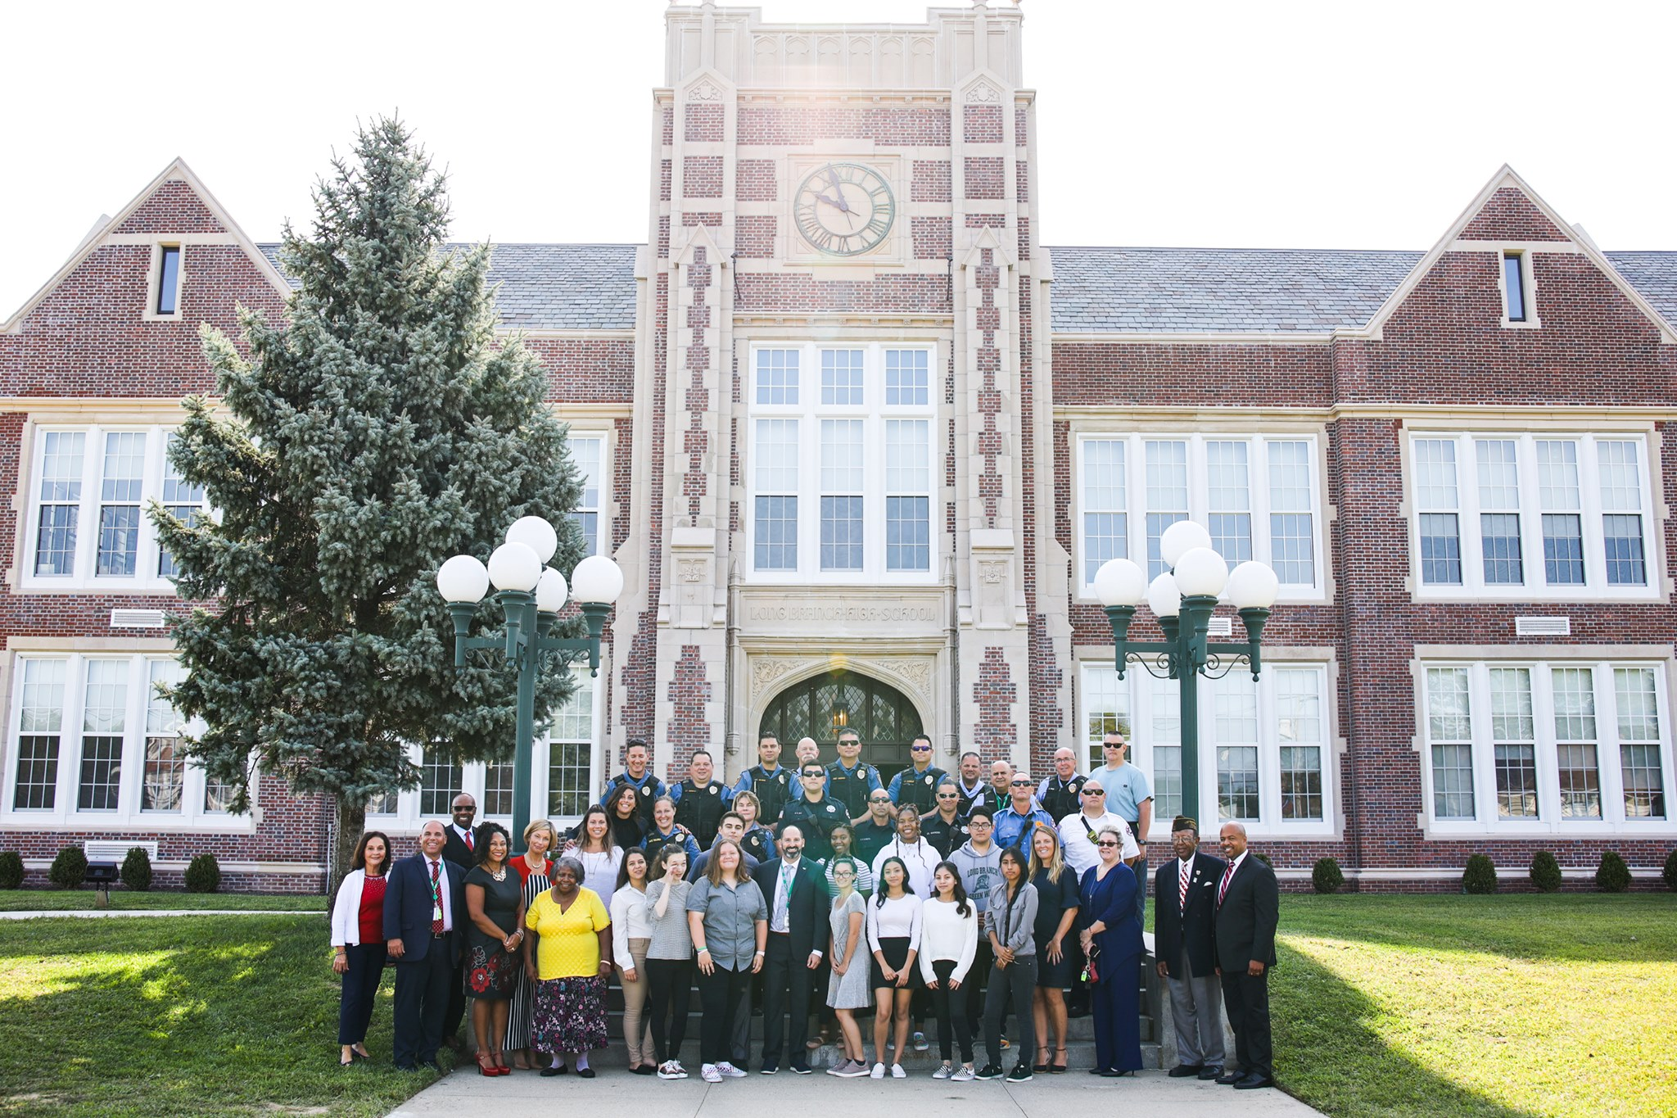
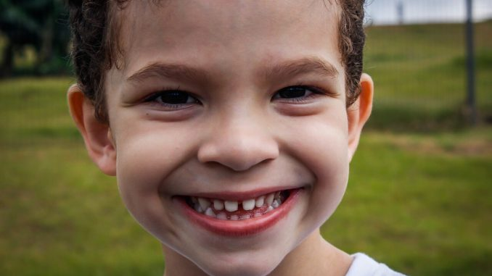
EXPERIENTIAL EDUCATION & CLINICAL PRACTICE- SCHOOL OF EDUCATION EXHIBITION- RACHEL POLZER
SITE
JOB TITLE
ASSIGNMENT
Anastasia A. Amerigo Elementary School
Visual & Performing Arts Magnet School
K-5
541 students
85% Reduced Lunch
Attended through Zoom
Teacher Candidate
Observe
Journal
Connect
Collaborate
Help students and teacher
Monmouth Learning Partners
15 hrs. field experience
TSD – EDS 330
Service-Learning Project
Homework Game
4/5 days a week
Prize!
MY IMPACT
STUDENTS
WHAT I LEARNED
One student completely changed
Passion
Excitement
Happiness
Results:
Homework habits stayed the same for most students
The 2 students who won were very deserving!
I was glad to show them I was proud of them for always being great students
5th Grade Students in Special Education
Reading, writing, math
L.D., O.H.I., A.S.D.
Worked with 2 classes
12 total students
Not doing homework
Not participating; unconfident
My Duty as a Teacher
Give students a reason to be happy!
Success is not measured by # of students, but the quality of change in one student
I cannot wait until I can change more students’ lives when I begin teaching!

