Slide 1
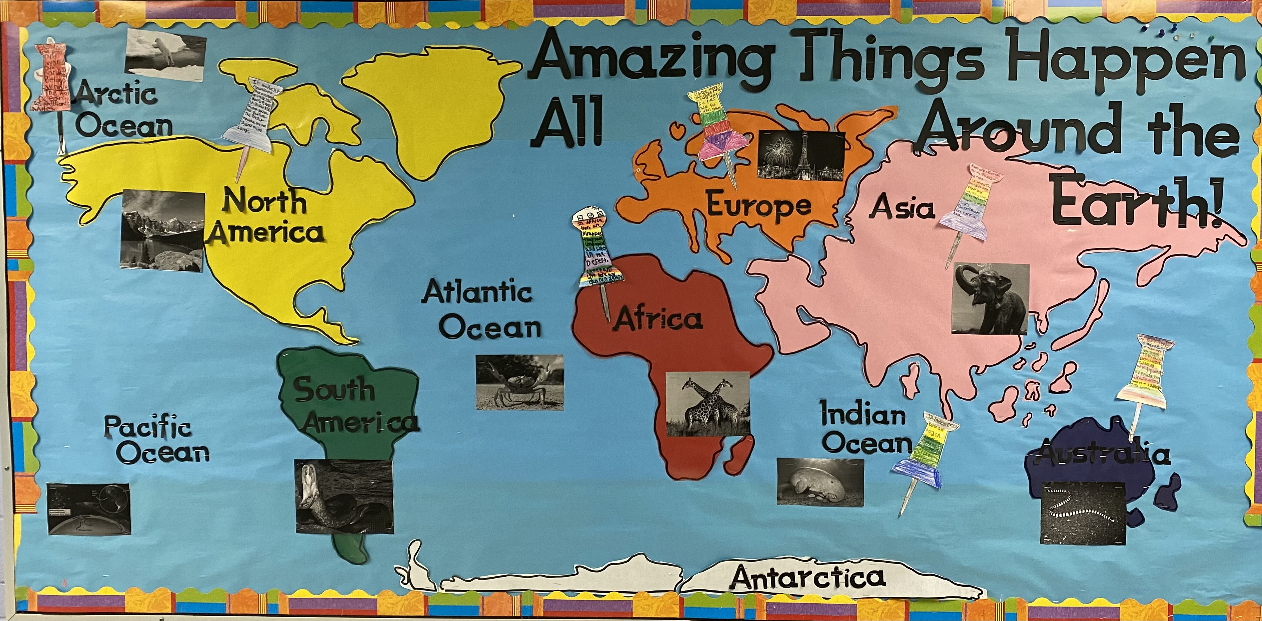
The Earth is Just as Unique as Our Students!
Brianne Brown
Monmouth University
UNDERSTANDINGS
I was able to closely work with students and apply accommodations learned in EDS 330 . Some students needed help reading during the research period and other students needed an increase in their workload because they finished faster. I was able to learn more about the Earth as I conferenced in with each student over the 5 weeks the project took! This connected directly to work in EDS 330, applying accommodations for student success.
SITE
ROLE IN CLASSROOM
Anastasia A. Amerigo Elementary School
Kindergarten – 5th Grade
567 Students
86% Economically Disadvantaged
Attended In-Person
In the classroom I guided students with research for their specific continent or ocean as well as created the bulletin board pictured below. Students used Epic, an online book collection for their research! They researched topics such as size, animals, landmarks and other fun facts. Once students completed their research it was time to begin drafting their sentences! In addition, students picked the most interesting animal they found in their region to add to the bulletin board.
CLASSROOM
5th Grade SCLD
11 students
9 Male – 2 Female
ADHD, Tourette’s, Emotional Disturbance, Several Cognitive Learning Disabilities
IMPACTS
I impacted the field site because I opened the students’ eyes to how amazing the world is. Additionally, each of the students is walking away from this assignment with a grater understanding of the Earth, just in time for Earth Day! The bulletin board is in the hallway where all the students can pass it, this impacts and boosts all the students’ confidence levels!
COURSE
EDS 330 – Dr. Kamei
SL Project created enhanced students’ Social Studies, Science, and ELA skills. This project focused on continents and oceans as a means for global awareness for Earth Day! Students each picked a continent or ocean to research and in turn created sentences about what they found most interesting.
FUTURE GOALS
Moving forward, I hope to keep impacting students lives and this service-learning experience has shown me how special student with exceptionalities are! In addition, I wish to continue inspiring students by showing them how unique the Earth is, just like them!

