Slide 1
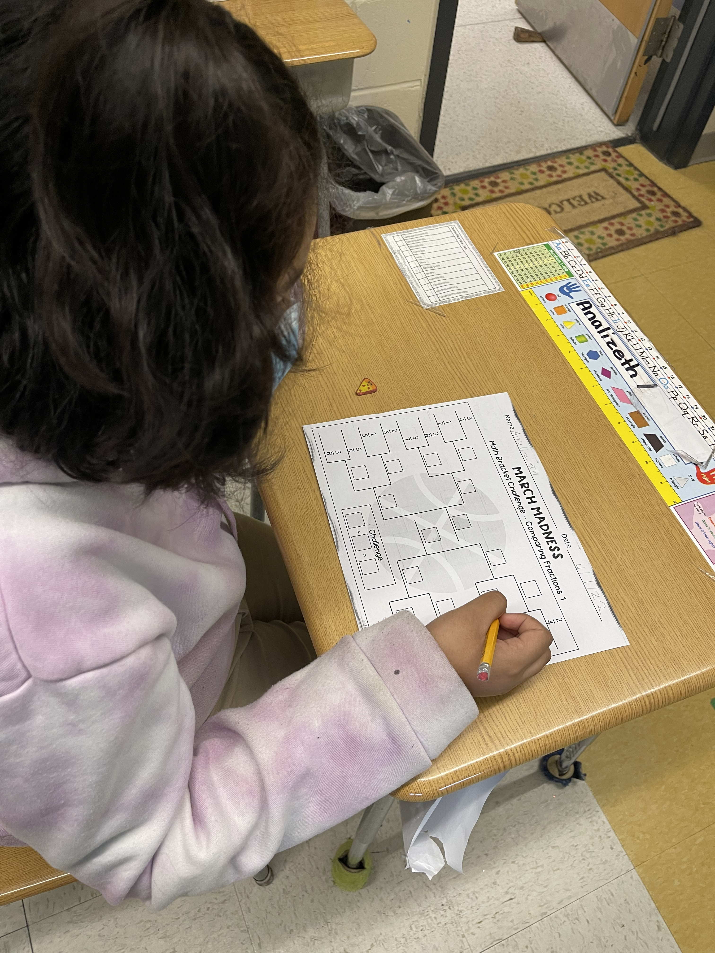
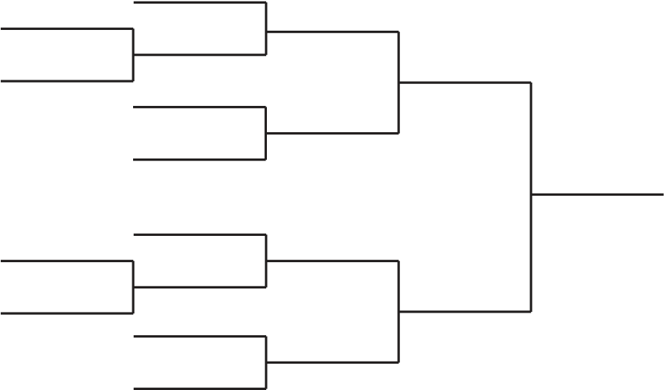
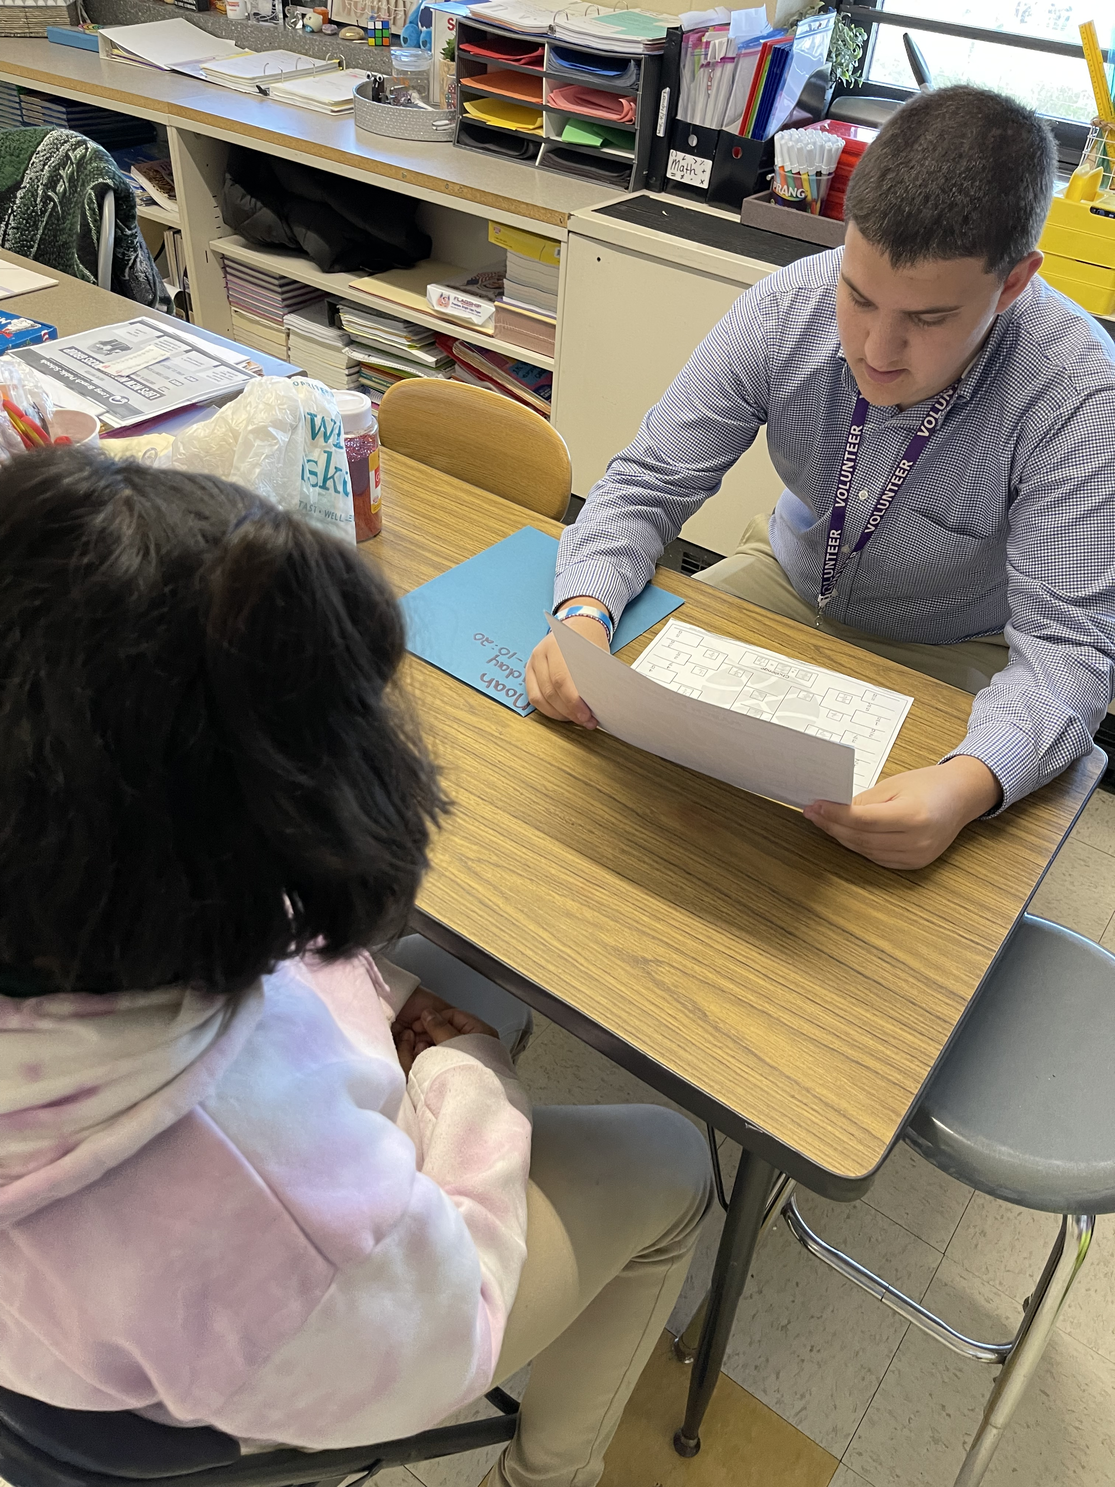
My Service-Learning Project: March Madness Math
By Noah Abraham
Who I Taught
2 classes of 4th grade Math
4 students in both
2 boys: 2 girls and 3 girls: 2 boys
i-Ready and Seesaw programs
2-hour periods
Mix of communication impaired and selective mute
My Project
Introduction and discussion about what March Madness is and how a bracket works
Discussed worksheet, how to complete, and competition rules
Let students work and allowed check-ins
Where I Went
Amerigo A Anastasia Elementary
Long Branch
Monmouth County
Long Branch Info
Pop: 30,516 (pop. as of 2019)
18.2% poverty rate
80% citizenship rate (as of 2019)
Race Breakdown
White: 68.1%
Black: 13.7%
Other: 18.2%
Data via census.gov and datausa.io
More AAA Elementary Information
Grades K-5
~600 Students
My Goals
Building better connections with my students
Being more active from the beginning of the semester
My Understanding
Every student has a unique set of behaviors, and even they change from day to day (learned experience)
Differentiation is not always obvious and NCLB isn’t always helpful (class connection
What I Did
Observed lessons being taught
Discusses with CT and aid about education field
Assisted students in independent work
The Impact I Made
Less work for CT and aid when I helped during individual work time
Provided challenge that was a good review for using tools and remembering content

