Slide 1
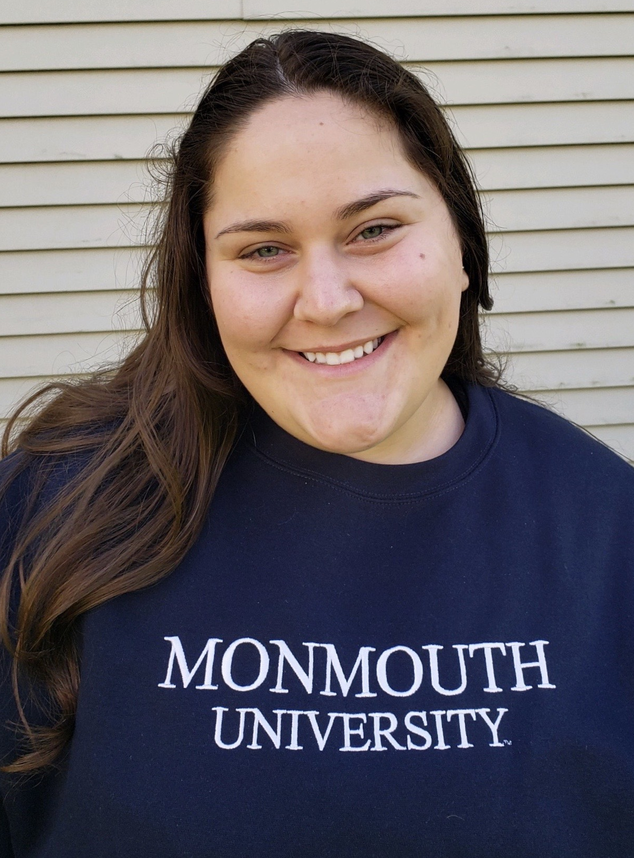
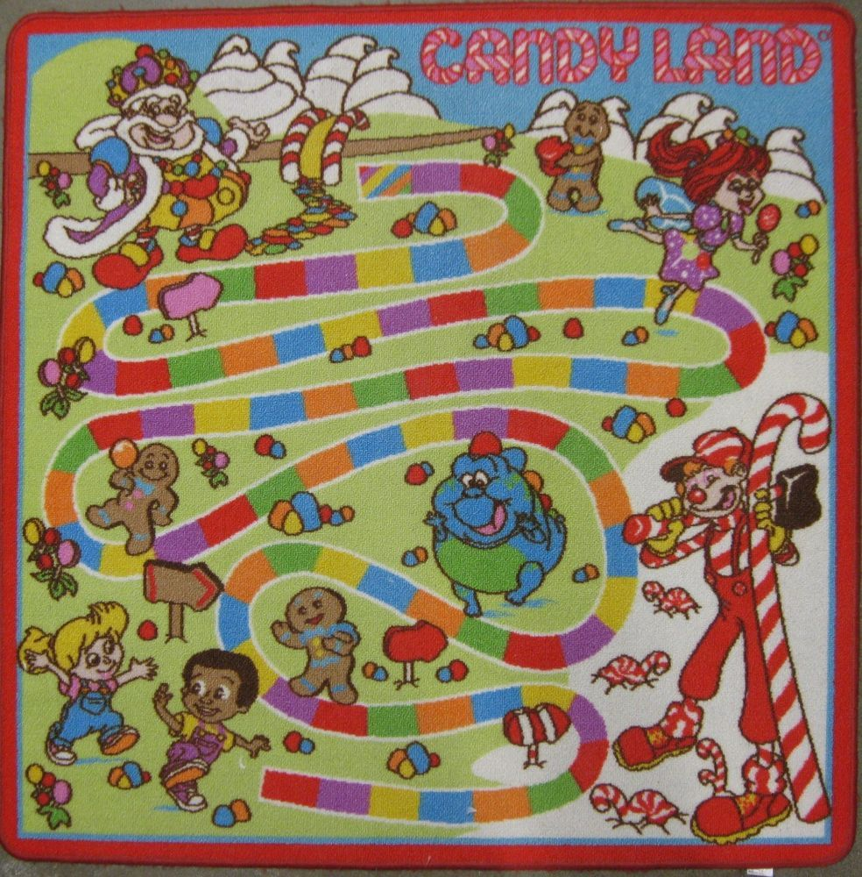
Service Learning Experience & Project: Math Candy Land
Lindsey Allen
EDS 330-50
Monmouth University
School
Amerigo A. Anastasia Elementary
Grades k-5
10:1 teacher : student ratio
581 students total
54% male, 46% female,
Majority Hispanic/Latino
(niche.com)
Community
Long Branch, NJ
Monmouth County
Population: 29,842
52% white, 30% Hispanic, 16% Black ...
My Classroom & Students
Mrs. Gregory’s 1st Grade
Self-Contained Learning Disabilities (SCLD)
1 paraprofessional
3 males, 1 female
SL Project
I wanted my students to
have a better grasp of math,
specifically addition
Math Candy Land Game was played once per week
Before the following week, I would evaluate students performance
Outcomes & Impacts
Students were more comfortable with solving addition problems
I made this game mobile so families and other classrooms can play too!
instilled confidence in students, have made a long-lasting impact on them
Future Goals
For students to continue to play this game
Make connections with other schools, students and educators

