Slide 1
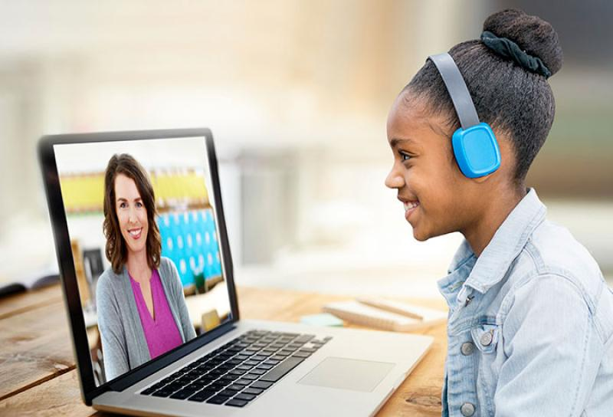
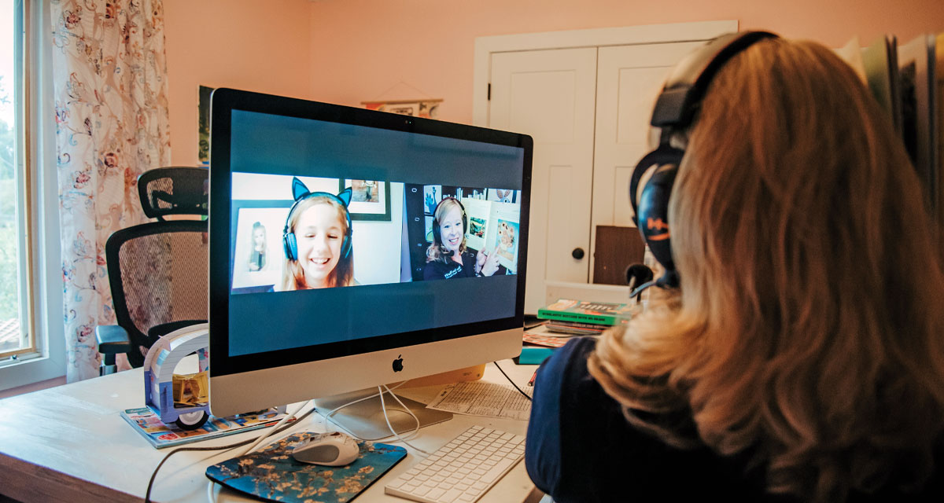
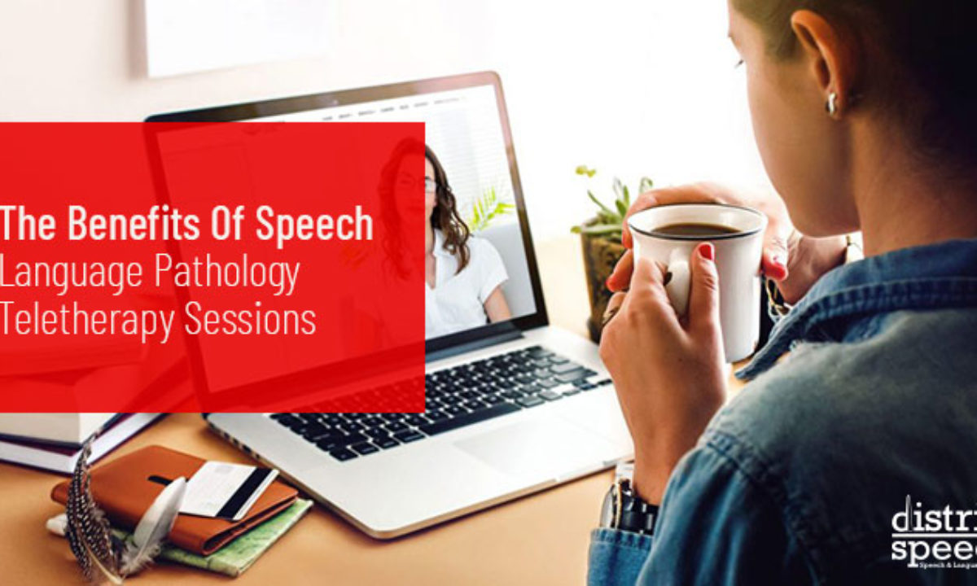
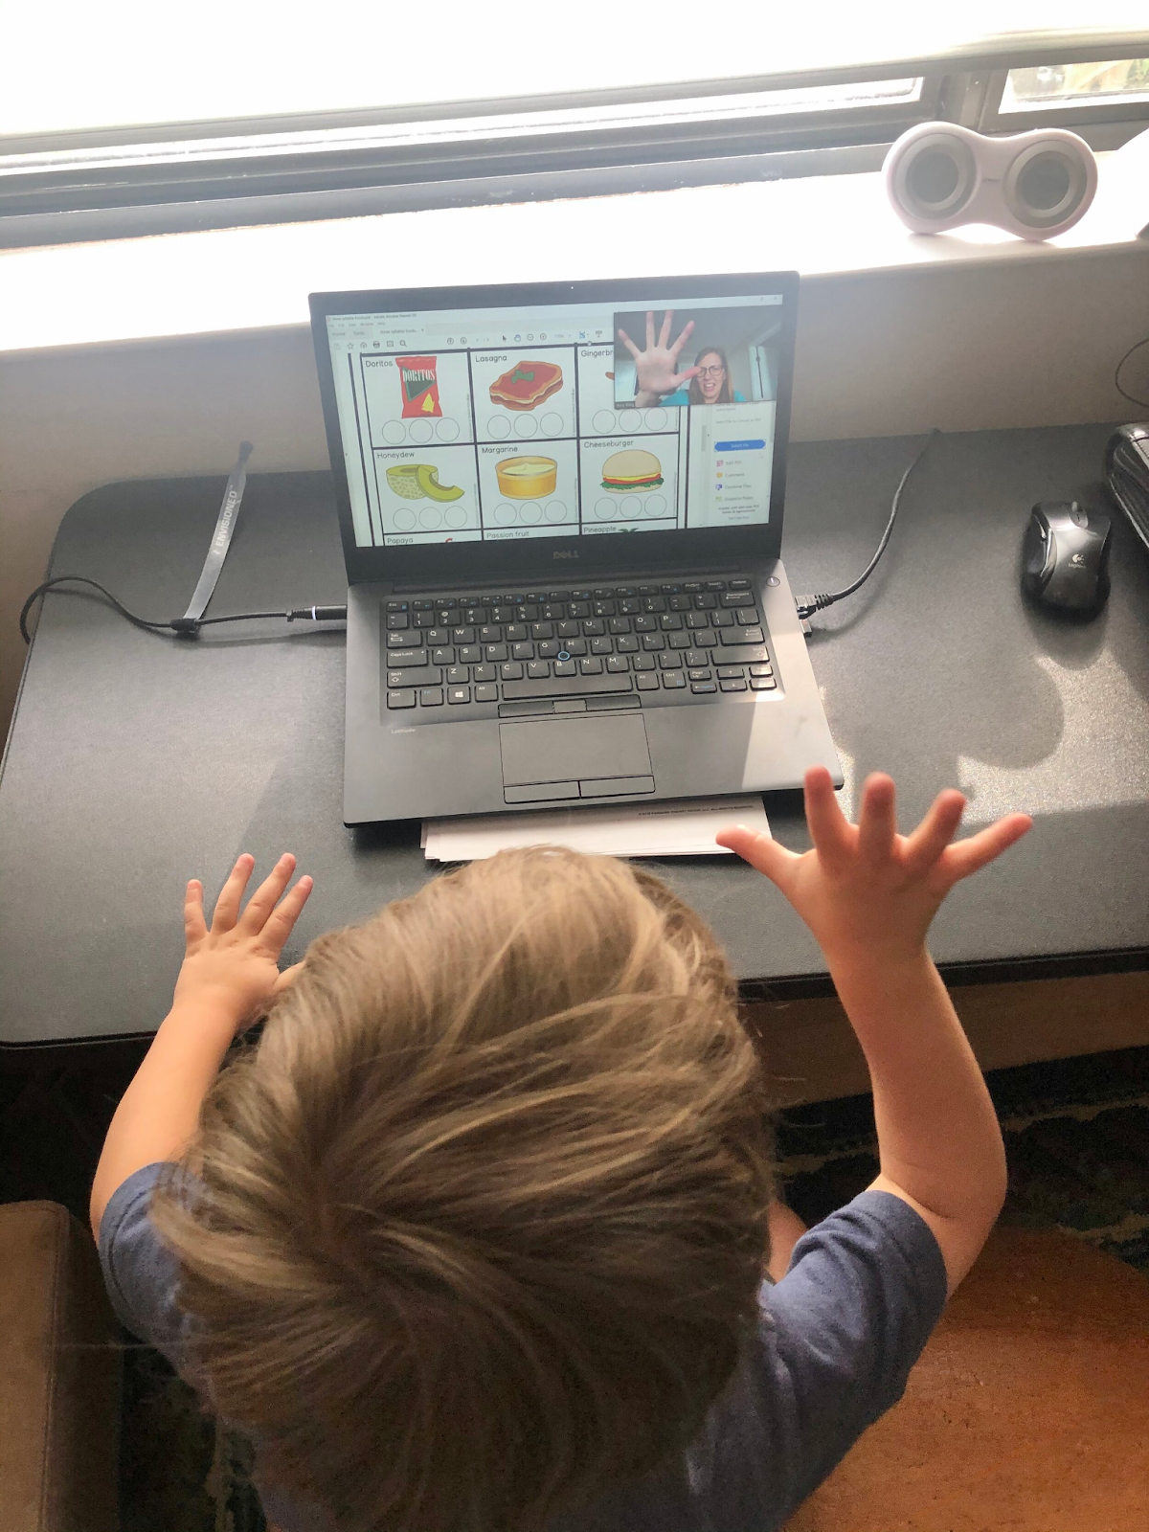
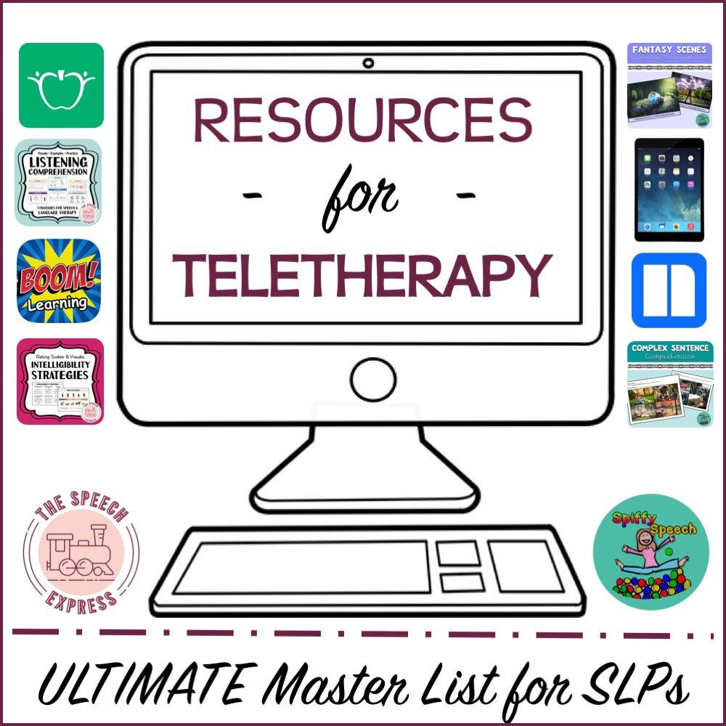
Effect of the Covid-19 Pandemic on Speech Language Disorders
Allison Lorberg, Emma Lieberman, Megan Williams, Sabrina Solomen
Monmouth University Graduate Students
School of Education
Teletherapy
Literature Review Findings
Literature Review Findings Continued
Survey Questions
Teletherapy
Telepractice uses the means of internet technology to virtually connect clinicians with their clients over various healthcare practices. It is an optimal choice for treatment when in-person services are unavailable, or not ideal. Telepractice is aimed to be as effective and consistent in quality as in-person treatment under the American Speech-Language Hearing Association’s (ASHA’s) Code of Ethics (ASHA, 2016). There are various forms of speech therapy through telepractice, such as synchronous, asynchronous, and hybrid. Synchronous services are conducted in real-time and consist of clinicians administering treatment to their client who is actively engaged. Asynchronous sessions are administered for the client to watch later their own viewing. Hybrid teletherapy is a combination of the methods which can be of preference for some clients.
The roles and responsibilities of the speech-language pathologist (SLP) utilizing telepractice are vast and consistent with that of in-person delivery. These roles include comprehension of technological resources, appropriately selecting client’s fit for virtual delivery of services, selecting and using assessments appropriately for telepractice, maintaining documentation, and collaboration with follow-up services if necessary (ASHA, n.d.).
During the recent global-wide Coronavirus pandemic, speech-language pathologists have determined a method to conduct virtual therapy sessions utilizing telepractice. The method is controversial as it presents both advantages and disadvantages of administering speech pathology practices via a virtual modality. Determining the effects of telepractice is crucial to optimizing the outcomes of clients who receive treatment through this method. Since the practice is a relatively new concept, researchers have begun to dive into the many aspects pertaining to telepractice.
With lack of knowledge regarding therapeutic procedures via telehealth, especially at the beginning of the pandemic, SLPs had difficulty maintaining their caseloads. A significant factor as to why caseloads were not able to be maintained was due to school districts not providing training or resources to support the provision of teletherapy. Research findings also indicated that the pandemic had a substantial impact on their roles and responsibilities as SLPs, resulting in the utilization of different treatment methods, and a reduction of referrals. This reduction in referrals led to reduced caseload size (Chadd et al., 2021). Some other factors that contributed to the reduction of caseloads were the lack of access to devices, WIFI, hot spots, and data for both clinicians and clients provided by school districts. These factors then contributed to clients having a poor experience in therapy, resulting in poor session attendance (i.e., no shows, cancellations, and opting out of treatment). Surveying caregivers regarding their perspectives of teletherapy during the pandemic will help improve teletherapy for future service delivery.
Teletherapy offers many advantages of speech service delivery when face-to-face offerings of service are unavailable or inconvenient. A primary benefit of teletherapy is the fact that services can be administered with no transportation required and from the comfort of one’s own environment. This can be beneficial for clients who suffer from anxiety or attachment issues and feel more secure in their own space. With this, teletherapy delivery also reduces the risk of transmitting illness or disease which is very prominent during the Coronavirus pandemic. Patient and care advocates reported that teletherapy sessions were tailored to in-home needs and improved the patient and parent’s self-efficacy due to more family involvement over teletherapy compared to in-person sessions (Tenforde et al., 2020) . Examining another perspective, teletherapy does yield some disadvantages compared to that of receiving and administering sessions in person. An obvious downside to an online modality of services is the reduced number of hands-on activities and services. Another disadvantage to this online modality could be potential technical issues either party may run into. This could include unstable internet access, a disruptive environment, or an inability to access technological resources. Additionally, challenges were reported with keeping pediatric patients entertained and engaged during teletherapy sessions compared to in-person sessions. This also affected standardized assessment, as these pediatric clients reported the three most difficult assessments to administer over teletherapy were speech sound production, augmentative and alternative communication (AAC), and the social aspects of communication. Speech-language pathologists also mentioned the difficulty of not being face-to face to practice social situations, the challenges of providing oral motor and swallow assessment, as well as developing the rapport between the clinicians and patients (Tenforde et al., 2020).
Because of the limitations and benefits of telepractice in speech therapy during the ongoing pandemic, caregivers have responded both positively and negatively to their children receiving services. Tambyraja et al. (2021) conducted a study in which they assessed how SLPs maintained teletherapy services during the pandemic. The results revealed the lack of online training from the school districts as well as resources for SLPs to maintain treatment created a persistent difficulty in contacting parents, which then caused parents to have a lack of involvement in their child’s services due to lack of their own training as caregivers (Tambyraja et al., 2021). Additionally, because many businesses were mandated to transition to operating at home, many parents (including the SLPs surveyed) were having difficulty maintaining a balance between employment and a household. The SLPs in the study reported that due to parents having issues with telepractice, they were unaware of how to motivate their children to be engaged in therapy and have their child improve throughout the duration of sessions. These difficulties resulted in a lack of involvement and parents withdrawing their children from services (Tambyraja et al., 2021).
Have your child’s communication skills improved since the initiation of using teletherapy?
Yes/no response
Please rate you agreement with the statements below
1= disagree
2= somewhat disagree
3= neutral
4= agree
5= strongly agree
My child's speech has improved significantly
Teletherapy is a practical mode of delivery for my child
Teletherapy is just as effective as in-person services
I prefer teletherapy over in person services for my child
Teletherapy is an effective approach to provide speech and language services Please share your experience of using teletherapy (i.e., advantages and disadvantages).
Open-ended response
Selected References
American Speech-Language-Hearing Association (n.d.). Telepractice. (Practice Portal).
Retrieved March 24, 2022, from
https://www.asha.org/practice-portal/professional-issues/telepractice/
Chadd, K., Moyse, K., &amp; Enderby, P. (1AD, January 1). Impact of covid-19 on the speech
and language therapy profession and their patients. Frontiers in Neurology,12, 1-11. https://doi.org/10.3389/fneur.2021.629190
Farquharson, K., Tambyraja, S. R., & Coleman, J. (n.d.). Speech-language teletherapy services
for school-aged children in the United States during the COVID-19 pandemic.Journal of Education for Students Placed at Risk, 26(2),1-22. https://doi.org/10.1080/10824669.2021.1906249 Tenforde, A. S., Borgstrom, H., Polich, G., Steere, H., Davis, I. S., Cotton, K., O’Donnell, M., & Silver, J. K. (2020). Outpatient physical, occupational, and speech therapy synchronous telemedicine. American Journal of Physical Medicine & Rehabilitation, 99(11), 977–981. https://doi.org/10.1097/phm.0000000000001571
Tohidast, S. A., Mansuri, B., Bagheri, R., & Azimi, H. (2020, July 15). Provision of
speech-language pathology services for the treatment of speech and language disorders in children during the COVID-19 pandemic: Problems, concerns, and solutions. International Journal of Pediatric Otorhinolaryngology, 138, 1-4. https://doi.org/10.1016/j.ijporl.2020.110262
Purpose
The purpose of this study is to explore the experiences of caregivers whose children have received speech therapy via telepractice. Findings will help determine contributing factors that guide the effectiveness of this service modality to ensure clients students in grades K-5 specifically are given optimal chances to improve communication ability even during the COVID-19 pandemic.
Proposed Methodology
Participants: This study will include a minimum of 50 participants who are parents/caregivers of those attending Monmouth University Speech and Hearing Center. It is estimated that the age range will be between 21-65 years of age and will consist of both males and females. There is no maximum response rate; however, the data collection will end after a one-month period.
Procedure: The participants will be parents of children K-5 who are clients at the MU Speech and Hearing Center and receive telehealth services. The sampling method is one of convenience. Through the MU Speech and Hearing Center, parents of children who receive telehealth services will be sent an email with a link to access the survey for possible recruitment. Prior to filling out the survey, participants will be asked to fill out a consent form. Once a participant launches the Qualtrics direct link, they will be presented with a letter of consent. After consent is provided, the survey will be presented. The investigators will utilize descriptive statistics to analyze the quantitative data. Open-ended responses gathered from the caregivers of clients will be analyzed for themes.
Research Questions
What factors should SLPs consider to be essential when utilizing teletherapy for speech therapy sessions to be effective for children K-5?

