Slide 1
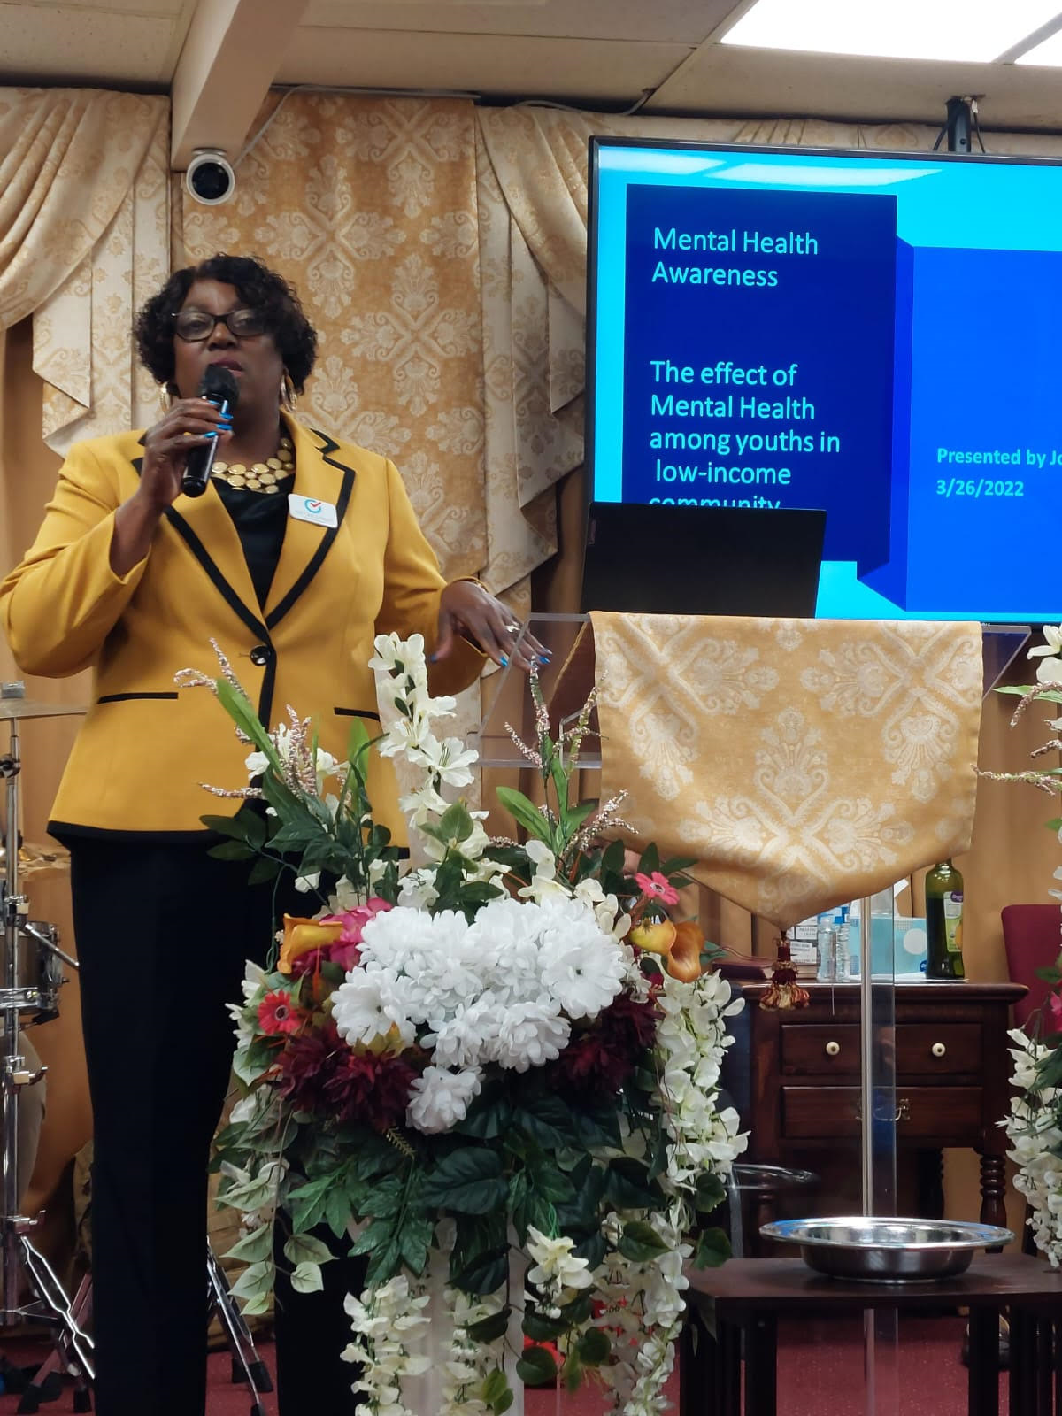



Combatting Religious Mental Health Stigma Through Education
Jossett McKenzie, April 2022
ABSTRACT
Problem and Population
Intervention
Impact
This project was inspired by the Social Work class Applications of Social Justice and Human Rights in Social Work. As a Clinical Practice with Families and Children student and as a leader of the Word of Faith Church of God, I wanted to bring mental health awareness to the youth and the community. After facilitating a panel discussion with youth, I found that their biggest concern was around mental health issues and how they were impacted. I was aware of the issue of religious mental health stigma and found that youth were concerned about that as well. To combat the stigma, I designed a mental health awareness presentation at the church. The response of the entire community was overwhelmingly positive.
Over the past decade, there has been a stigma within religious groups on how the church views mental illness. The topic of mental health has often been seen as a sign of weakness rather than accepted as a health issue; prayer and stronger faith were the solutions. The youths in the WOF church have shown interest in learning more about mental health and how it has affected them as youths within the church community. Approximately 75% of the kids in the church are second-generation immigrants from various Caribbean countries. The Black immigrant population has increased rapidly over the past two decades, with Black immigrants and their children making up about one-fifth of the U.S. Black population (Liwei Zhang, 2021). Immigrant youth that struggle with mental illness are disadvantaged because of stereotypes and lack of knowledge on mental health (Liwei Zhang, 2021). The pandemic of 2019 started a new wave of mental health issues among youth in WOF and across the country. They have reported signs of depression, loneliness, and feeling isolated from their friends and peers. In addition, African-Americans are 20% more likely to experience mental health issues than the rest of the population (Mental Health Association, 2022).
A 45-minute mental health awareness presentation was provided to the church during morning service. The audience comprises of approximately 25 youths and 25 adults. The presentation was a viewed via social media with feedback from Jamaica, India, Africa, and Canada as well as the USA.
In feedback gathered after the presentation-
all participants reported they were impacted by the presentation
all wanted more training about mental health
some participants were referred for counseling after getting information presentation
parents of second-generation youth increased their awareness of mental health and the cultural barriers that they may encounter
Advancing Social Justice
and Human Rights
As specified in the General comment no. 14, the right to health is an inclusive right. It extends not only to timely and appropriate health care but also to the underlying determinants of health, including access to health-related education and information.
Through this presentation, I advanced human rights and social justice by providing access to education on mental-health related education and information.
Site of Intervention
Word of Faith Church 108 Fortunato Pl. Neptune, NJ, a part of Monmouth County; Neptune has a population of 27,384, of which 10.5% are below the poverty level (Neptune township, 2001). The issues addressed concern the 8-18 years old and their parents that attend the WOF church on Sundays. The congregation lives in Ocean and Monmouth County. There are also congregants that participate digitally as the services are live-streamed on Facebook. There is also participation from families in Jamaica, Canada, Kenya and Florida, Georgia, and New York.
References
Liwei Zhang, A. B. (2021). To unfold the immigrant paradox: maltreatment risk and mental health of racial-ethnic minority children. Front. Public Health.1-13
Mental Health Association (2022). Black and African American Communities and Mental Health. https://www.mhanational.org/issues/black-and-african-american-communities-and-mental-health
Office for High Commissioner for Human Rights (OHCR) https://www.ohchr.org/en/health

