Slide 1
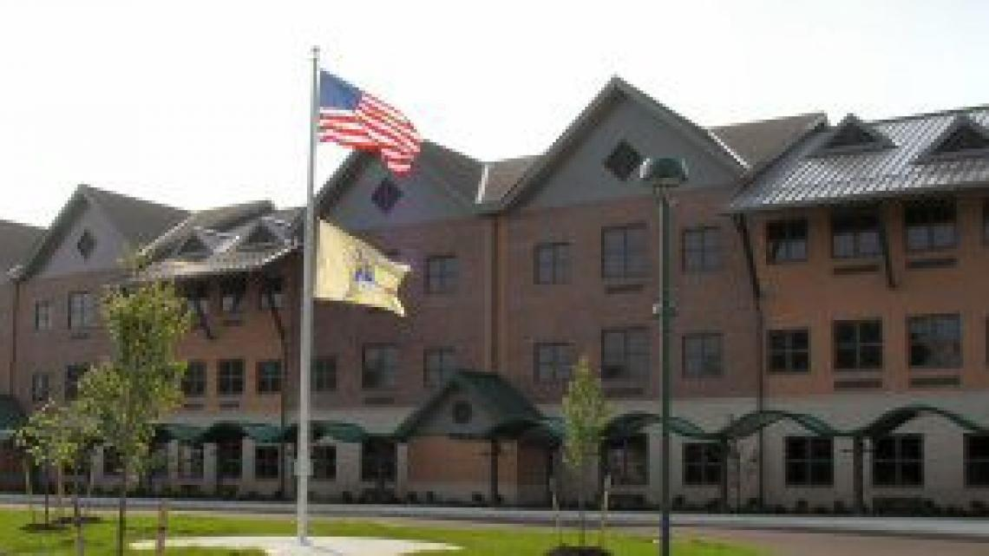
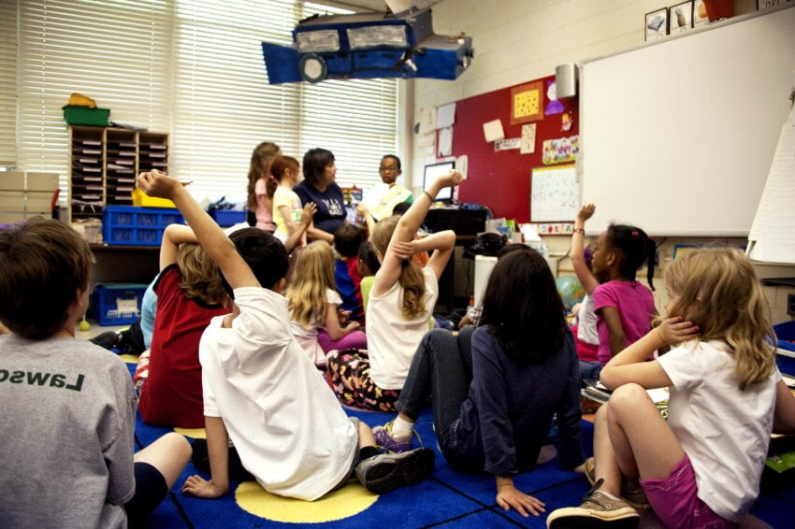
Clinical Practice- School of Education Exhibition Benjamin Hutter
Site:
Amerigo A. Anastasia Elementary School
K-5
Visual & Performing Arts Magnet School
Over 500 students
Job Title:
Teacher Candidate
Assist Co-Teacher
Engage with students
Observe student behavior and classroom operations
Assignment:
15 field hours
TSD EDS 330
Service-Learning Project
Create math games to help students through repetition
Students:
5th Grade Special Education Class
Math, Writing, Reading
Students struggle with content retention and are sometimes unmotivated
My Impact:
Helped struggling students in small groups
Reinforced math topics through games
Further created an encouraging environment
What I Learned:
I witnessed different strategies being implemented in the classroom
Gained a greater confidence and ability in engaging with a diverse group of students.

