Slide 1



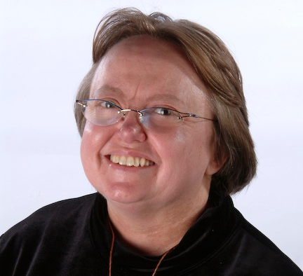
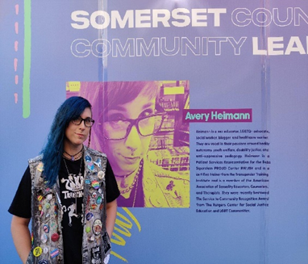
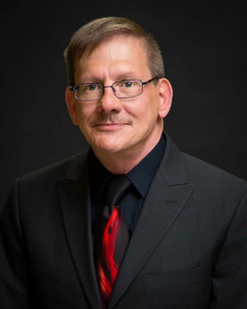
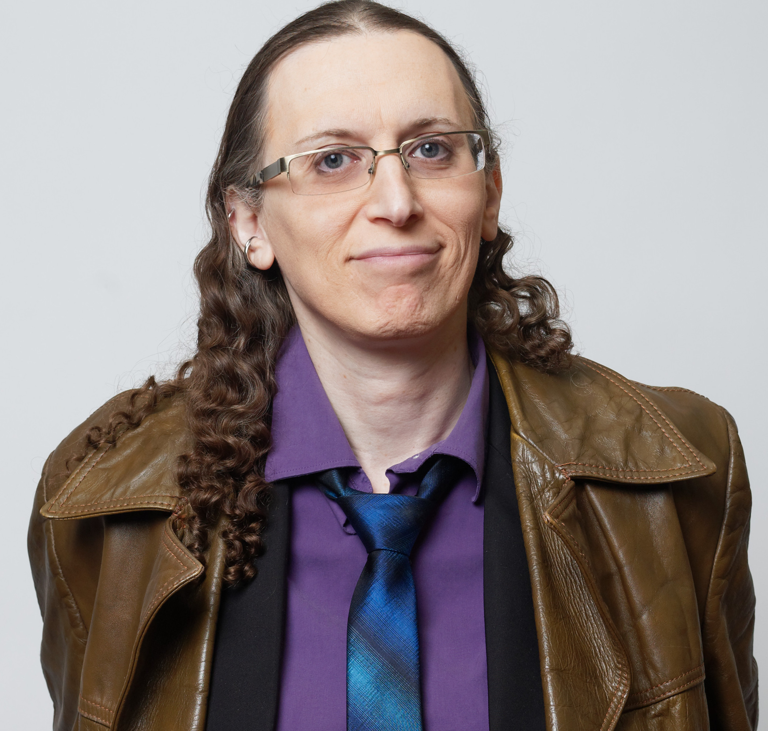
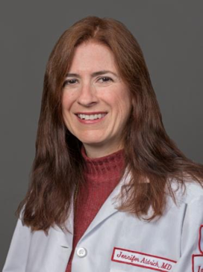


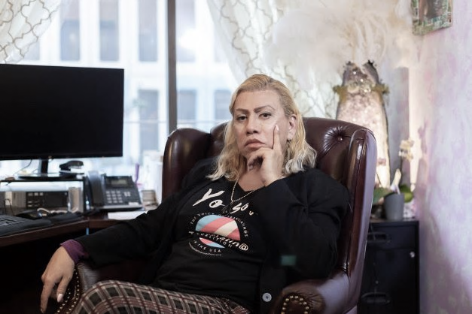

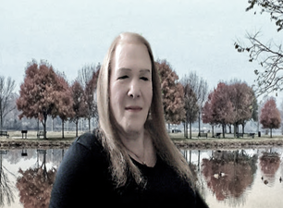

AGING AND THE EXPERIENCES OF TRANSGENDER AND
GENDER NONCONFORMING ADULTS
Mars Graves, MSW Student, Coordinator of Event
ABSTRACT
The diverse experiences
of transgender and
gender nonconforming
(GNC) adults, especially
in older adulthood, were
explored in this event.
---------------------------
Keynote speaker Loree
Cook-Daniels, M.S.
provided historical
context & an
overview of some of the
challenges of aging
in the trans/GNC
community.
----------------------------
Three panels followed:
three panelists spoke
about their lived
experiences.
Next, experts in the
health care and mental
health care fields
reviewed barriers,
stigma, and
complexities that people
In the community face.
Event
Health & Mental Health
Transgender/GNC Older Adults
National Conference Sponsored by the School of Social Work’s LGBT+ Older Adult Project: January 29, 2022, 1-4 pm
353 people REGISTERED
220+ ATTENDEES
25 STATES represented
23 COLLEGES/UNIVERSITIES
-57% of transgender/GNC women ages 50 and older are HIV+ (Centers for Disease Control and Prevention, 2021)
-Nearly 2/3 of older adult transgender/GNC persons are disabled (James, et al., 2016)
-Little to no training on transgender/GNC health for geriatric health care providers (James, et al., 2016)
-40% have attempted suicide in their lifetime (James, et al., 2016)
-Particularly high rates of distress (general stress) and depression among transgender/ GNC older adults as compared with LGB or straight older adults (Hoy-Ellis, et al., 2016; Hoy-Ellis et al., 2017)
Pioneers
Learned “how to be trans” from other people- there was no road map
May have been rejected by families and others
LGB Bias- not always accepted in the community
Some waited for certain changes in their lives- death of parents; children leaving home; retirement; divorce; medical crisis; etc. before “transitioning” in any way
Avoided seeking care for fear of discrimination
Program
Keynote
Loree Cook-Daniels M.S. (she/her)
Panel 1- Lived Experiences
Nicole (Niki) Brownstein (she/her)
Graeme Davis (he/him)
Bamby Salcedo (she/her/ella)
Panel 2- Health Care
(1) Jennifer L. Aldrich, M.D.(she/her)
(2) Nik Lampe, M.A. (they/them)
(3) Alexandra Nowakowski, PhD, MPH (they/them/theirs)
Panel 3- Mental Health Care
Avery Heimann, M.A., MEd, MSW, LSW
(they/them)
(2) Charles P. Hoy-Ellis, PhD, MSW, LCSW
(he/him)
(3) Laura A. Jacobs, MSW, LCSW-R
(he/she/they/none)
Na
Takeaways
Need for training on transgender/GNC concerns for mental health and health care providers.
Gender-affirming care reduces stigma and may allay fear of discrimination.
References
Centers for Disease Control and Prevention (2021). HIV Infection, Risk, Prevention, and Testing Behaviors Among Transgender Women—National HIV Behavioral Surveillance, 7 U.S. Cities, 2019–2020. HIV Surveillance Special Report 27. https://www.cdc.gov/hiv/pdf/library/reports/surveillance/cdc-hiv-surveillance-special-report-number-27.pdf
Hoy-Ellis, C.P. & Fredriksen-Goldsen, K.I. (2016). Lesbian, gay, & bisexual older adults: Linking internal minority stressors, chronic health conditions, and depression. Aging & Mental Health, 20(11), 1119-1130. https://doi.org/10.1080/13607863.2016.1168362
Hoy-Ellis, C.P. & Fredriksen-Goldsen, K.I. (2017). Depression among transgender older adults: General and minority stress. American Journal of Community Psychology, 59(3-4), 295-305. https://doi:10.1002/ajcp.12138
James, S.E., Herman, J.L., Rankin, S., Keisling, M., Mottet, L., & Anafi, M. (2016). The Report of the 2015 U.S. Transgender Survey, National Center for Transgender Equality. https://transequality.org/sites/default/files/docs/usts/USTS-Full-Report-Dec17.pdf

